Slide 1
The Scramble for Africa and the Berlin Conference

Slide 2
Scramble for Africa
A process of invasion, occupation, colonization and annexation of African territory by European powers during the age of New Imperialism

Slide 3
Europeans Land Claims in Africa before the Berlin Conference
Portuguese was the first to establish trading posts on the African Continent during the 15th century
Liberia was created by the United States for freed slaves
British and the Suez Canal
King Leopold II of Belgium in 1874 sent convoys to colonize and civilize Central Africa (Congo)
France and Portugal discovered Leopold plans and laid claims to lands in Africa
Notes:
Suez Canal- 1875- Britain purchased a controlling interest from the ruler of Egypt who was bankrupted and unable to repay loans that he had contracted for the canal and modernization of the country. Then Britain established a protectorate over Egypt

Slide 4
Berlin Conference
The race for colonies in Africa, brought conflict among European countries
A way to settle that conflict:
13 European nations and the United States met to decide all questions connected with the Congo River basin in Central Africa and territorial claims in Africa.
No African Leaders were in attendance

Slide 5
Outcome of the Berlin Conference
Declared the Congo River basin to be neutral which guaranteed freedom for trade and shipping for all states in the basin;
Rejected Portugal claim to the Congo River estuary
Forbid slave trading
Established a framework for negotiating future European claims in Africa.
Must notify other nations of its claim and be able to show control of the area
Founding of the independent Congo Free State (King Leopold's private property)

Slide 6
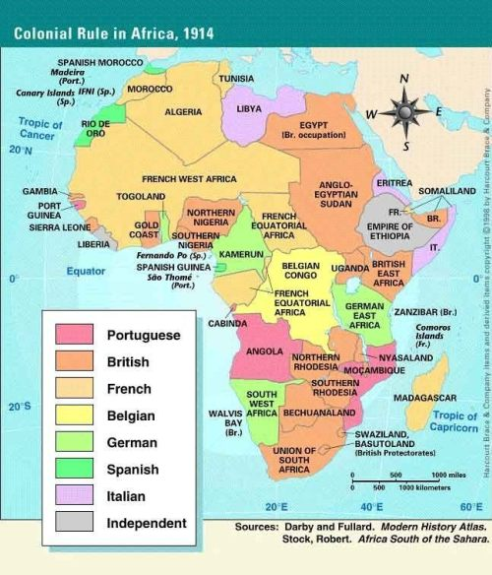

Slide 7
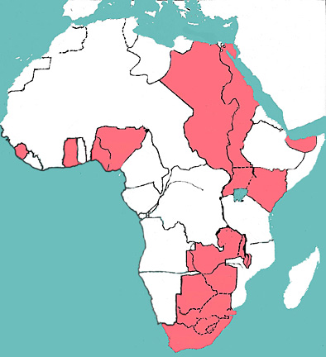
British Colonies
Mediterranean Sea
Egypt
Britain had managed to get some of the most valuable land in Africa.
South Africa and Rhodesia have Diamonds, and Gold
Egypt-Suez Canal
This provided a much quicker and safer route to India – the “Jewel in the Crown” of the British Empire.
Red Sea
Sudan
Nigeria
British East Africa
Rhodesia
South Africa

Slide 8
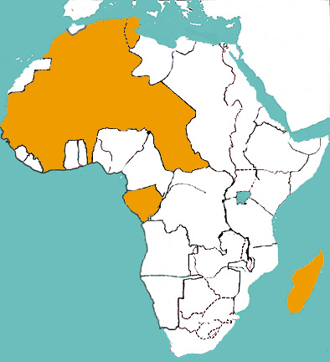
French Colonies
Tunis
French
Morocco
Algeria
French built up a large empire in North West Africa
This had caused problems in the colonies of Morocco and Tunis.
French West Africa
French Equatorial Africa
Madagascar

Slide 9
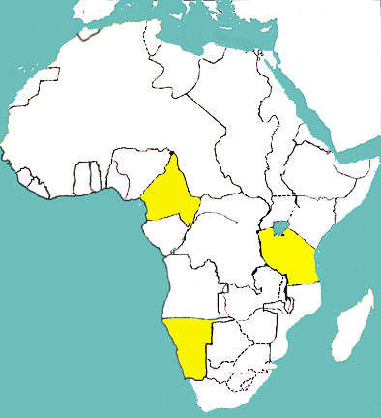
German Colonies
Germany entered the Scramble for Africa very late
Due to Italian colonial interests
That is why, their land did not have much value
Despite this, Kaiser William II was determined that Germany should have a major empire.
Togoland
Cameroon
German East Africa
German
SW Africa

Slide 10
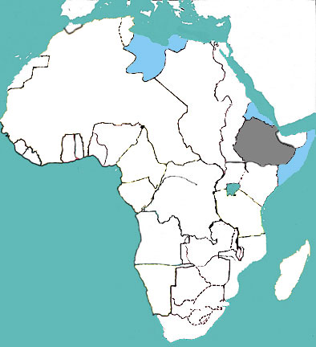
Italian Colonies
Tunis
Libya
Italy did have some colonies but also some failures
Tried to conquer Tunis but the French beat them to it
Tried to conquer Ethiopia but the native defeated it
Eritrea
Ethiopia
Italian
Somaliland

