Slide 1
Warmup 1/28
Start a New Unit Title and Warmup page
Unit 6:
The Atlantic Revolutions
Warmup:
What is the difference between de jure and de facto?
Google it if you need to

Slide 2
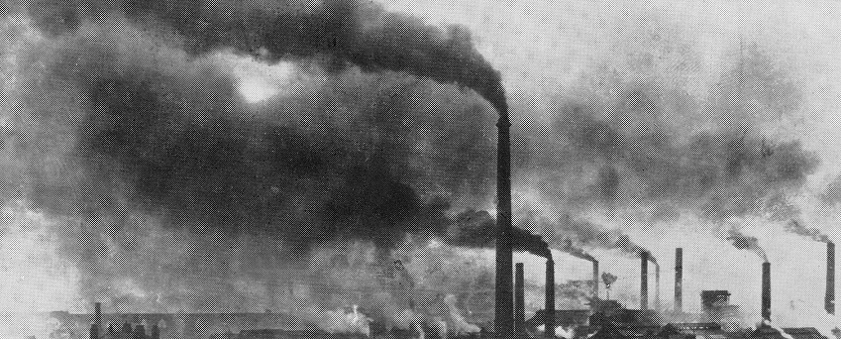
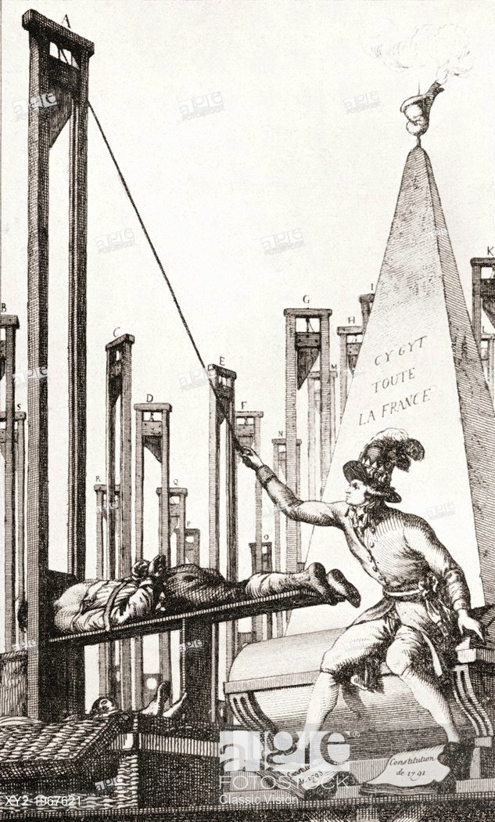
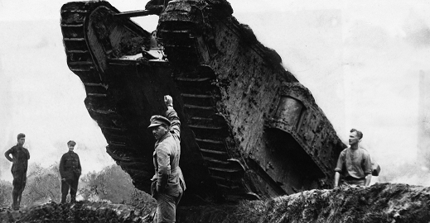
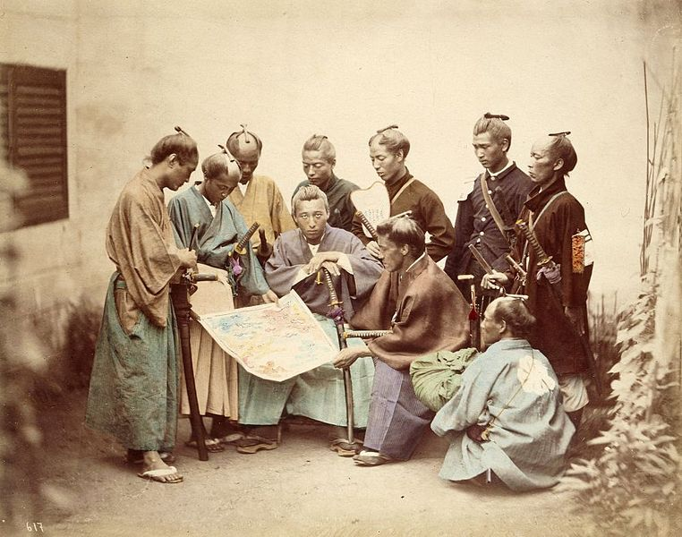
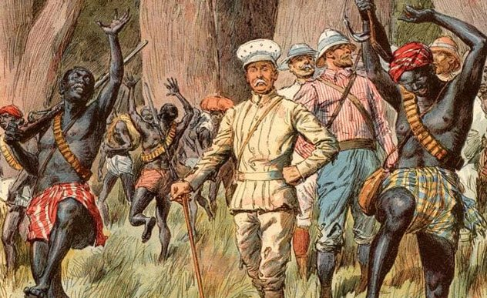
Semester 2: The Long 19th Century

Slide 3
Long 19th Century
Describes the period 1789-1918
Unit 6: The Atlantic Revolutions: modern government is born
Unit 7: Industrial Revolution: the second great social revolution occurs
Unit 8: New Imperialism: Europe sets out to conquer the world
Unit 9: Nationalism: modern ideas of nation and identity form, uniting states and tearing others apart.
Unit 10: World War 1: it all ends in a bloodbath

Slide 4
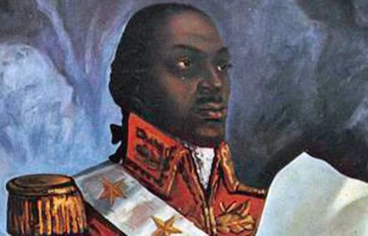
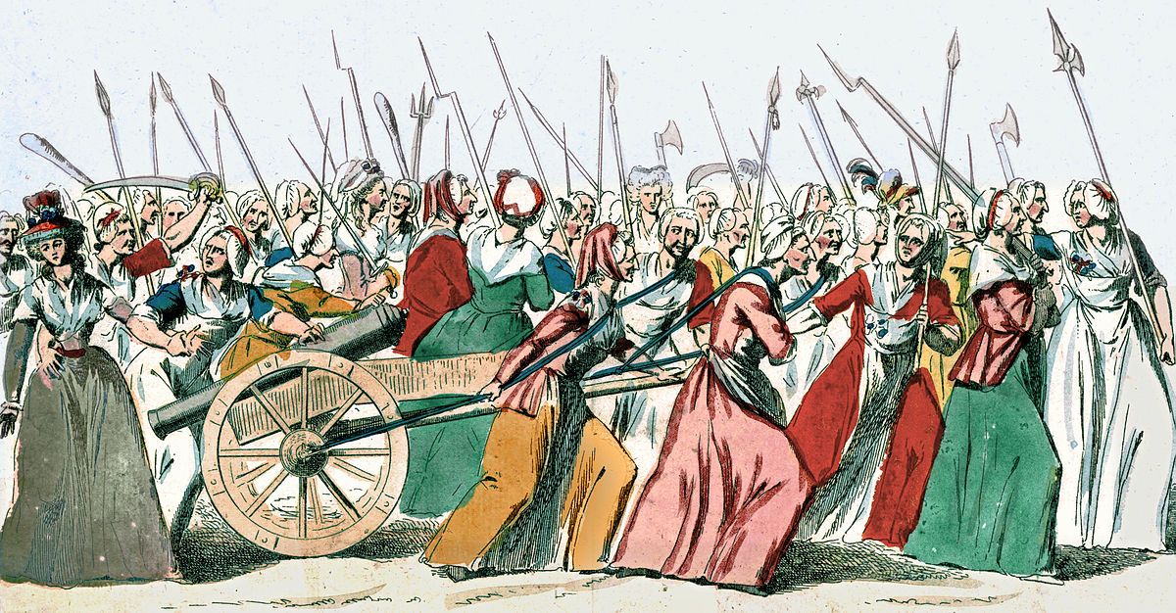
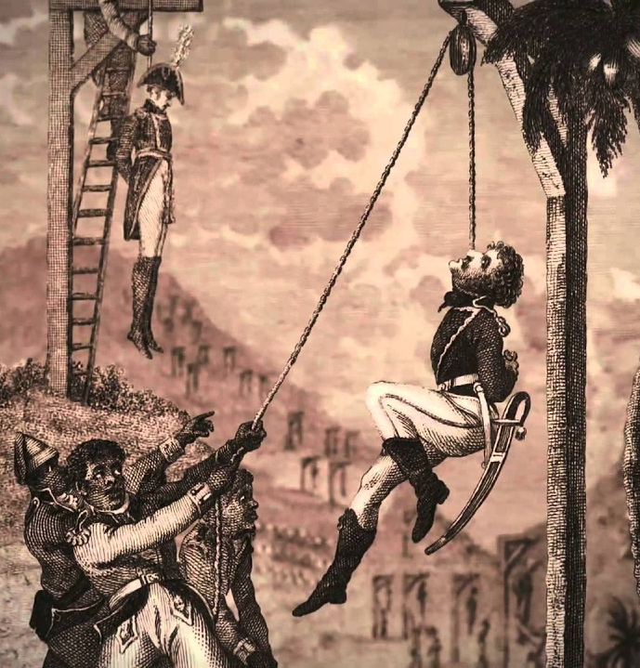
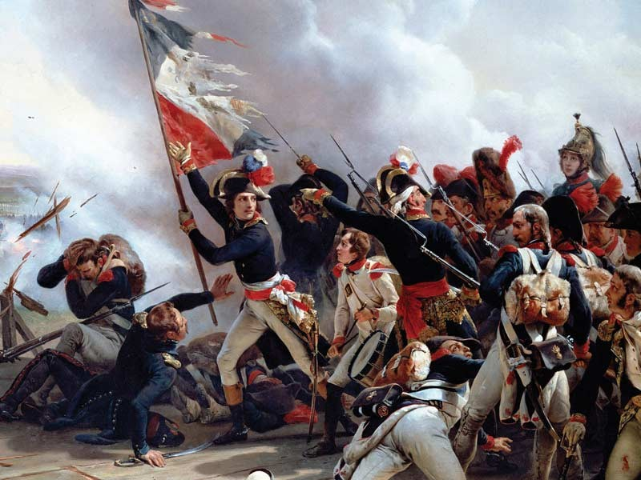
Unit 6: The Atlantic Revolutions

Slide 5
Notes: Unit 6 – The Atlantic Revolutions
1776-1848
The Atlantic Revolutions are defined by 2 movements:
The people of Europe demanding a say in their governments.
The people of Americas pushing back against European control.

Slide 6
Unit 6 – The Atlantic Revolutions
What are we going to learn:
Political Systems
The Enlightenment
The French Revolution
The Haitian Revolution

Slide 7
Notes: Political Systems
A political system is simply the method by which decisions are made for a state.
A political system is defined by how power is ACTUALLY distributed.
De jure: according to the law
De facto: in actuality

Slide 8
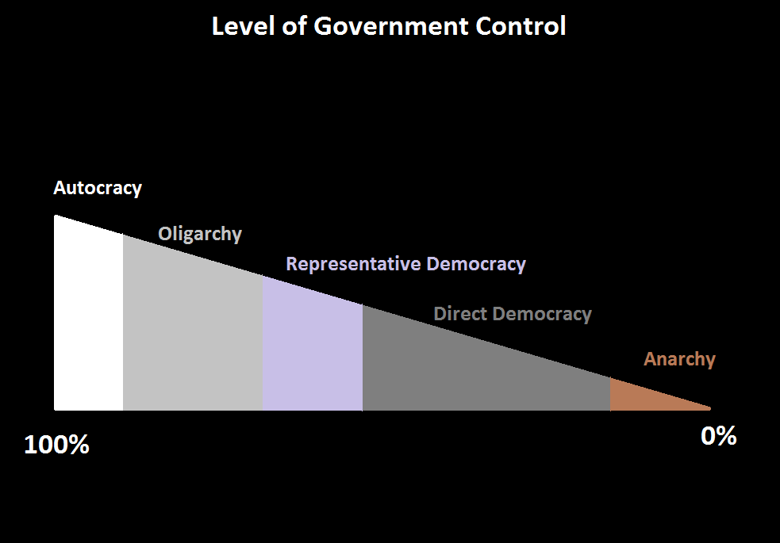
Power Spectrum – draw this

Slide 9
Notes: monarchy or republic
Monarchy: any government with a royal family, where political power can be inherited or owned.
Republic: a system that is not a monarchy, where political power cannot be owned.
Being a monarchy or a republic does not define what system of government a country is

Slide 10
Assignment: Political Systems
You are going to read about the 5 political systems.
There are many, many more political systems but pretty much any government would fit under one of these five labels.

Slide 11
Political Systems
Autocracy: almost all power rests in one person.
Oligarchy: a small group of people make all the decisions. Not chosen by the people
Representative Democracy: people vote on leaders, who then make decisions.
Direct Democracy: people vote on all or most government decisions.
Anarchy: the government does not have the right/power to force people into anything.

Slide 12
Which system is this?
Oopu: this made up country has no royalty. It has a legislature called the parliament, which controls all laws and decisions in the government. The parliament is elected every 5 years.

Slide 13
Which system is this?
Monkeyshinre: this made up country has no royal family. It has an elected congress and senate that makes all the decisions with the help of an elected president. However, the president has been in power for 20 years and uses his power to fix elections, making it appear as if he and his party were elected by a landslide every time.

Slide 14
Which system is this?
Floatsburg: this made up country has a King and Queen who inherited power from the Queen’s father. All laws are created by a citizen’s committee. The laws are only approved by a general vote by the people. The citizen’s committee is selected by a random lottery of every of-age person in the country every year.

Slide 15
Notes: Sovereignty
Sovereignty is power or authority of a state to determine laws and decisions for all things within the territory of the state—including living persons.

Slide 16
Notes: Governments on Sovereignty
Autocracy: the supreme ruler has full sovereignty over the state and people.
Oligarchy: sovereignty is divided amongst the wealthiest and most powerful.
Representative Democracy: sovereignty rests in the people but they allow it to be wielded by chosen representatives.
Direct Democracy: sovereignty rests in the people.
Anarchy: all people are sovereign over themselves.

Slide 17
Which system is this?
Maccaland: this made up country has a king and queen. The actual laws and decisions are made by a Council of Notables, who are appointed by the Queen. Rich, successful business people are the only ones who are ever appointed to this council.

Slide 18
Which system is this?
Estados de Camerones: this made up country has no royalty. Most of its laws and decisions are created by a congress and prime minister that are elected every 3 years. However, all decisions and laws made by that government are added to the next ballot and people can reject those laws or decisions.

Slide 19
Assignment: Identifying Political Systems
You are going to look at example political systems and determine what kind of government they each are

