Slide 1
Warmup 2/27
(Still in Unit 6)
How did the various governments of the French Revolution deal with the issue of slavery?

Slide 2
Logistics
If you missed yesterday’s essay or did not finish, you need to come make that up ASAP
We have 2 more parts of Unit 6:
The Haitian Revolution
Age of Revolutions
Test in 2 weeks (mid march)

Slide 3
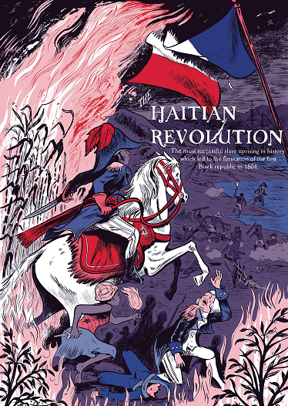
Notes: Haitian Revolution 1791-1804
Fought mostly by slaves in the French colony of Saint-Domingue.
One of the only successful slave revolts in history.
Created the modern nation of Haiti.

Slide 4
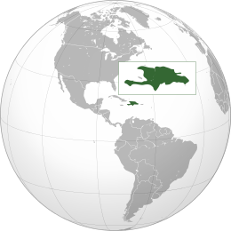
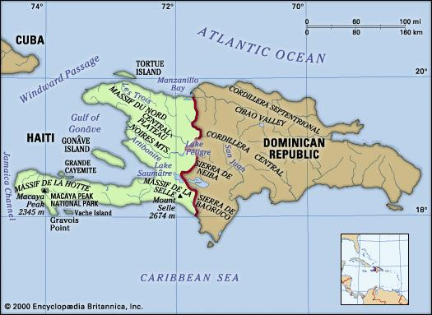
Notes: Haiti and Hispaniola
The Caribbean Island of Hispaniola is divided in two.
Haiti was a French Colony.
The Dominican Republic was a Spanish Colony.

Slide 5
Notes: Saint-Domingue
The French Colony that became Haiti was called “Saint-Domingue.”
It was incredibly profitable.
In 1789 it produced:
60% of the world’s coffee.
40% of the world’s sugar

Slide 6
Notes: Population of Saint-Domingue
10,000 Grand Blancs—white people of considerable property—slaveowners.
30,000 Petite Blancs—whites not wealthy enough to own slaves.
28,000 mulattoes and free people of color.
A mulatto was someone of both white and black descent.

Slide 7
Notes: Population of Saint-Domingue
All told there was 68,000 free people in Saint-Domingue in 1789.
There were 452,000 slaves.
The slaves here lived in brutal conditions—worse even than slavery elsewhere.
Most slaves were dead within 7 years of arriving on the island.

Slide 8
Video Notes
Today and tomorrow we will watch a video
Grab a video notes sheet from the back of the room

Slide 9
Video Notes
We’re jumping right into the video.
Get out your video notes from yesterday.
If you were absent, grab a sheet from the back.

Slide 10
Haiti summary
French slave colony revolts in 1791
Bloody war between slaves and slave owners
Whites reject peace.
Spain and Britain become involved in the war.
Radical French government declares all slaves free.
Haiti wins against both Spanish and British armies
Napoleon takes over and turns against Haiti
Napoleon’s army smashes the Haitian army and captures Louverture, who dies in prison.
Rochambeau begins a war of extermination against the black people of Haiti.
Dessalines starts a brutal guerilla war, murdering all white Frenchmen. Drives the French army out.
Haiti becomes free in 1804.

Slide 11
Why is Haiti so poor?
America and all European nations refused to recognize Haiti for decades.
The sugar/coffee economy wasn’t able to compete with other slave colonies.
Military dictators have frequently sold out the people of Haiti to foreign companies.

