Slide 1
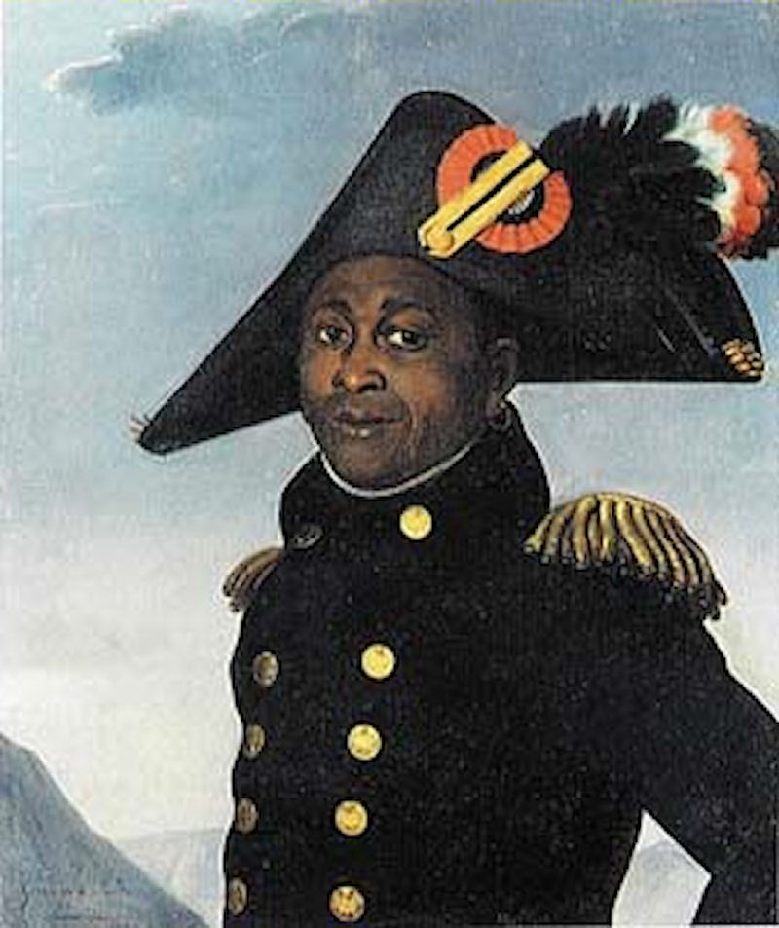
Haitian Revolution in Review
We will very briefly review the story of the Haitian Revolution

Slide 2
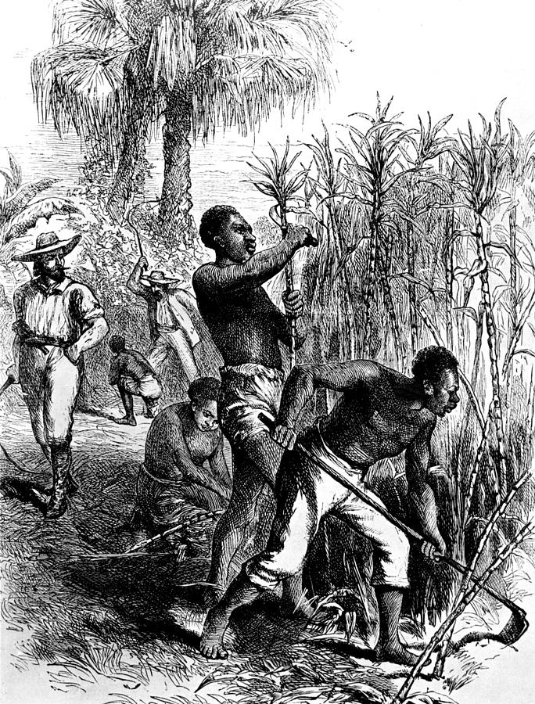
Before the Revolution
Rich colony
Brutal slavery
Slaves outnumber free people 7:1
French Rev begins and people begin to think more about freedom and equality

Slide 3
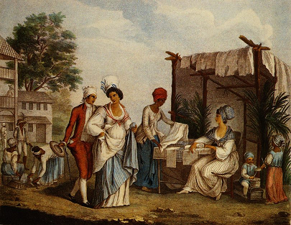
Growing Troubles
The mixed race population asks for legal equality with whites from the French Bourgeois government.
Request granted by the governor of the colony refuses to accept it
Whites begin to consider their own revolution

Slide 4
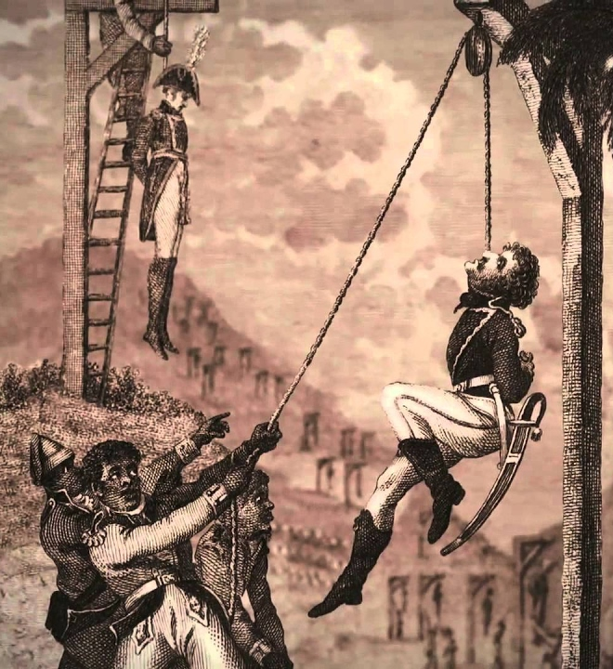
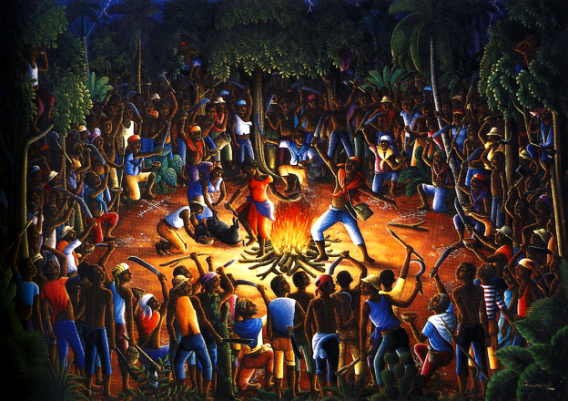
Revolution Begins 1791
Massive slave revolt led by Boukman Dutty
Hundreds of slave-owners executed in surprise attacks
Brutal war begins

Slide 5
Toussaint
Toussaint L’ouverture, a free black man, eventually becomes the leader of the revolution.
Successfully fights the slave-owners
France sends 10,000 troops to restore order

Slide 6
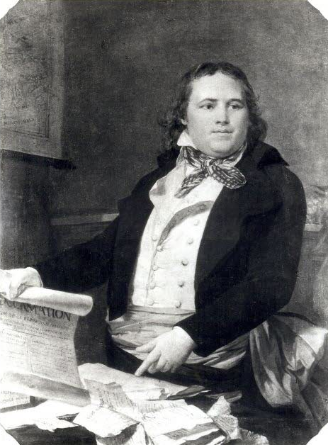
Uneasy Peace
Peace is kept by the new governor, Sonthonax
In 1794, Sonthonax gets the French Radical government to free all slaves
Feeling betrayed, the whites of Saint-Domingue invite the British to invade and reinstall slavery

Slide 7
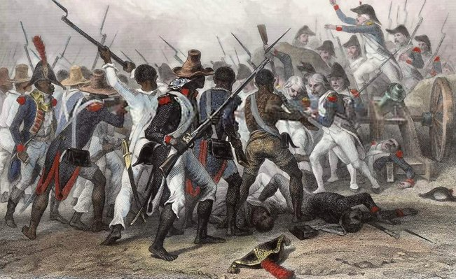
War
For 8 years, Toussaint and his army of ex-slaves fights for France against Britain and Spain
Toussaint is made governor of Saint-Domingue

Slide 8
Toussaint in Charge
Toussaint forces many of his followers back to the plantations to help the economy
He creates the Haitian Constitution
Permanently abolishes slavery
Makes discrimination based on race illegal
Makes Haiti a military autocracy

Slide 9
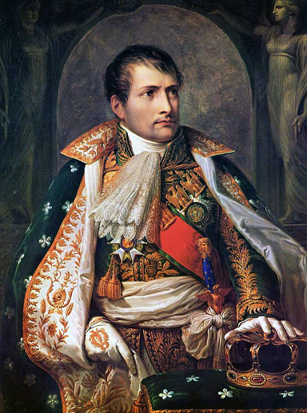
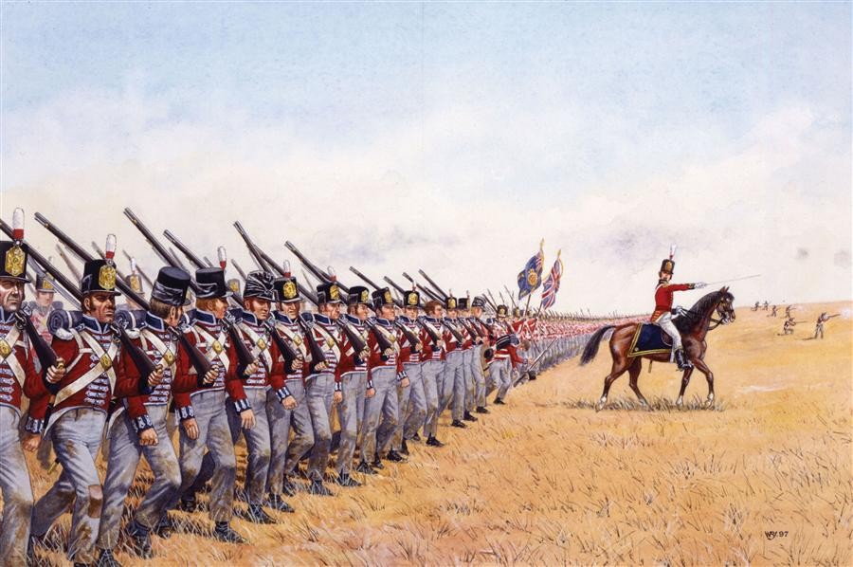
Napoleon
When Napoleon takes over, he turns on Haiti.
Dispatches an army to Haiti that begins a brutal war against black Haitians
Toussaint is captured and dies in a French Prison

Slide 10
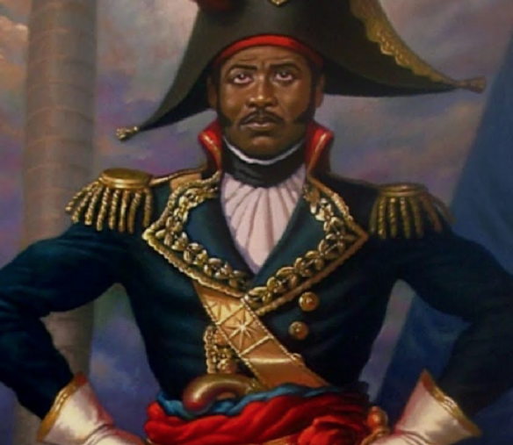
Dessalines
When Napoleon brings slavery back to a nearby colony, Haiti’s black population again revolts
Their new leader, Dessalines, orders the execution of all white Frenchmen remaining in Haiti
Napoleon’s forces are finally driven off

Slide 11
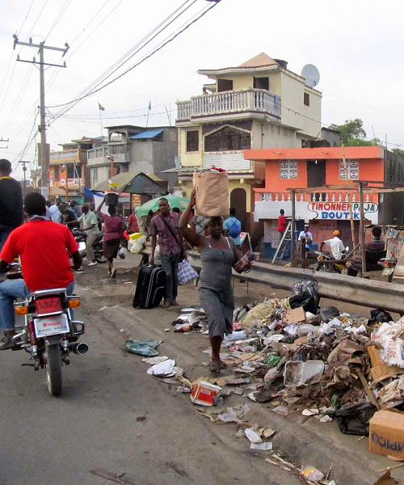
Haiti
White countries refused to recognize, support, or trade with Haiti.
Brutal military dictators in the tradition of Dessalines have continued to sell-out the people of Haiti
It remains one of the poorest countries on Earth
But it is free from slavery and racial discrimination.

