Slide 1
Warmup 3/14
What motivated the Haitian Revolution?
What was Toussaint L’ouverture’s role?
How did it end?
Turn in Haitian Revolution video notes if you have not already.

Slide 2
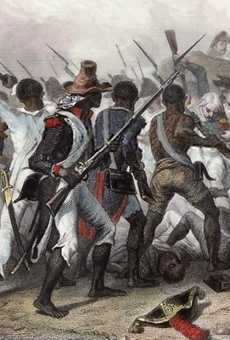
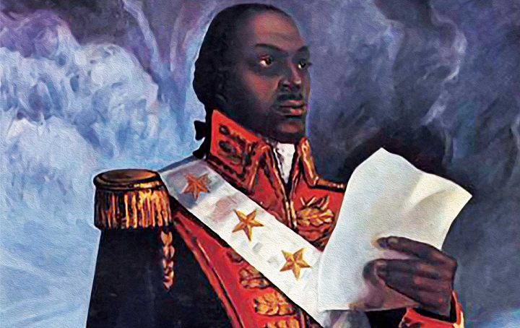
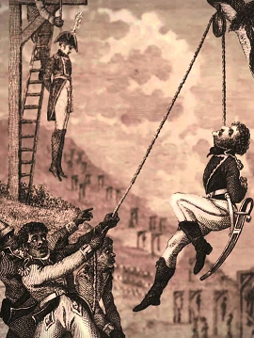
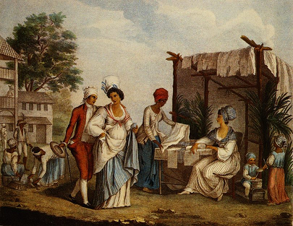
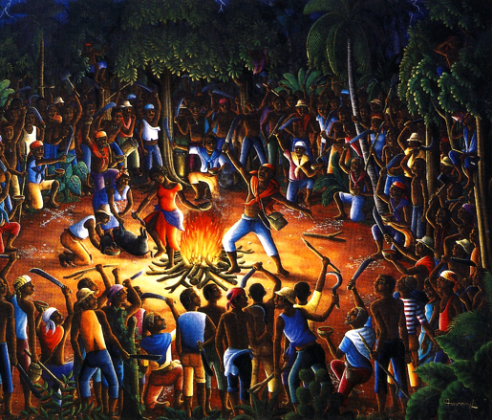
Haitian Revolution in Review

Slide 3
Haiti summary
French slave colony revolts in 1791
Bloody war between slaves and slave owners
Whites reject peace.
Spain and Britain become involved in the war.
Radical French government declares all slaves free.
Haiti wins against both Spanish and British armies
Napoleon takes over and turns against Haiti
Napoleon’s army smashes the Haitian army and captures Louverture, who dies in prison.
Rochambeau begins a war of extermination against the black people of Haiti.
Dessalines starts a brutal guerilla war, murdering all white Frenchmen. Drives the French army out.
Haiti becomes free in 1804.

Slide 4
Today
You will be assigned into small discussion groups.
You will have to work as groups to answer 4 questions.
Your final answers will be written on a worksheet
Each person must take a turn recording the final answer.

Slide 5
Instructions
Don’t move on until you are asked to do so
We will be talking about the background to each question before answering it

Slide 6
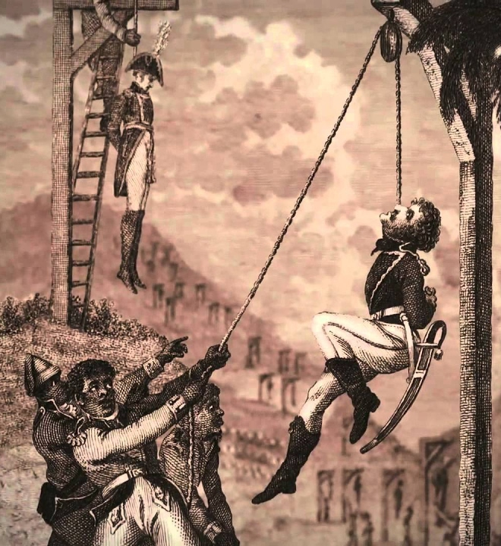
Question 1: Brutality
Background: The Haitian Revolution was marked by brutal treatment of prisoners.
The first revolt was mostly a massacre of slave-owners
Dessalines ordered the 1804 Haiti Massacre, in which all white Frenchmen living on the island (and many women and children) were killed.
On the other hand, the white slave-owners and Napoleon’s army also killed most of their captives
And many slaves wanted revenge for centuries of brutal treatment

Slide 7
Question 1: Brutality
Question: how strongly should we condemn the brutality of the revolution?
Sub Questions:
Was it understandable?
Did the Haitians commit worse crimes than their enemies
Can war crimes ever be understandable?

Slide 8
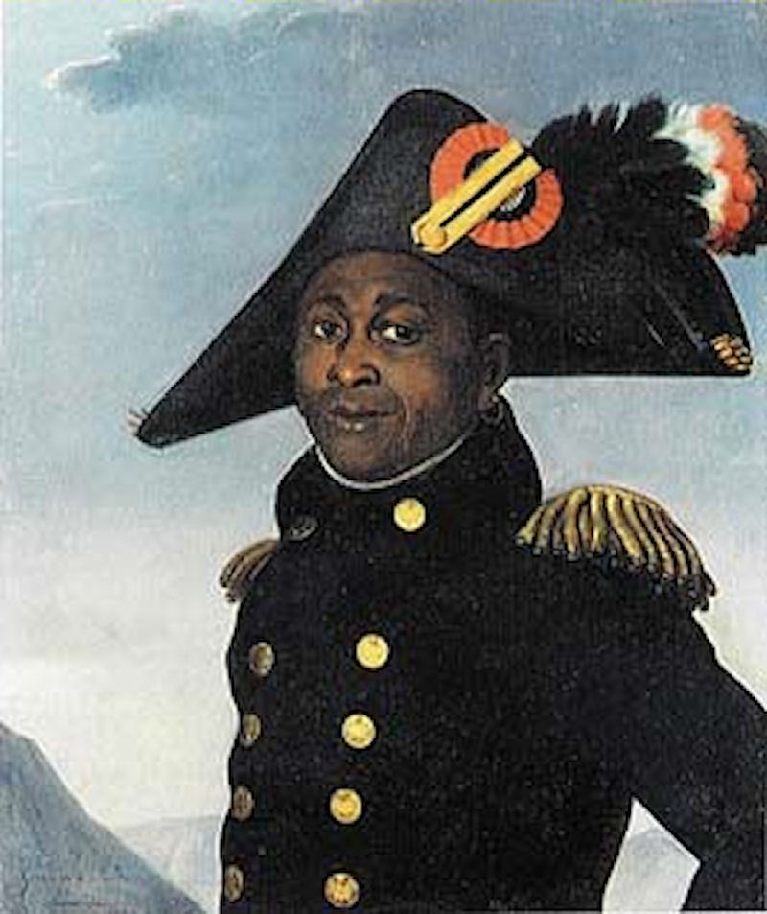
Question 2: Toussaint
Background: Toussaint L’ouverture is a mixed figure.
He led the Haitian armies to stunning victories
He stopped his soldiers from the sort of killings that were common before and after his reign
However, he also offered to send them all back to slavery in a peace settlement
He also forced his followers into labor
And he installed himself as military dictator for life in the Haitian Constituion

Slide 9
Question 2: Toussaint
Question: Should Toussaint be viewed as a hero?
Sub Questions:
Did he do more good than bad?
Would Haiti have survived without him?

Slide 10
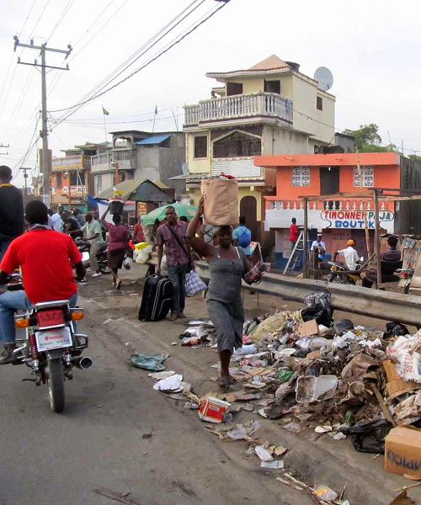
Question 3: Haiti
Background: Haiti is free but has always had problems.
Slavery and racial discrimination has been illegal in Haiti for 200 years. There is almost no racial inequality.
White countries refused to recognize or trade with it for almost a hundred years.
It has been mistreated by its military dictators ever since Dessalines’ time
It is one of the poorest countries on Earth

Slide 11
Question 3: Haiti
Question: Should the Haitian Revolution be viewed as a success?
Sub Questions:
What were its goals?
Was it more successful than the French Revolution?

Slide 12
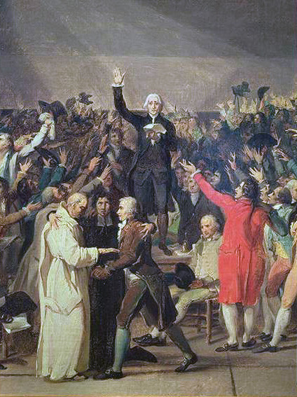
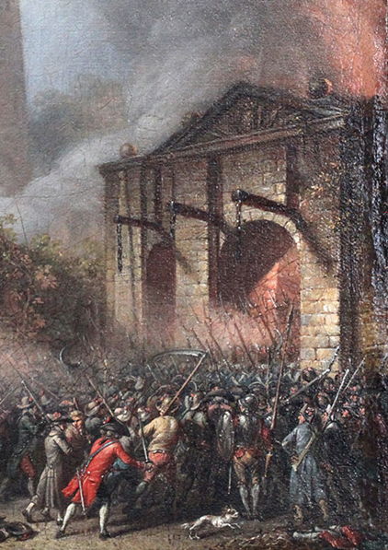
Question 4: La Grande France
Background: The Haitian Revolution has many ties to the French Rev
Happened in French territory
Was about fighting for equality and liberty
Was championed by the Radical French government
However, it happened far away from France itself and had a very different conclusion

Slide 13
Question 4: La Grande France
Question: Should the Haitian Revolution be considered part of the French Revolution?
Sub Questions:
Was it part of the same struggle or a different struggle?

Slide 14
Intructions
Turn in your discussion worksheet.
Grab a study guide from the back
We will be starting a project tomorrow
The test will be next week on block day, Tues/Wed

