Slide 1
Warmup 3/21
Make a Unit 7 title page:
UNIT 7: THE INDUSTRIAL REVOLUTION
Then make a warmup page and answer:
What is the Industrial Revolution?
How has it change human society?

Slide 2
Test Makeups
Available now
Will not be multiple choice. Expect to write.
You’ll need about 20-30 minutes.

Slide 3
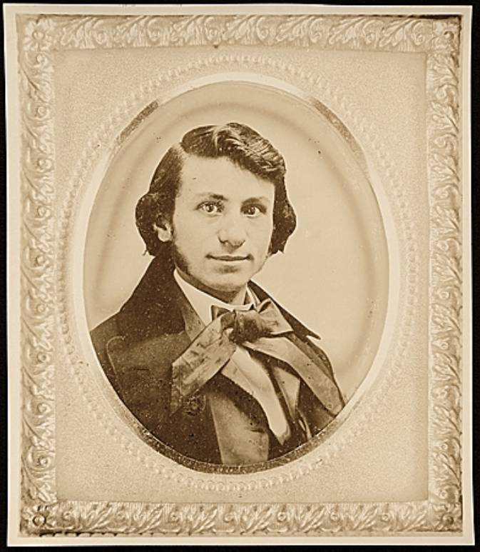
Louis Maurer 1832-1932

Slide 4
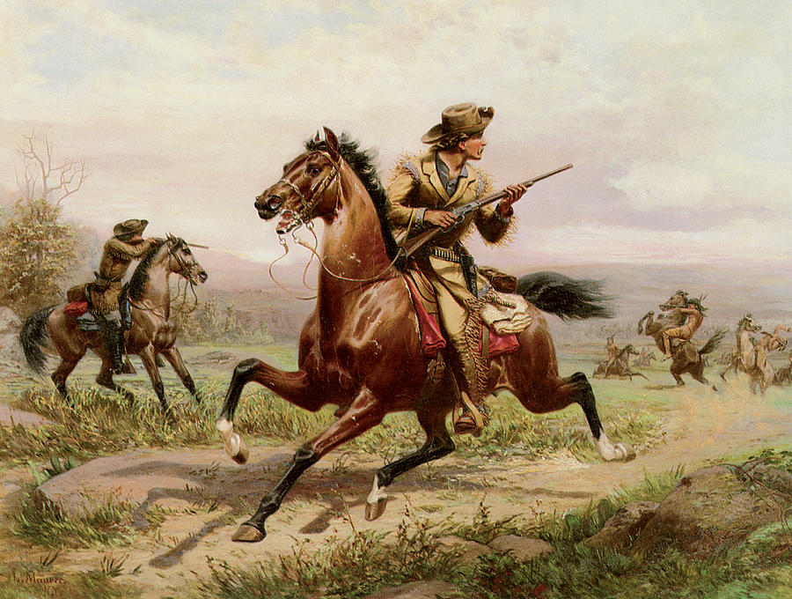
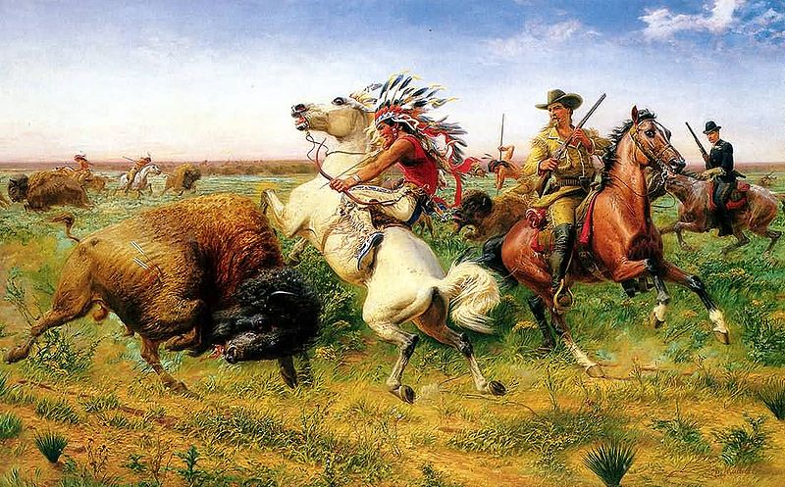
Louis Maurer 1832-1932

Slide 5
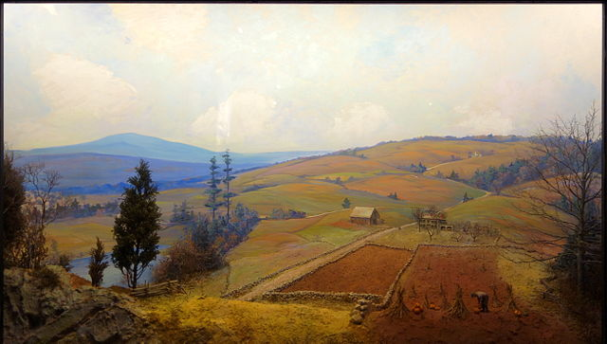
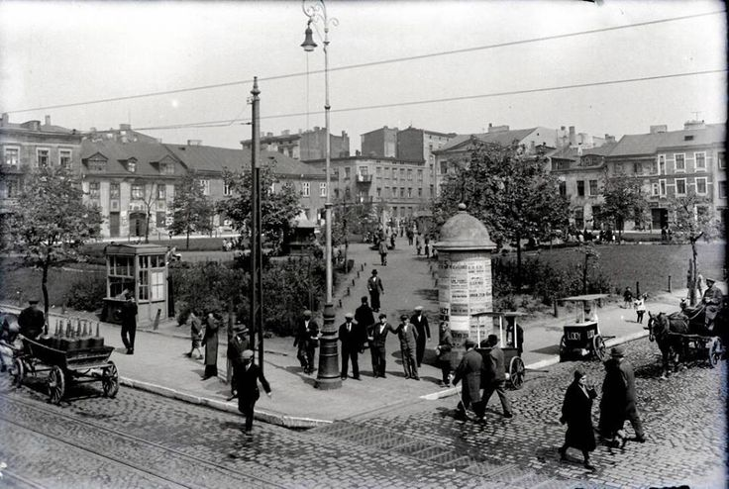
1832
Most of America looked liked this.
91.2% of Americans live on Farms
1932
Most of America looked liked this.
43.9% live on farms.

Slide 6
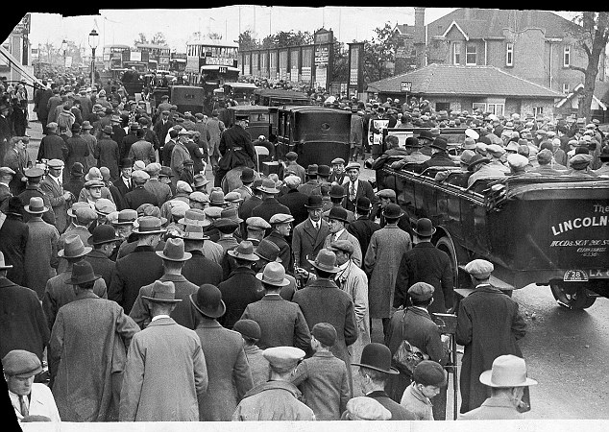
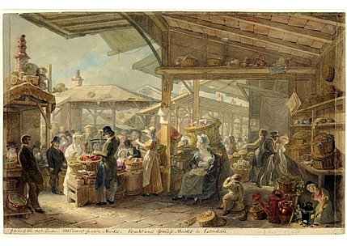
1832
12 million people live in America
1932
123 million live in America

Slide 7
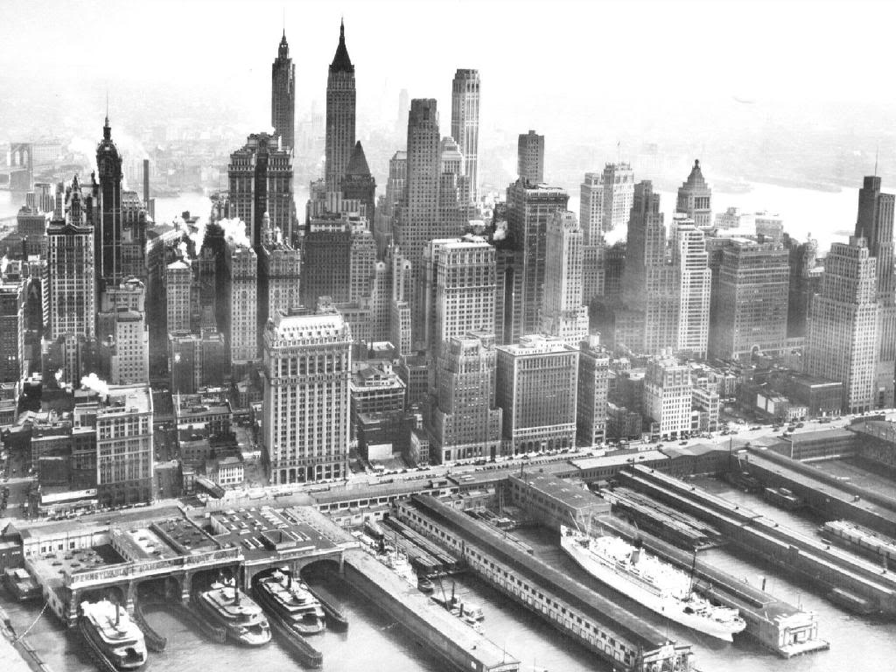
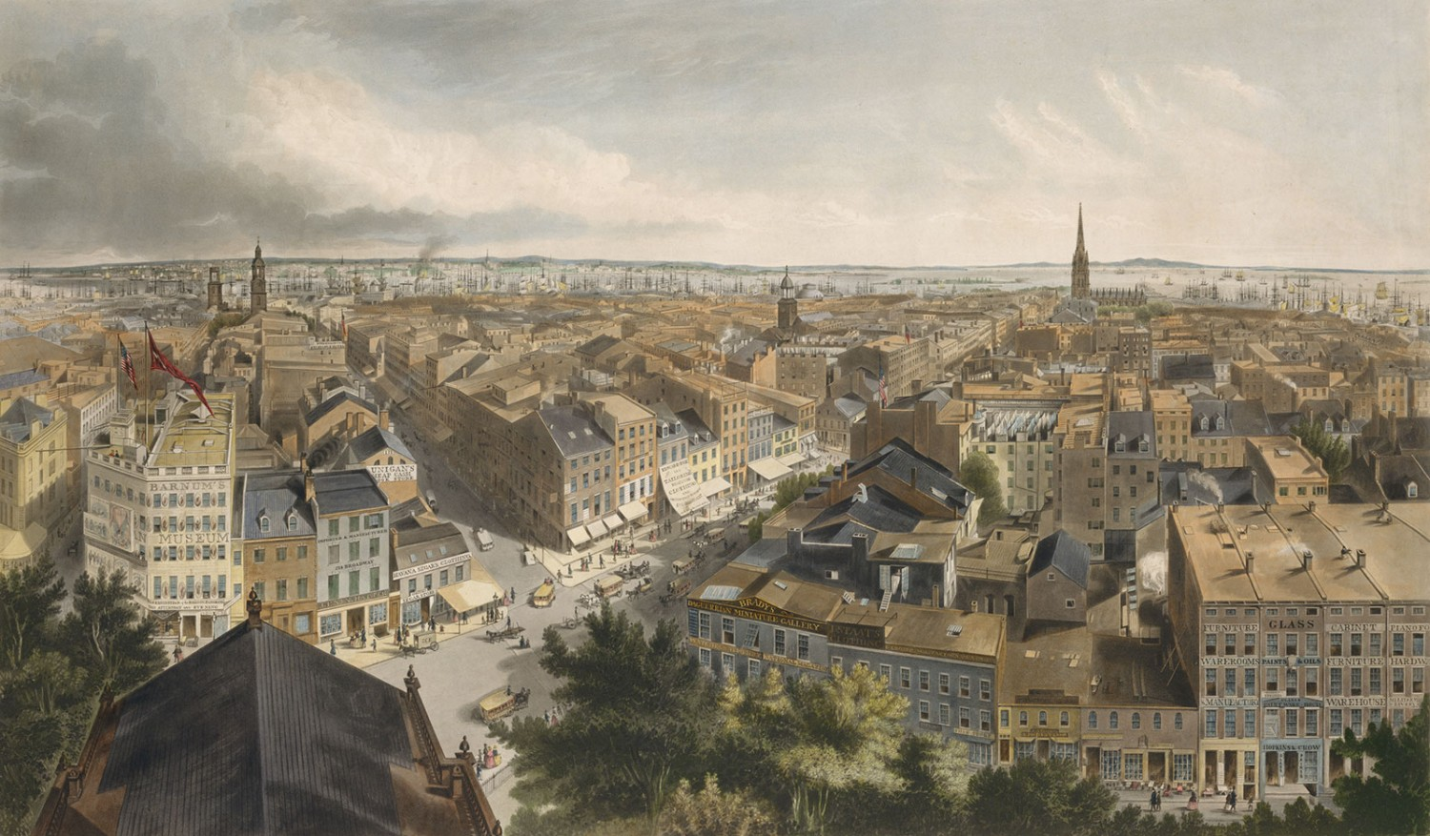
1832
New York’s Population:
202,300
1932
New York’s Population:
6,930,446

Slide 8
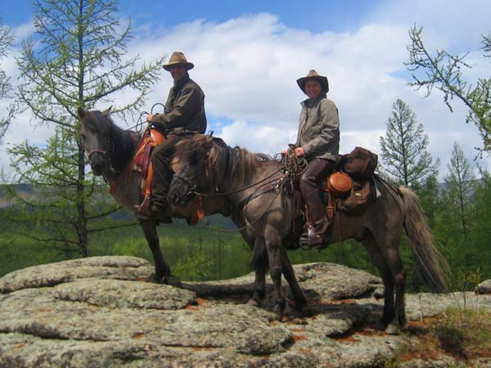
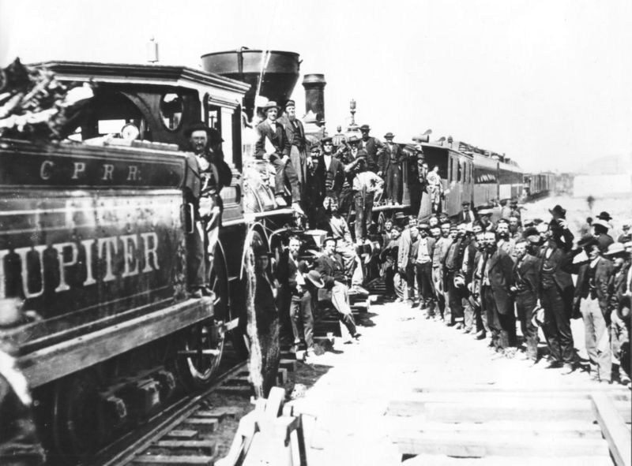
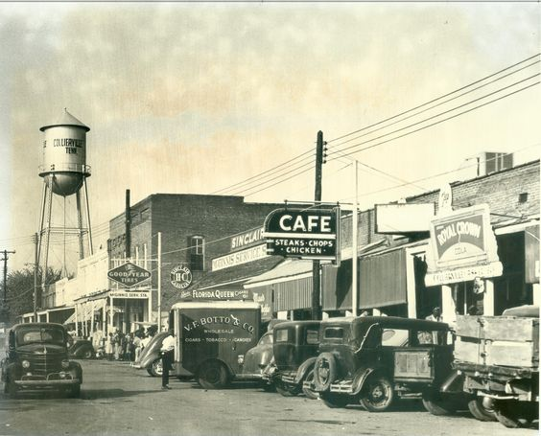
1832
Two forms of Travel:
Walk or Horse
1870
Increasingly replaced by Railroads
1932
Cars have made the horse irrelevant

Slide 9
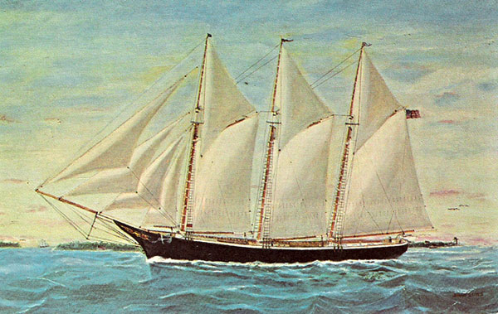
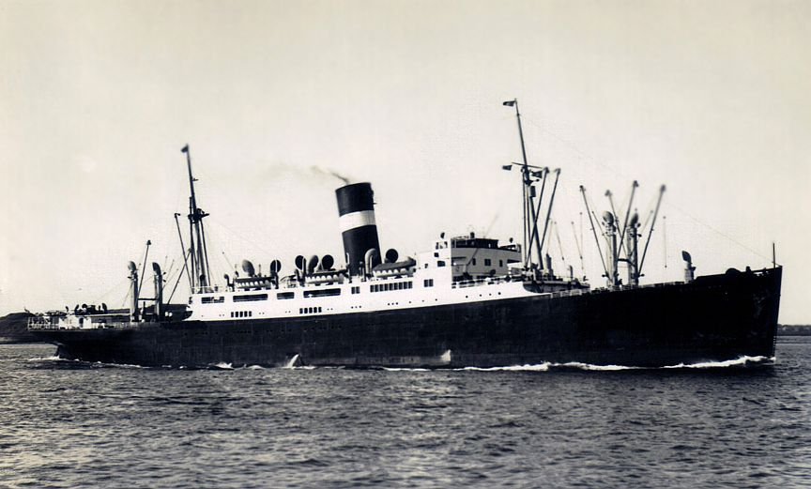
1832
Wooden Sail Boats
Few carry more than 150 people
1932
Steel ships. Most use diesel.
The largest carry more than 2000 people

Slide 10
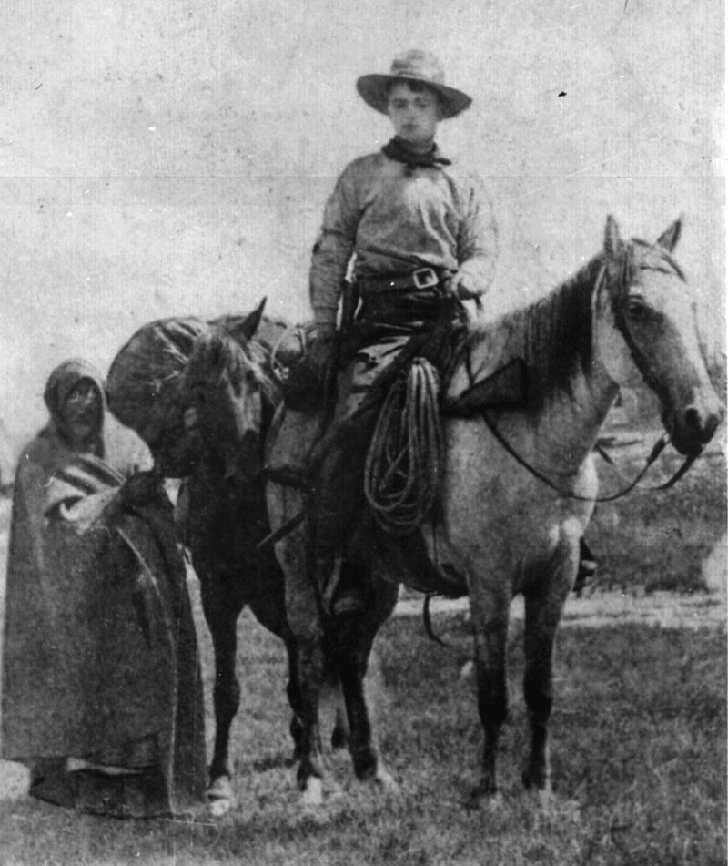
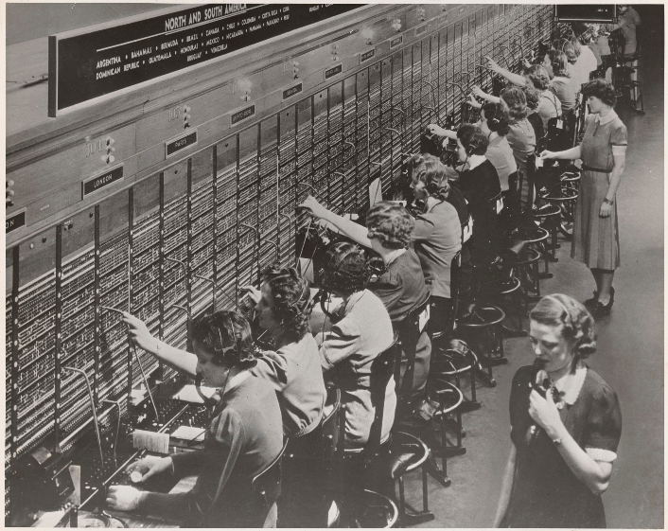
1832
Letters take 3 weeks to cross America
4-6 weeks to/from Europe
1932
1 in 3 Americans have telephones
Telephone calls to Europe available in 1930

Slide 11
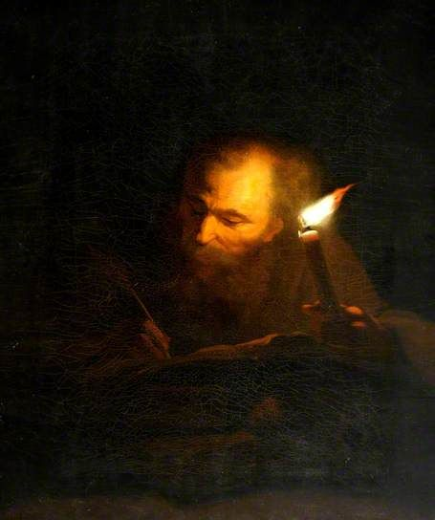
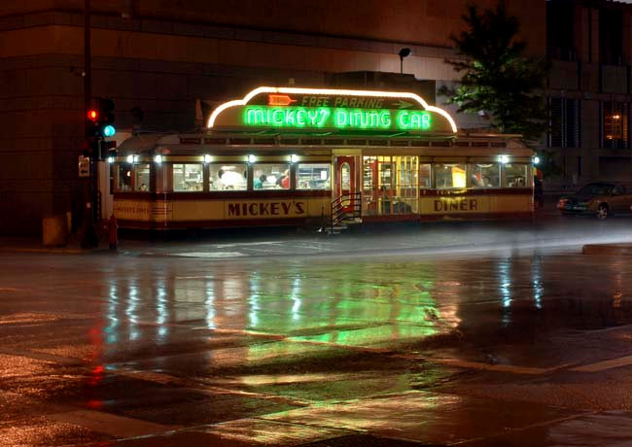
1832
Only sources of unnatural light are candles and fire.
Most go to bed at sunset
1932
All American cities are lit by electricity.
Night life has developed in many cities.

Slide 12
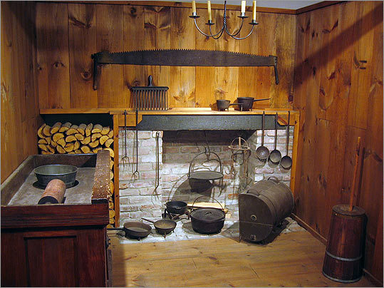
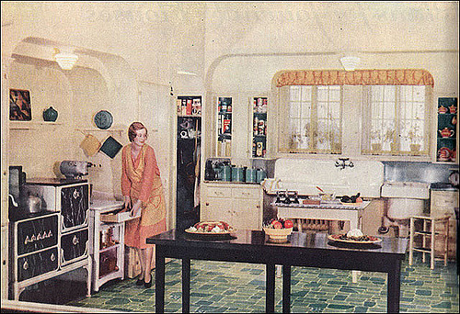
1932
Mass produced appliances.
Ovens, stoves, and ice boxes
Refrigerators in some homes.
1832
Kitchens are crude
Cooking done by fireplace

Slide 13
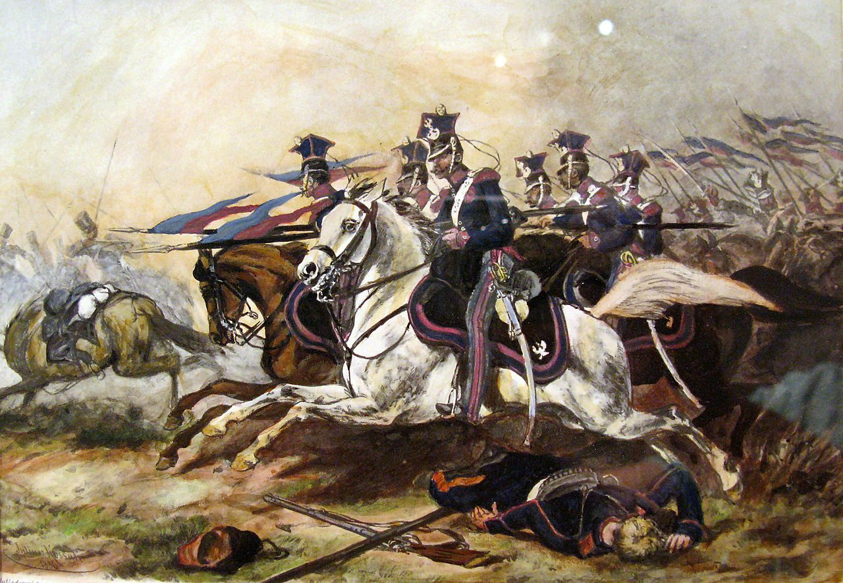
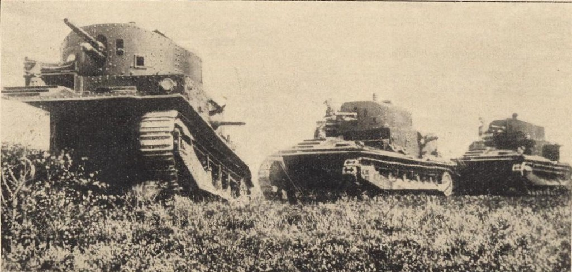
1832
Wars are fought with muskets
Horsemen still charge with lances
1932
Wars are fought with machine guns, tanks, planes, and missiles.

Slide 14
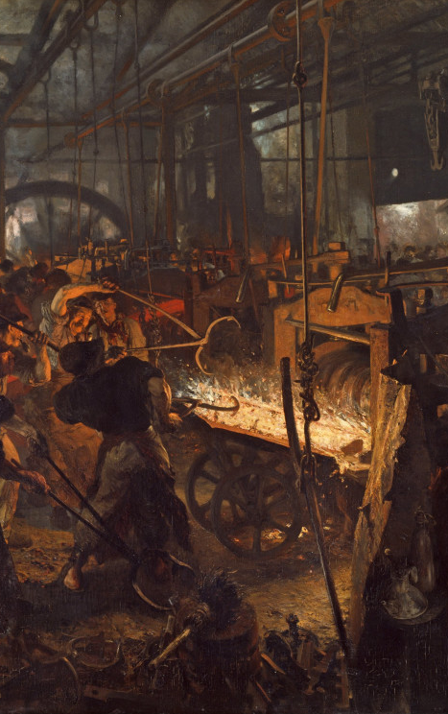
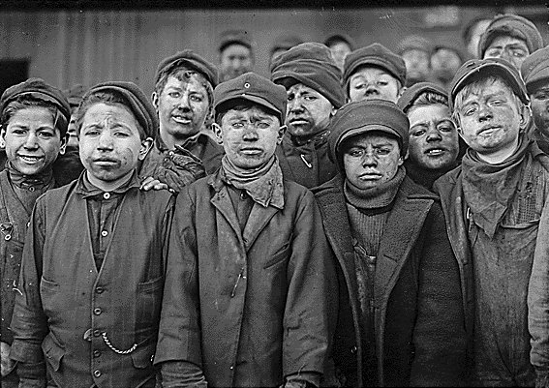
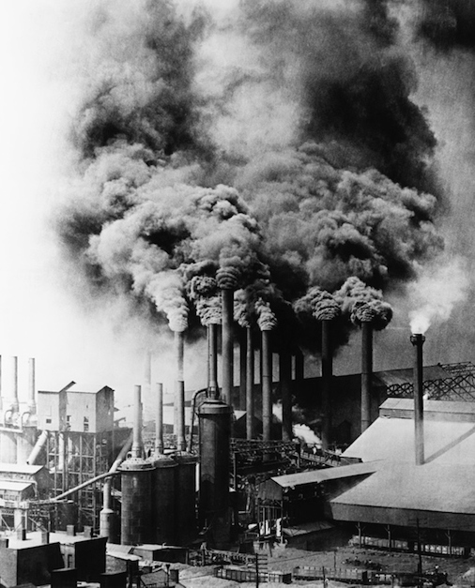
Unit 7: The Industrial Revolution

Slide 15
NOTES: The Industrial Revolution
The second great social revolution in human history.
Came in two waves:
The First Industrial Revolution: 1760-1840 in Britain
The Second: 1860-1920 in Europe and America and Japan

Slide 16
Notes: Industrialization
Industrialization is the process of a society changing into a mechanized society.
Mechanization is the use of machines to create things or do work—rather than human/animal power.

Slide 17
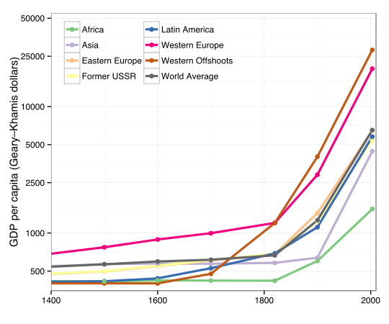
Notes: Industrialization
The main change is production.
Mechanization allows the same number of workers to produce more.
Since less people were needed to make the food, tools, clothes, etc. it allowed greater specialization.

Slide 18
Notes: Industrialization
Industrialization led to many changes:
Greater population
Growth of cities
Farms grow in size, decrease in number
Vastly increased population density
People owned more
People moved more often
Accelerating development of the sciences
Decline in environmental health
Increase in worker/citizen unhappiness

Slide 19
Assignment: Industrialization Intro
Read each part.
Summarize or answer questions on the right.

