Slide 1
Notes: Renaissance
Renaissance: a period during which there was a flourishing of art in Europe, inspired by old Roman and Greek values.

Slide 2
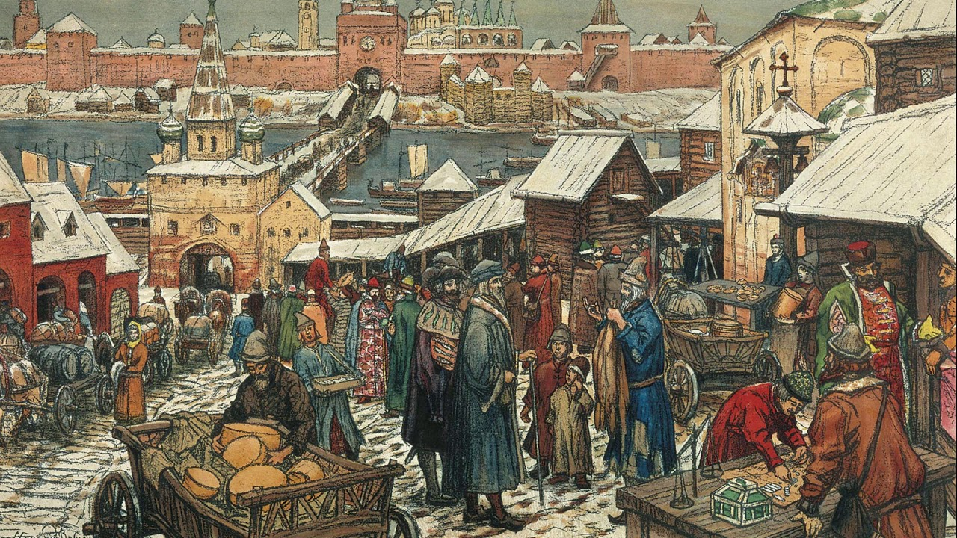
Notes: Renaissance
Did not end the middle ages. Renaissance occurs during the Late Middle Ages
Very little change for everyday people
Art takes huge leaps forward.
A few people start to question the dominance of the church.

Slide 3
Notes: Renaissance
The Renaissance did not affect most Europeans.
Only a handful of wealthy individuals in a few wealthy cities actually experienced the Renaissance.

Slide 4
Renaissance vs Medieval Art
We will look at a few comparisons of art on the same topic.
For each: take 2 minutes to record differences you notice. Record as many as you can.
Think about style, colors, depth, perspective, background, realism, etc.

Slide 5
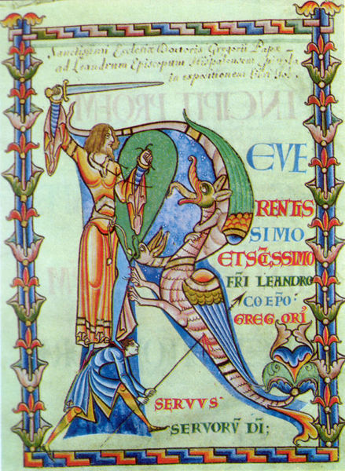
Slaying Dragons

Slide 6
Slaying Dragons
In Notebook:
In contrast to the medieval painter, which values would you say are important to the painter of this renaissance piece?

Slide 7
Notes: Renaissance Elements
Realism: Renaissance artists focused on portraying things as they actually look.
Naturalism: Renaissance artists thought nature was worth portraying.
Perspective: Use of artificial lines used to make it appear as if flat paintings have depth.

Slide 8
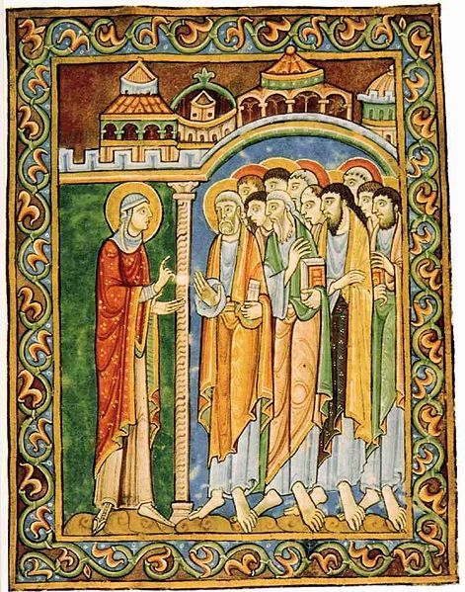
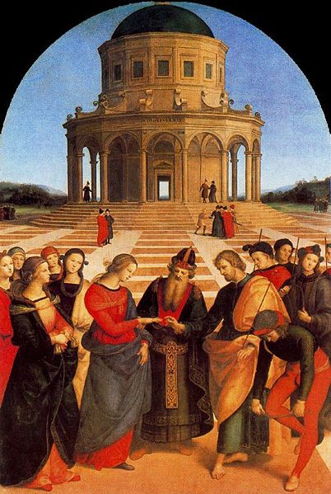
Two Maries

Slide 9
Two Maries
In Notebook:
Do you think this painting demonstrates realism? Naturalism? Perspective? What part of the painting demonstrates that to you?

Slide 10
Notes: Humanism
Perhaps the most important legacy of the Renaissance.
Humanism is the focus on human qualities rather than idealized or divine qualities.
It is the belief that we can help ourselves and don’t need to be saved.
Humanist artists focused on showing human emotion

Slide 11
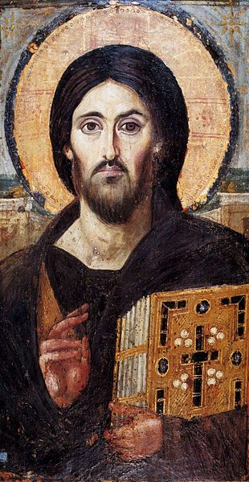
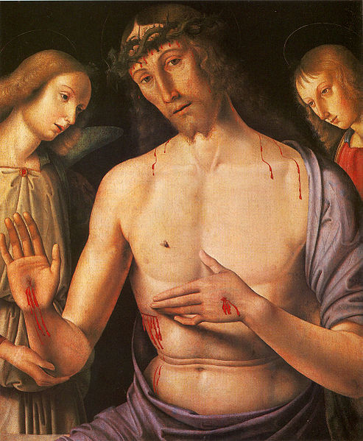
Jesus

Slide 12
Jesus
In Notebook:
In what ways does the painting on the right display humanism more than that on the left.

Slide 13
Task
To finish assignment, go to my website and do the following:
Prompt: how can humanism be seen in Renaissance but not Medieval art?
Look at the paintings provided and use at least 3 of them to prove your answer
When using paintings as a source, talk about the specific things you see in the painting that shows your point.

Slide 14
No Warmup
Grab an ipad and a partner (or you can work on your own)
Turn in:
Medieval Europe
Crises of the 14th century

Slide 15
Renaissance Values
Realism: Renaissance artists focused on portraying things as they actually look.
Naturalism: Renaissance artists thought nature was worth portraying.
Perspective: Use of artificial lines used to make it appear as if flat paintings have depth.
Humanism is the belief that humans are of value—as are their emotions and reasoning.

Slide 16
Humanism
Perhaps the most important legacy of the Renaissance.
Humanist artists focused on the human element of their work.

