Slide 1
Enlightenment Beliefs
Equality: the belief that all people are created equal and should be treated the same.
Reason: ideas must be based on evidence and logic.
Popular Sovereignty: governments have power only so long as people obey.
Constitutionalism: governments should clearly define their own powers and limits.
Natural Rights: all humans have certain basic rights regardless of their government.

Slide 2
Warmup 1/31
Would an anarchy be a good place to live?
Why?
Are we naturally good or naturally evil?
Why do you think that?

Slide 3
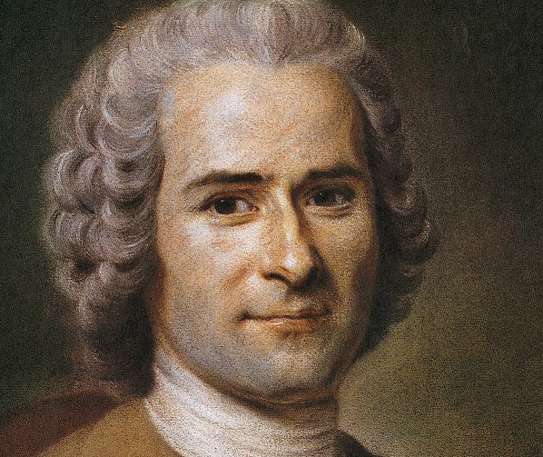
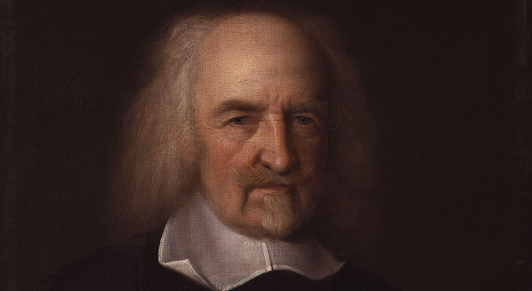
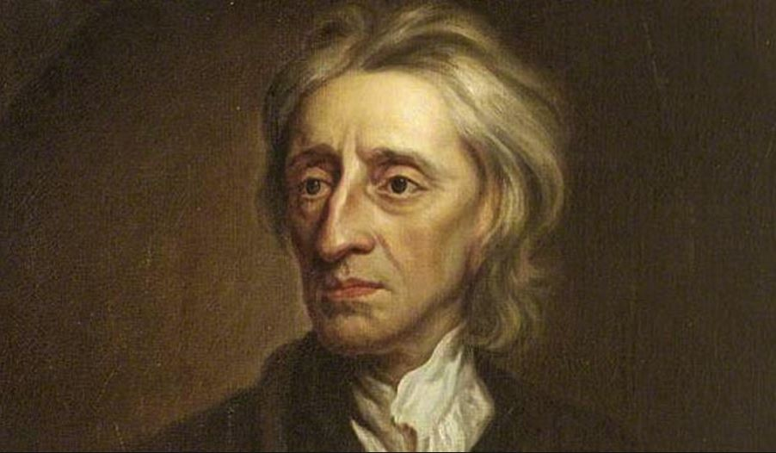
Hobbes, Locke, Rousseau
We’ll be reading about the 3 most important philosophers of the Enlightenment.
Thomas Hobbes
John Locke
Jean-Jacques Rousseau
We’re going to figure out what they believe and why.

Slide 4
ASSIGNMENT: Hobbes, Locke, and Rousseau
Part 1
Grab worksheet and reading material
Read each philosopher one at a time.
Summarize on the worksheet 2 facts about each philosopher and 5 things they believe
Done at 2:38

Slide 5
ASSIGNMENT: Hobbes, Locke, and Rousseau
Part 2
Get with a partner.
Answer the following sections:
Human Nature
Purpose of Government
Best Government
12 minutes

Slide 6
ASSIGNMENT: Hobbes, Locke, and Rousseau
Part 3
Finish the last section on your own.
Answer should be at least 3 sentences.

Slide 7
Quiz Monday
Quiz covers:
Political systems: anarchy, representative democracy, direct democracy, oligarchy, autocracy, monarchy, and republic
Enlightenment: reason, popular sovereignty, constitutionalism, equality, and natural rights
Hobbes, Locke, and Rousseau: what they believe about human nature and the purpose of gov.

