Slide 1
Warmup 1/30
Make a new Unit Title and Warmup page for Unit 6: The Atlantic Revolutions
What kind of political system does the following government use?
Alpensloss: the rather small kingdom of Alpensloss is a monarchy. However, by agreement with his great grandfather, the King of Alpensloss has a strange deal. On each citizen’s 18th birthday, the King (or King’s representative) signs a contract with that citizen that clearly states whether that citizen will join society or not. If the citizen chooses not to join, they can still live within Alpensloss but are immune to all its laws and are not covered by any of its services.

Slide 2
Logistics
We’re joined by a student teacher, Mr Chillem
He’ll be taking over class for some time later this semester.
We’ll be going over some of our political science stuff before we move on.

Slide 3
Warmup 1/30
What kind of political system does the following government use?
Alpensloss: the rather small kingdom of Alpensloss is a monarchy. However, by agreement with his great grandfather, the King of Alpensloss has a strange deal. On each citizen’s 18th birthday, the King (or King’s representative) signs a contract with that citizen that clearly states whether that citizen will join society or not. If the citizen chooses not to join, they can still live within Alpensloss but are immune to all its laws and are not covered by any of its services.

Slide 4
Logistics
We’re joined by a student teacher, Mr Chillem
He’ll be taking over class for some time later this semester.

Slide 5
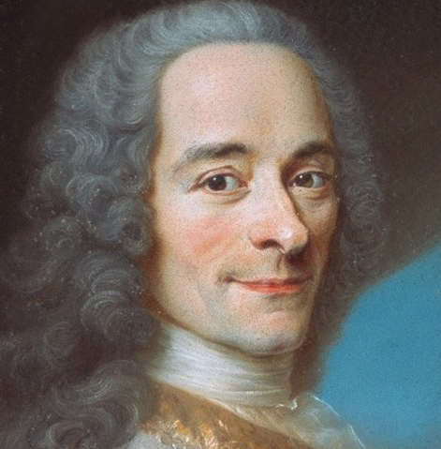
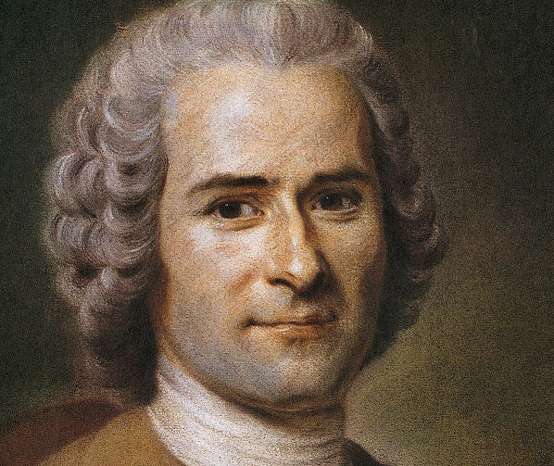
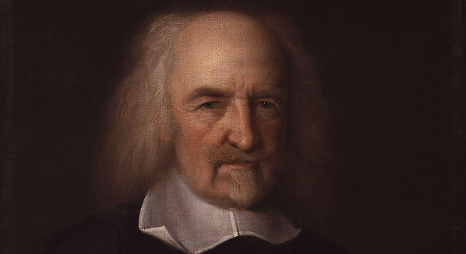
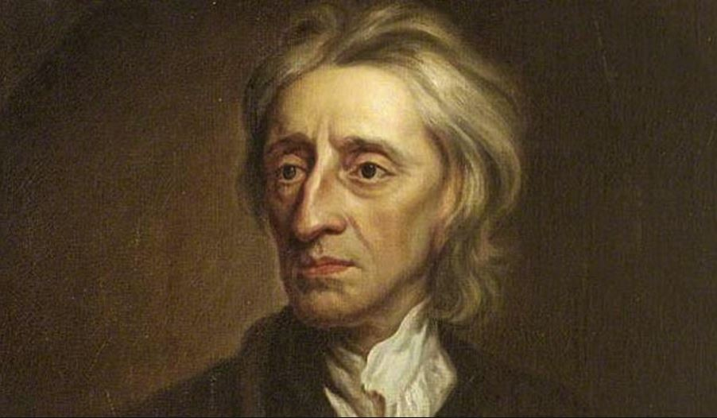
Notes: The Enlightenment
Enlightenment: 18th century philosophical movement that used reason to argue how the world should be.
Redefined how we think of governments.
Would be one of the main causes of the Atlantic Revolutions.

Slide 6
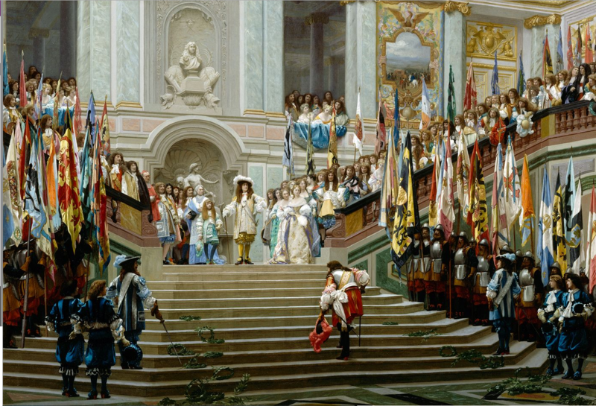
Notes: The Age of Absolutism
The Enlightenment was a reaction against the period of government known as the Age of Absolutism
In Europe from 1550-1800, Kings had become Autocrats
They were above the law and could change the laws at a whim.

Slide 7
Notes: The Enlightenment
The Philosophers of the enlightenment mostly believed this absolute power to be unjust
They argued that government should be responsible to its people

Slide 8
ASSIGNMENT: The Enlightenment
You are going to read a document on 5 key beliefs of the enlightenment.
Figure out what each of them are.
20 minutes

Slide 9
Defining Enlightenment
Get with a partner.
Work together to create your own definition for each of the enlightenment beliefs.
8 minutes

Slide 10
Enlightenment Beliefs
Reason: ideas must be based on evidence and logic.
Popular Sovereignty: governments have power only so long as people obey.
Constitutionalism: governments should clearly define their own powers and limits.
Natural Rights: all humans naturally have certain basic rights regardless of their government.
Equality: all humans are born equal and should have the same rights and same opportunities.

