Slide 1
No Warmup
Grab a bubble sheet from the back
Quiz in 5 minutes
Staple and Turn in:
Political Systems
Identifying Political Systems
The Enlightenment
Hobbes, Locke, and Rousseau

Slide 2
Quiz
10 minutes
10 questions
Come scan when finished

Slide 3
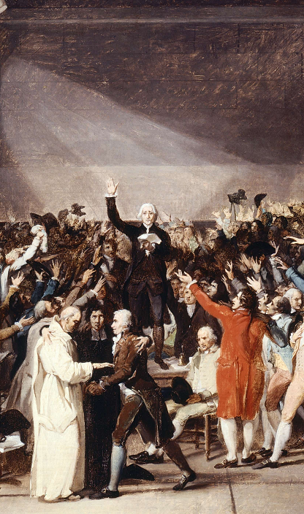
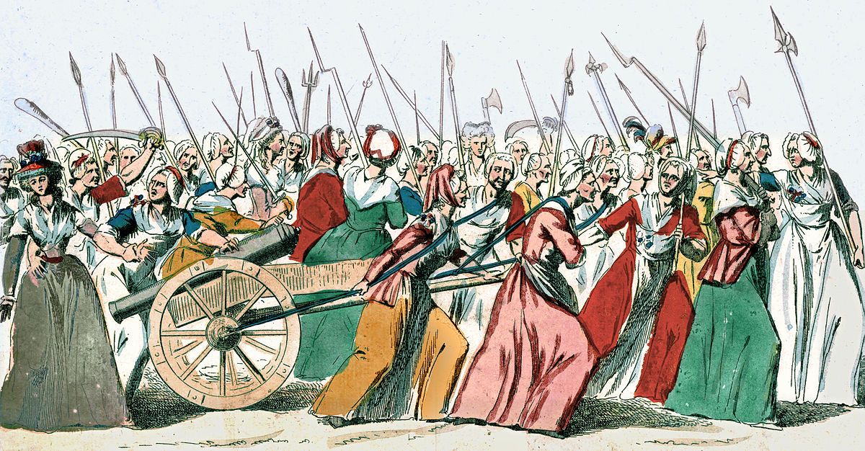
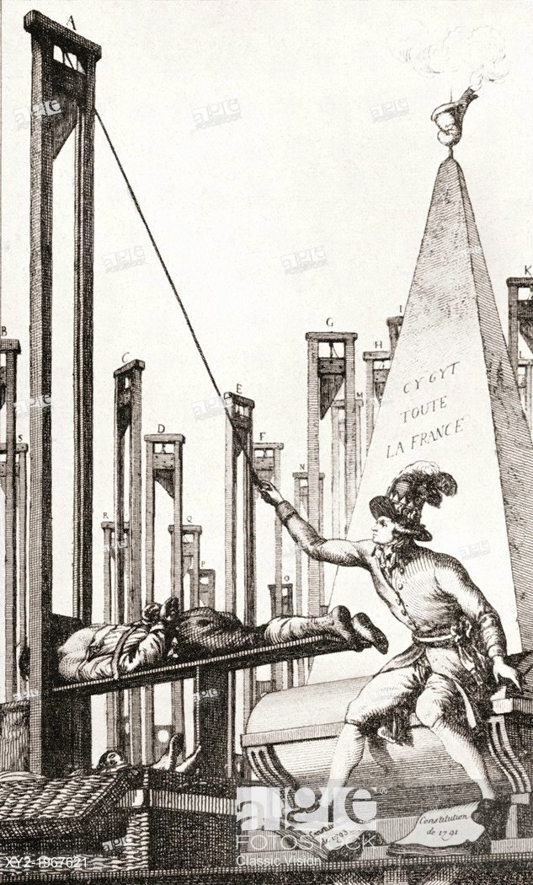
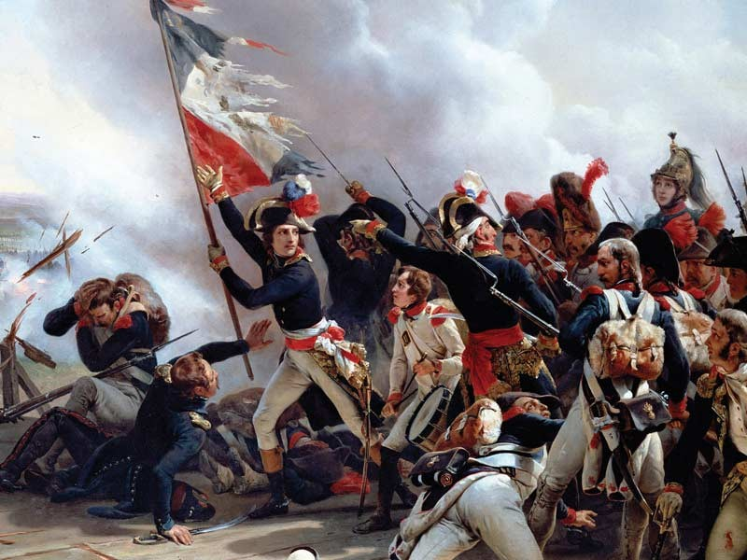
The French Revolution: 1789-1799

Slide 4
French Revolution
It started in:
1789

Slide 5
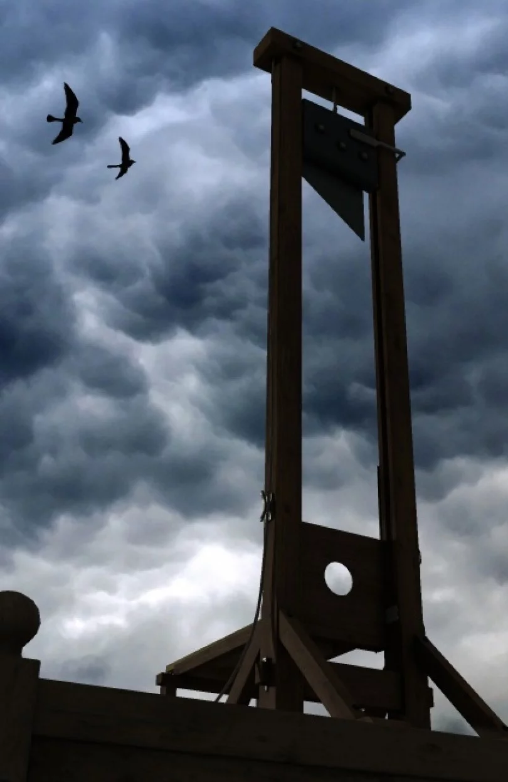
French Revolution
We are going to learn about the French Revolution twice:
1st: very simple, not going into nuance
2nd: going much more in depth
We will do this because the French Revolution is quite complex and can be very difficult to understand.

Slide 6
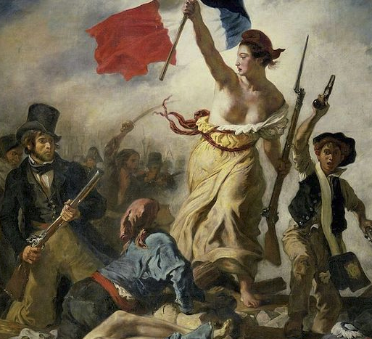
Notes: Coming of the French Revolution
French Revolution (1789): the overthrow of the French Monarchy and the establishment of a democratic republic.
Inspired dozens of revolutions in the following 150 years.
The most extreme revolution that had occurred up to that point in history.

Slide 7
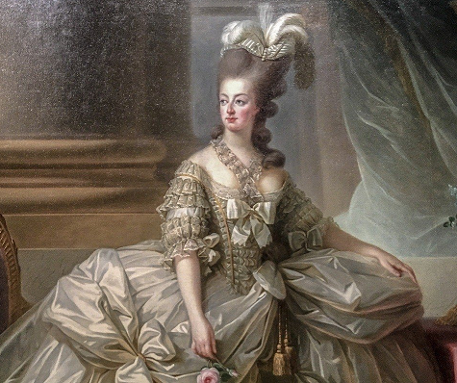
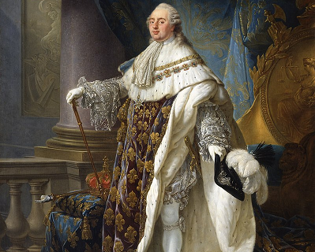
Notes: France 1789
In 1789, France was a very unequal country.
King Louis XVI and his wife, Marie Antoinette, were fabulously wealthy
They lived in the Versailles, a palace famed as the most expensive building on Earth.

Slide 8
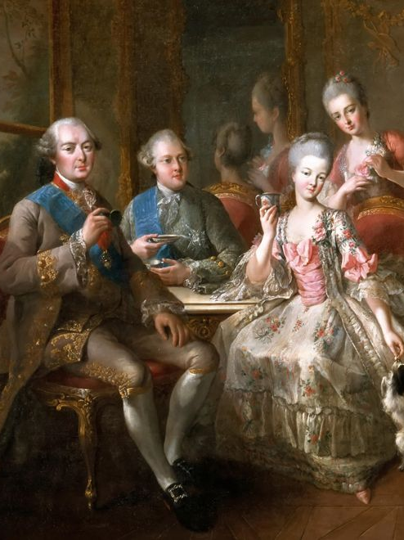
Notes: France 1789
Surrounding the King and Queen were almost 350,000 Nobles.
The Nobles were born from important families with special positions in government.
The Nobles did no work, paid no taxes, and took most of their money from the lower classes.

Slide 9
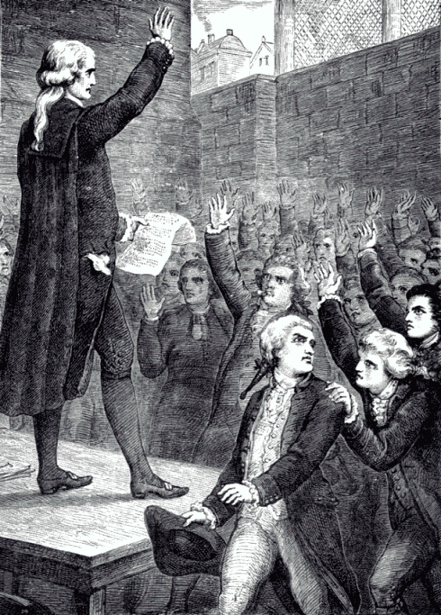
Notes: France 1789
Then there were the middle class bourgeoisie.
They were educated, successful, and wealthy
But they were held back because they did not have noble titles.
They had to pay most of the taxes

Slide 10
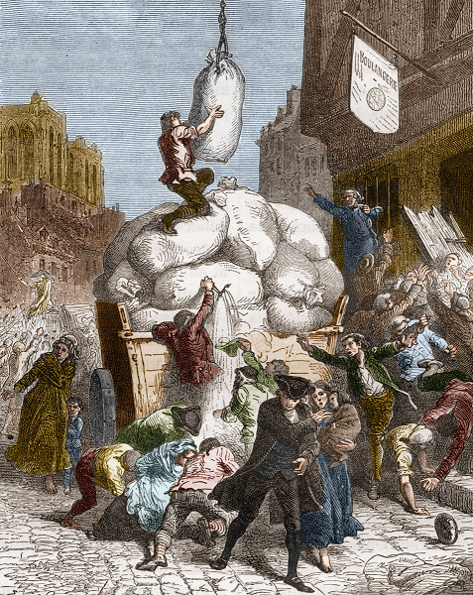
Notes: France 1789
At the bottom were the peasants and urban poor.
Mostly poor and uneducated
For 10 years, they had been struggling to get enough food.
Both they and the bourgeoisie looked at the nobles jealously

Slide 11
Notes: Three Estates
The whole country was divided into three “estates”
1st Estate: Priests
2nd Estate: Nobles
3rd Estate: Everyone Else
The 3rd Estate was 97% of the population
Priests
Nobles
Everyone Else
Peasants
Urban Poor
Bourgeoisie

Slide 12
Notes: What was unequal?
The 3rd estate paid taxes to:
the 1st estate
2nd estate
the government.
The 1st and 2nd estate paid almost no taxes
About 70% of 3rd estate lived in crushing poverty.
Priests
Nobles
Everyone Else
Peasants
Urban Poor
Bourgeoisie

Slide 13
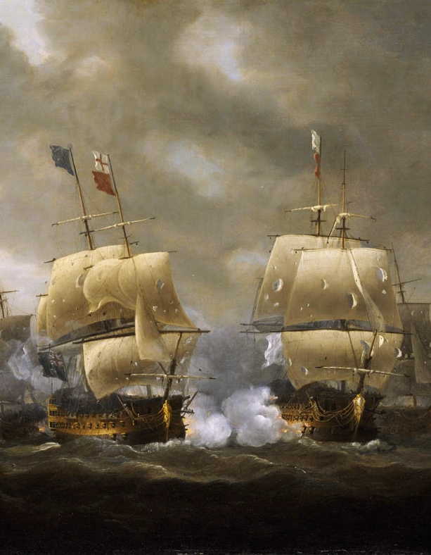
Notes: French Debt Crisis
By 1789, France had a huge debt problem.
France had been fighting Britain on and off for 100 years.
Wars are expensive
The government could not pay off its debt.

Slide 14
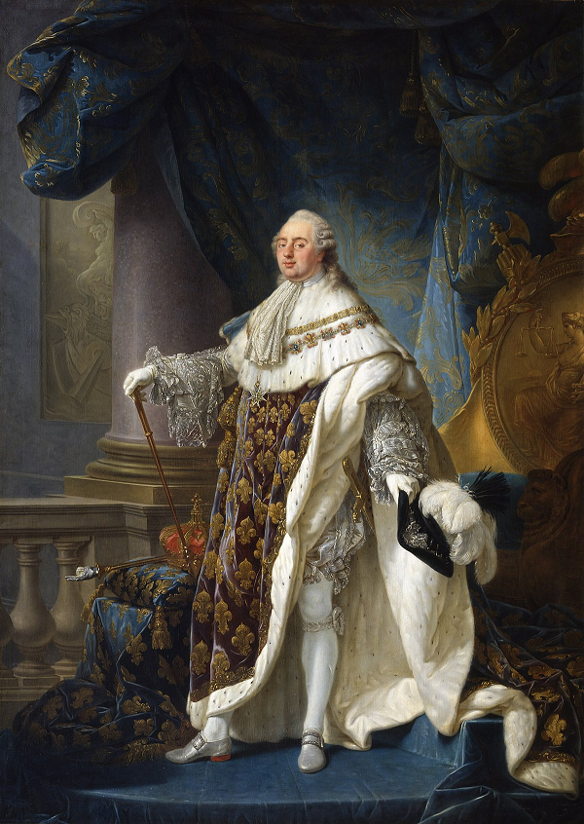
Notes: French Debt Crisis
The French King, Louis XVI, tried many times to get enough taxes to pay off the debts.
The problem was that most of the country’s money belonged to nobles and priests, who didn’t pay taxes.

Slide 15
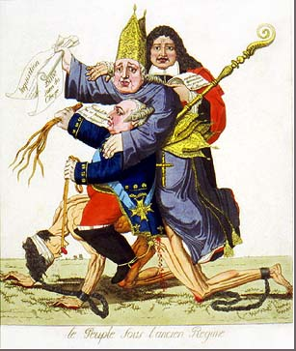
Notes: French Debt Crisis
By 1789, France was approaching financial ruin and bankruptcy and the King was desperate for solutions.
People in every estate were talking about how to fix France
This was the chance for revolution.

