Slide 1
Warmup 2/4
What’s wrong in France in 1789?
What reasons did people have to be upset at the government?
Turn in your 4 assignments if you haven’t already

Slide 2
Logistics
Quiz remakes available before or after school.
We don’t have NEST time this week
Turn in your 4 assignments if you haven’t already
Course Selection

Slide 3
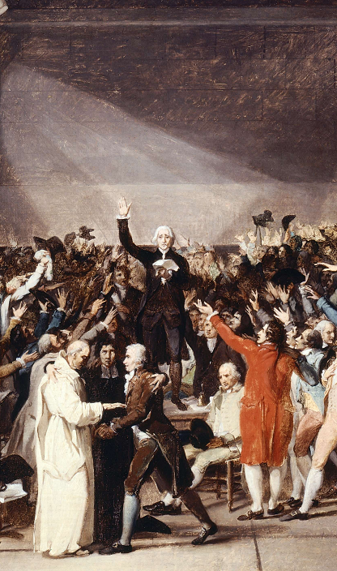
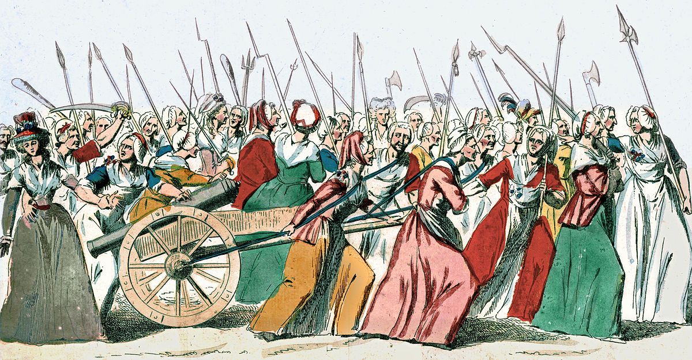
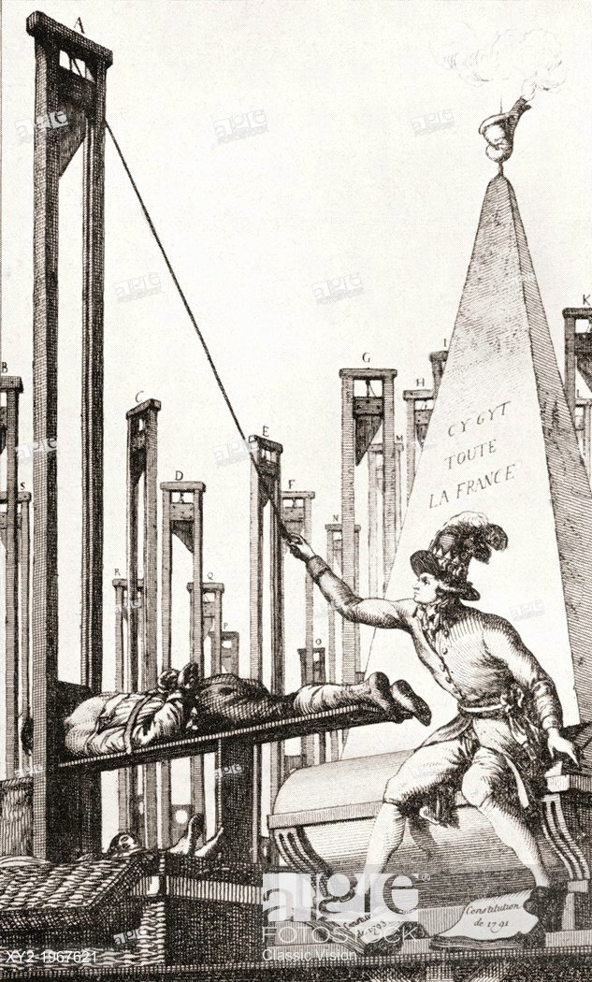
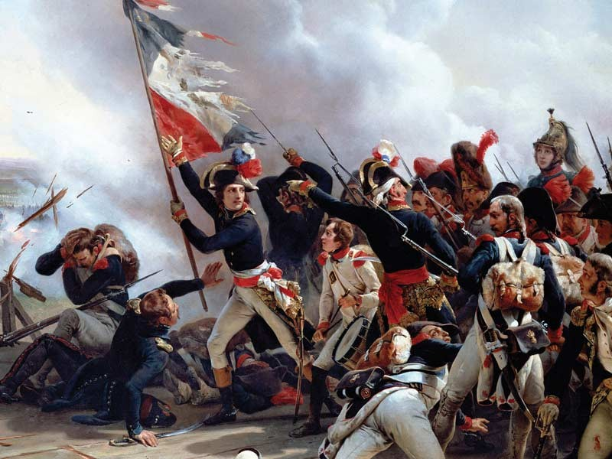
French Revolution

Slide 4
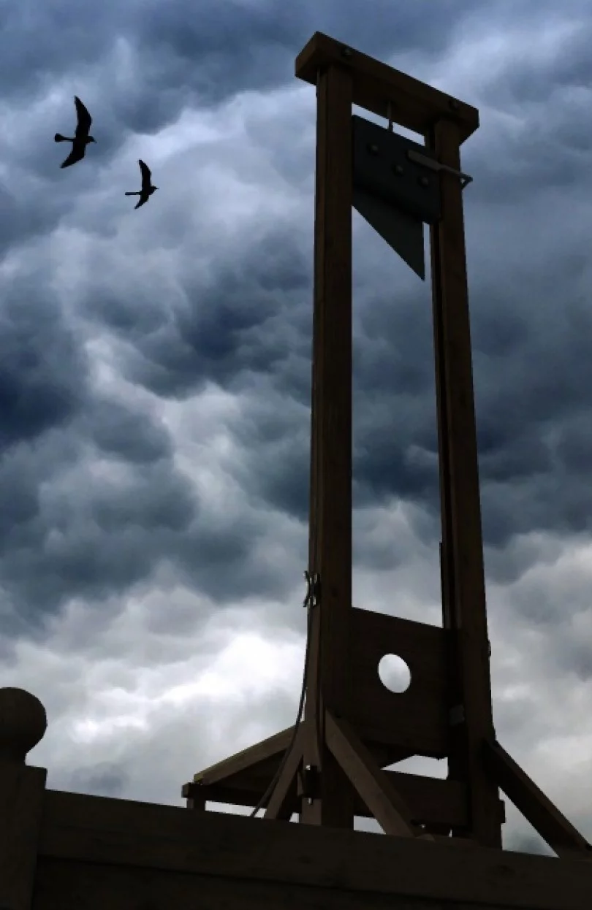
French Revolution
We are going to learn about the French Revolution twice:
1st: very simple, not going into nuance
2nd: going much more in depth
We will do this because the French Revolution is quite complex and can be very difficult to understand.

Slide 5
Notes: Key People and Terms
King Louis XVI: the king of France, killed in the third year of the revolution.
Maximillian Robespierre: the radical leader of France during the Reign of Terror. Killed in the fifth year.
Napoleon Bonaparte: French General. Ends the revolution, becomes Emperor, and conquers most of Europe.
Bourgeoisie: the middle class and wealthy who were not nobles.

Slide 6
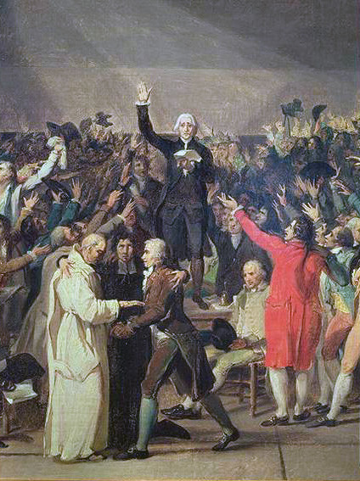
Notes: Estates General
Priests
Nobles
France had huge debt problems in 1789
A massive meeting was called known as the Estates General
All three Estates present: priests, nobles, and third estate
Third Estate represents 97% of France but get the same voting strength as the 1st and 2nd estates.
The 3rd Estate feels cheated and revolts, forming their own government.
Everyone Else
Peasants
Merchants
Bourgeoisie

Slide 7
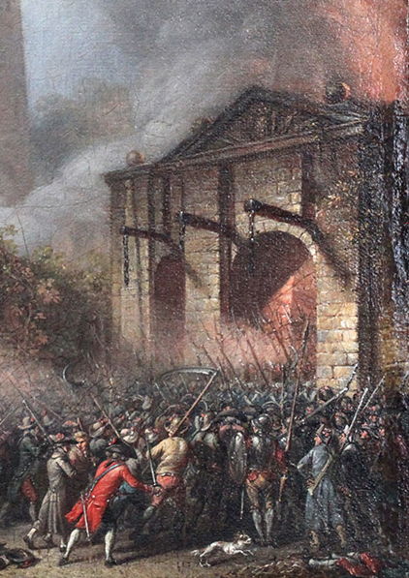
Notes: Revolution!
The Storming of the Bastille: The King’s prison is attacked by the people of Paris.
They attack the Bastille in support of the new revolutionary government.
King Louis considers fighting against them but popular support for the revolution convinces him to accept the new government.

Slide 8
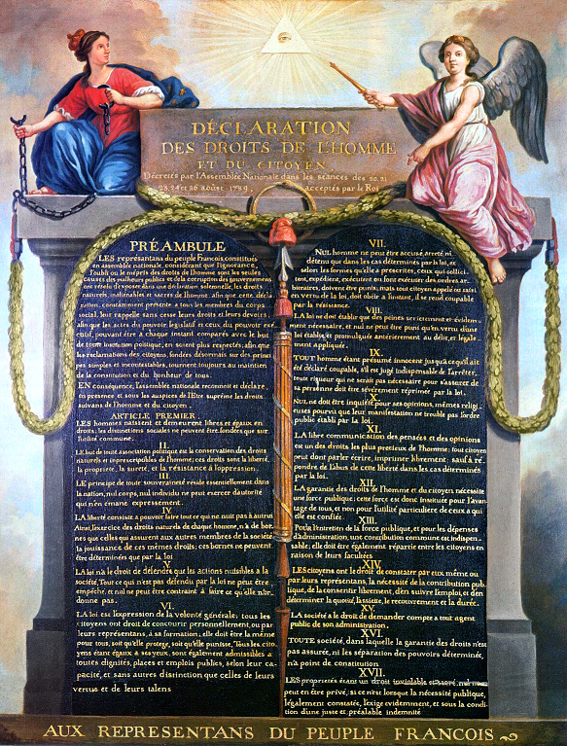
Notes: Triumph of Freedom
The Revolutionary government takes over
France ends feudalism.
The Declaration of the Rights of Man and Citizen establishes rights for all people in France.
The First French Constitution establishes a moderate government similar to the US government.
The King goes along for a while but eventually tries to flee

Slide 9
Notes: the Reign of Terror
1793-1794
Revolution becomes increasingly radical
In 1793, the monarchy is brought to an end and a republic is established
King Louis XVI is executed
His wife, Marie Antoinette, is executed the following year
Robespierre and his friends in the Committee of Public Safety take over the government

Slide 10
Notes: the Reign of Terror
The Revolution turns against those who don’t support it.
Those who resist are executed
Fair trials are cancelled, witnesses are not heard.
16,000 are executed in 13 months.
Eventually people grow sick of the new government and execute them.

Slide 11
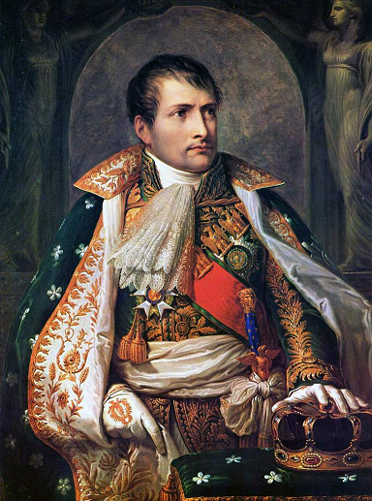
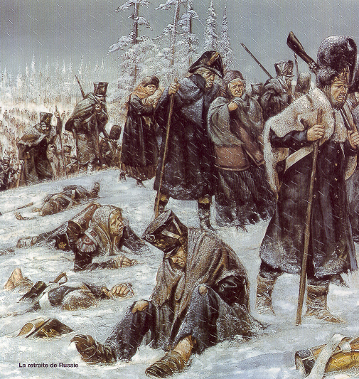
Notes: Napoleon
In 1799, a French General, Napoleon, takes over the government.
Napoleon turns France into an Autocracy
Keeps some of the rights of the revolution but discards others.
France conquers most of Europe
The ideas of the revolution are spread by Napoleon’s army.
Napoleon eventually defeated and exiled

Slide 12
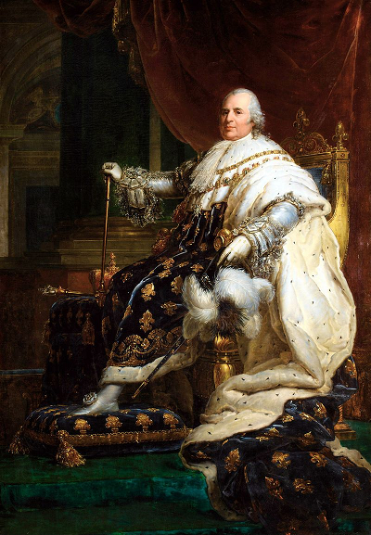
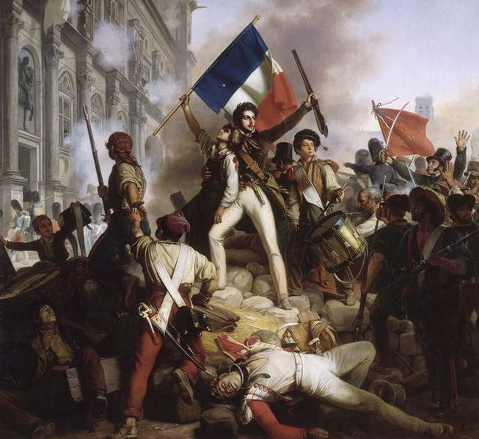
Notes: After Revolution
France becomes a monarchy once more
King has even more power than before the revolution.
France needs two more revolutions before the King is finally overthrown for good in 1871.

Slide 13
Assignment: French Rev Discussion
You will be assigned into small discussion groups.
You will have to work as groups to answer 4 questions.
Your final answers will be written on a worksheet
Each person must take a turn recording the final answer.

Slide 14
Question 1:
What changed about the government during the Reign of Terror?
Sub Questions:
What was the French government like before the Reign?
What was it like after?

Slide 15
Question 2:
Which forms of government were at some point true of France during the Revolution?
Sub Questions:
During what time was each government functioning?

Slide 16
Question 3:
How did “the people” get control of France during the Revolution?
Sub Questions:
What events gave them control?
Why did the King give up power?

Slide 17
Question 4:
Why didn’t the revolution stop with the first government? Why did the Reign of Terror take place?
Sub Questions:
Why wasn’t the first government able to keep control?

