Slide 1
Warmup 9/19
Define the following:
Inequality
Prejudice
Micro-Aggression
Income
Wealth

Slide 2
Income Inequality

Slide 3
Extreme
Poverty
Poverty
Working Class
Middle Class
Upper Class
Top 1%
Take out Library books
Public Schools
Vote in all states
Public Transit
Would not starve
Can buy used clothes
Used car, bad condition
Coffee, etc.
Always enough food
Children can apply to any college
Rent in poor areas
College if kids take loans
Restaurant once a month
Reasonably priced new car
Family provides economic support.
Dental Care
Afford to move
Own property in Kent, Renton
Basic Medical care
Club sports
College debt-free
House in Seattle etc.
Boat in a marina
Vacation 2x a year
Private School
Vacation home
Luxury cars

Slide 4
Wealth vs Income
Income: how much money you make
Wealth: how much money you have
Wealth inequality tends to be more severe than income inequality

Slide 5
Wealth Distribution
We often calculate wealth distribution by 20% chunks of the population called quintiles:
The wealthiest 20%
The second wealthiest 20%
The middle 20%
The second poorest 20%
The poorest 20%

Slide 6
Wealth Distribution
The charts look like this:

Slide 7
Key things
US Gross National Income 2017: $19.1 Trillion
US Households: 126.22 million
Equal Income Distribution: $151,323
US Poverty Line for family of 4: $26,000

Slide 8
Chart 1: Equal Distribution
First chart is easy
Make a horizontal line at $151,323
This would be what America would look like with everyone making the same amount

Slide 9
Extreme
Poverty
Poverty
Working Class
Middle Class
Upper Class
Top 1%
Take out Library books
Public Schools
Vote in all states
Public Transit
Would not starve
Can buy used clothes
Used car, bad condition
Coffee, etc.
Always enough food
Children can apply to any college
Rent in poor areas
College if kids take loans
Restaurant once a month
Reasonably priced new car
Family provides economic support.
Dental Care
Afford to move
Own property in Kent, Renton
Basic Medical care
Club sports
College debt-free
House in Seattle etc.
Boat in a marina
Vacation 2x a year
Private School
Vacation home
Luxury cars

Slide 10
Chart 1 Discussion
Turn and talk:
Would this be a good thing?
Why?
Turn and talk:
Should some people make more money than others?
How much more?

Slide 11
Chart 2: Ideal Distribution
Now you are going to make a chart that represents the ideal distribution of income.
Remember: to increase one side of the line, you have to decrease the other.
Questions to think about:
How much money should the poorest 1% be making?
The poorest 10%?
Where should the middle be?
How much more than the middle income should the wealthiest 10% be making?
How much more than the middle should the wealthiest 1% be making?

Slide 12
Chart 2 Discussion
Share chart with another group:
How similar are your charts?
What makes your chart ideal?

Slide 13
Chart 3: True Distribution
Now you are going to make a chart that you think is accurate to how the US income is distributed.
Don’t look it up. Try to estimate. Do you think it is more equal then the ideal or less equal? By how much?
Questions to think about:
Do you think the poor make more or less than you put on your ideal chart?
What % of Americans make more than that equal distribution point of $151,000?
How much greater is the wealth of the top 10% than the middle? The top 5%? The top 1%?

Slide 14
Chart 3 Discussion
Share chart with another group:
Why do you think this is accurate?
This isn’t ideal (otherwise it would be your ideal chart) so what isn’t ideal about it?

Slide 15
Video
Watch me!

Slide 16
Chart 4: Actual
Mr Best will guide you through the actual chart.

Slide 17
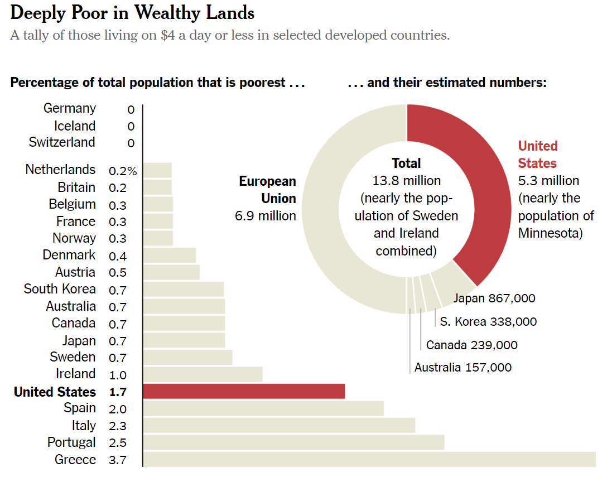

Slide 18
Final Discussion
Turn and talk
Do you think this is okay? Why? Why not?
Answer the same question in the final box on your worksheet

