Slide 1
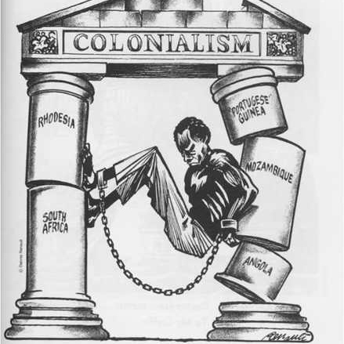
Decolonization
Decolonization: the process of gaining independence by former imperialized countries.
Took place from the 1940-70s

Slide 2
Decolonization
Background we will need:
Nationalism
The World Wars
The Cold War

Slide 3
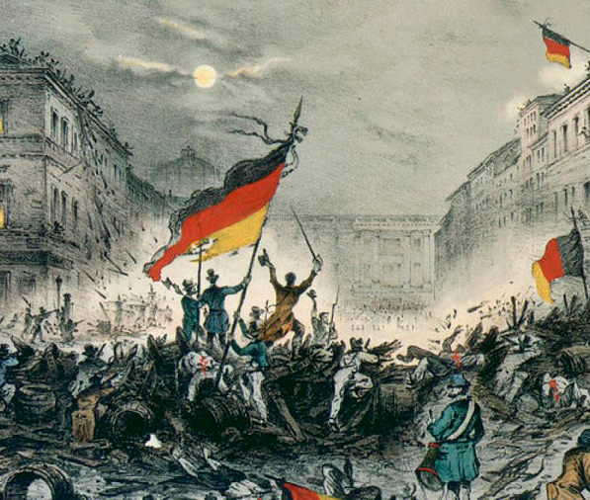
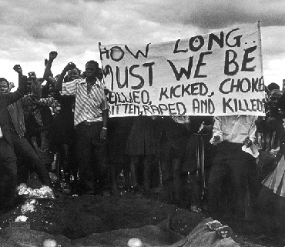
Nationalism
Nationalism is the identification with your nation (ie. American) and support for its interests.
Chief among them is independence and unity.
Nationalism emerged in Europe after the French Revolution.
By the 1910s it had spread throughout the European empires.
For the moment, the protests were contained almost everywhere.

Slide 4
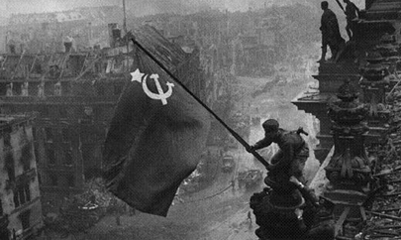
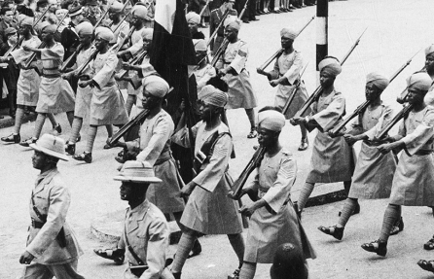
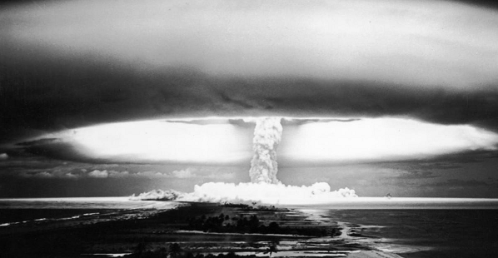
The World Wars
From 1914-1945, the industrial countries of the world dragged their empires into their wars.
Millions served. 150,000 Indian soldiers died fighting for their colonial overlords. Perhaps as many as a million Africans.

Slide 5
The World Wars
The second world war especially was billed as the fight of liberty against tyranny.
But when they came home, they found themselves back under the control of colonial tyranny.
Nationalism and independence movements gain incredible power after 1945

Slide 6
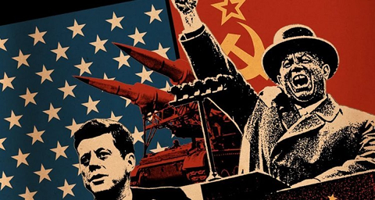
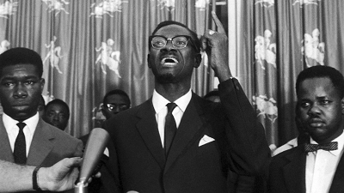
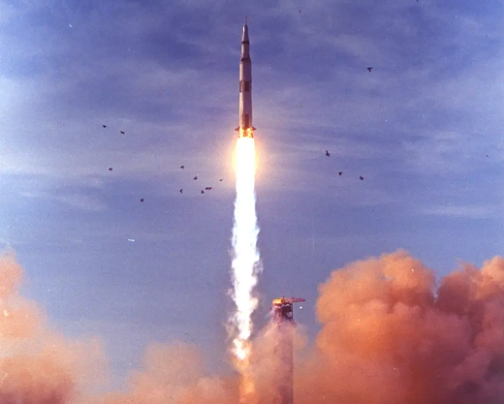
Cold War
After the wars, the world became dominated by the rivalry of the United States and the Soviet Union.
The Soviets condemned imperialism while America found itself helping its European allies retain their empires.
Many freedom fighters turned to the Soviets and their communist allies for support.

Slide 7
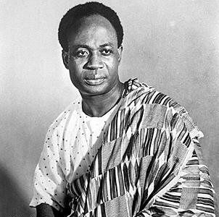
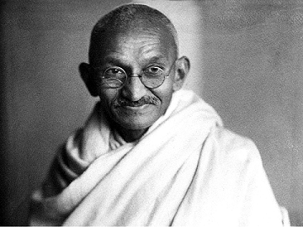
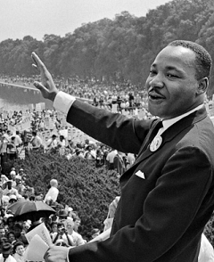
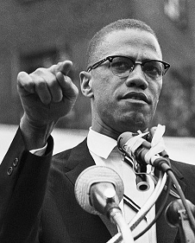
Nationalism
In the 1940s and 1950s, the peoples of the empires began to demand their independence.
This belonged to a global civil rights movement that sought to bring an end to the racist abuses of the last centuries
Meanwhile in Europe, devastated by war, people began to lose interest in policing unruly empires

Slide 8
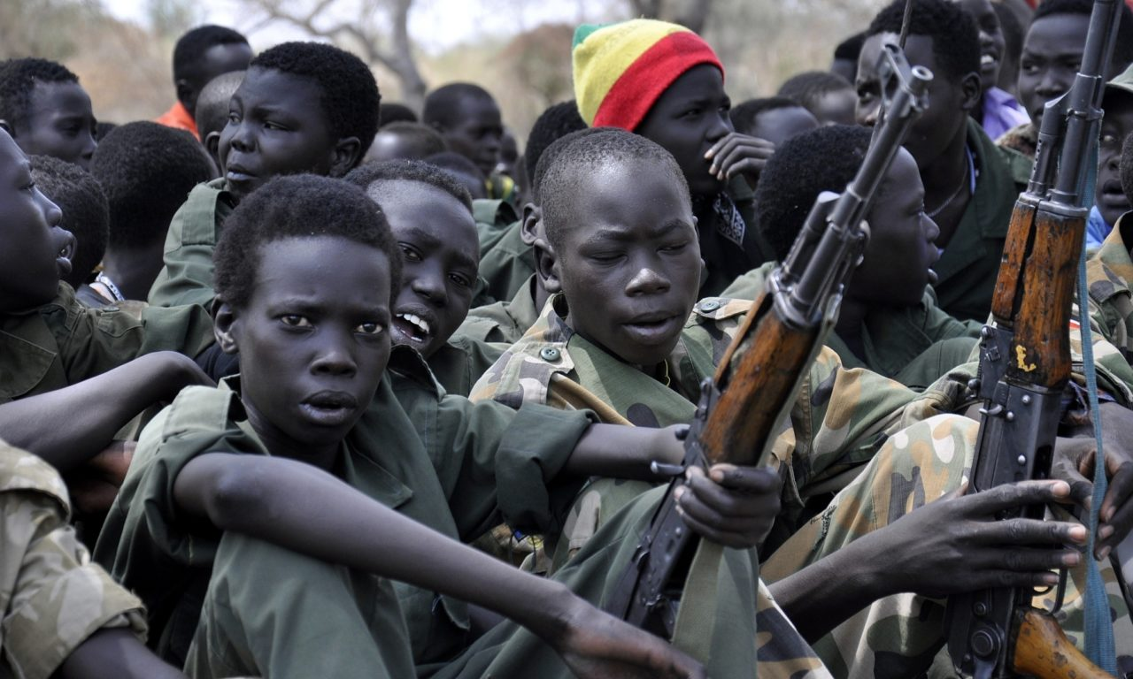
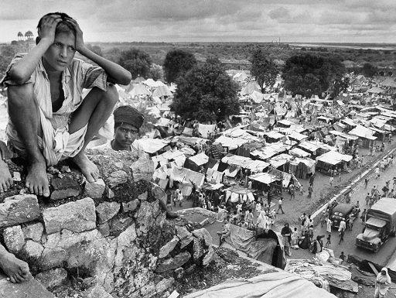
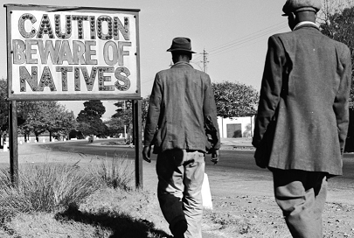
Process of Decolonization
The outcomes of decolonization varied dramatically.
A handful of countries emerged mostly unscathed.
Many were left with deep problems that would leave them in ruin for decades.
All were left with Western in positions of power.
Some really weren’t decolonized at all.

Slide 9
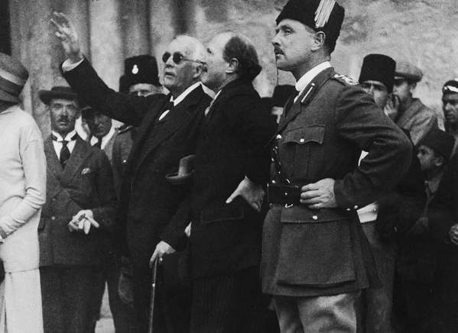
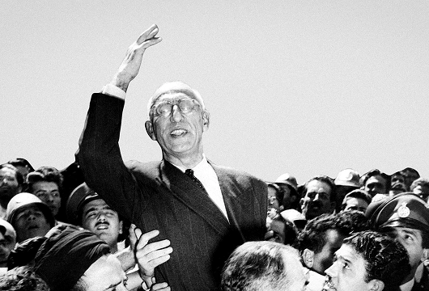
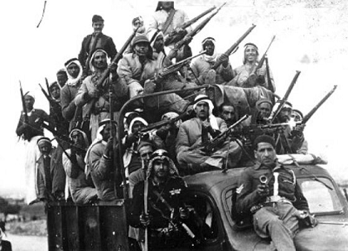
Middle East: 1940s
Middle East was freed from the Ottoman Empire from 1880-1918 only to be added to European Empires.
Few were under European control for more than 50 years, some less than 10. Most free by 1950
Europeans used this transition period to install European companies into power
Europe and USA still interfere with these countries to assure the flow of oil.

Slide 10
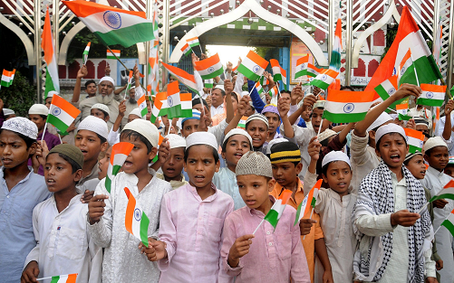
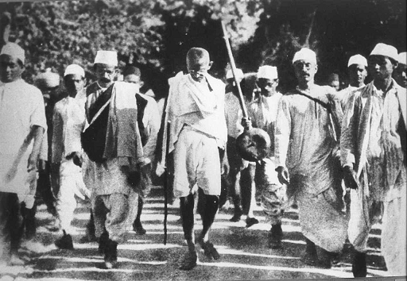
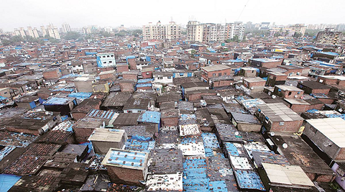
India: 1947
During WW2, pressure from Indian nationalists grew to an irresistible level.
Shortly after the war, Britain granted India independence.
India was one of the strongest countries that emerged from imperialism but still had problems.
Enormous inequalities and a weak economy were left over from British rule.

Slide 11
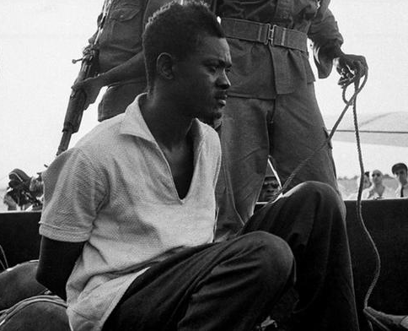
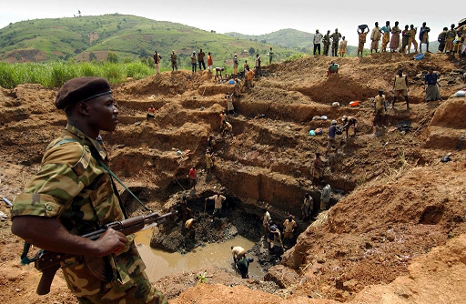
Africa: 1956-1980
Europe maintained economic control of Africa while surrendering political control
African countries were abandoned with no realistic plan for political stability
They exploded into civil war, were taken over by dictators, and bled dry by the same European companies that had ruled under the empires.
Only in the last 20 years has Africa started to really recover.

