Slide 1
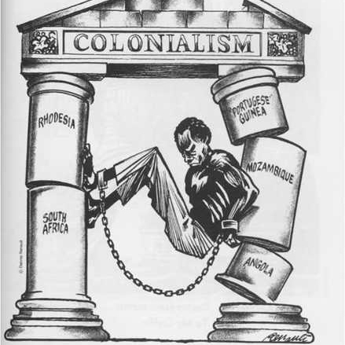
Decolonization of Africa
Africa was the last major region to be decolonized.
Decolonization of Africa took place from 1956-1980.
In 1956, two countries controlled almost all of Africa: Britain and France

Slide 2
Pressures to Decolonize
African Nationalism put enormous pressure on imperial governments
US government pressured its allies to decolonize
Soviet Union support provided the threat of communist revolts
Civil Rights movement drew international attention
European citizens thought the empires too expensive

Slide 3
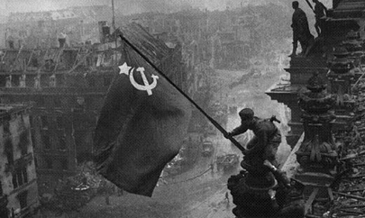
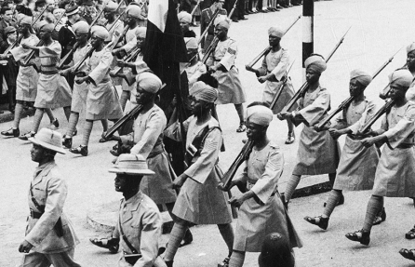
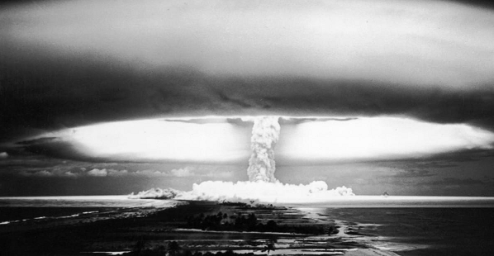
Background: WW2
African soldiers returning from Europe after World War 2 were well trained and highly political.
Many had served among European soldiers as equals.
Now they were asked to return to Africa as second-class citizens.
Countries demanded their independence but were denied.

Slide 4
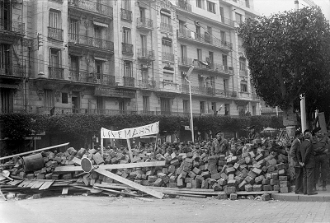
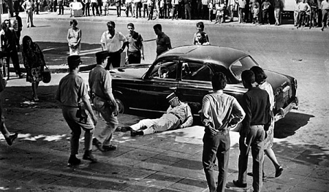
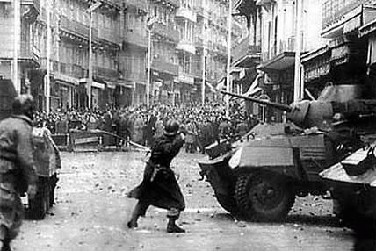
Background: Algeria
In 1954, this conflict erupted into the Algerian War.
Tired of oppression under the French, Algerians rose up to overthrow them.
Despite pressure from America, France decided to violently fight this war.
It was very bloody. 250,000 were killed over the 7 year conflict.
Fear of this repeating in other colonies further pressure Europe to decolonize.

Slide 5
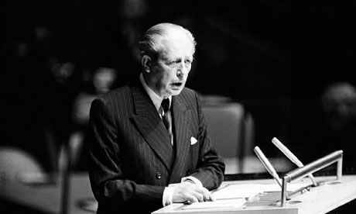
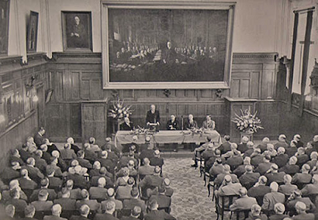
The Winds of Change: 1960
In 1960, things were too much for the empires to hold on anymore.
The British Prime Minister, Harold McMillan, delivered the Winds of Change Speech
The message was clear, Britain was giving up on its Empire.
France quickly followed suit.

Slide 6
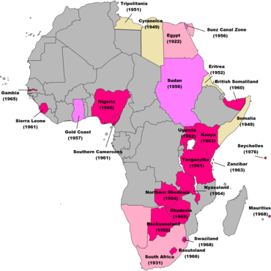
British Decolonization: The Spider Web
Britain decolonized rapidly from 60-66
But only British officials left.
British companies, and the corrupt local collaborators stayed.
Britain set up tax-haven islands and established a secretive offshore banking network that still funnels away tens of billions of dollars every year.

Slide 7
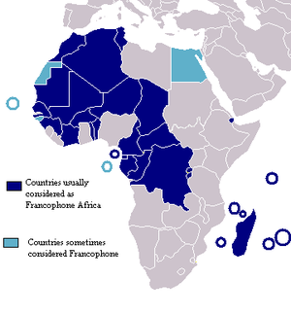
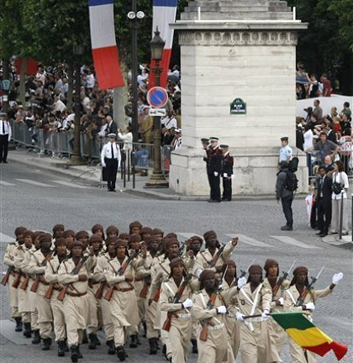
French Decolonization: Window Dressing
France officially decolonized even more rapidly than Britain.
But France never really left. French colonial administrators and financiers continue to exercise significant power even to this day.
Like British colonies, former French colonies are dominated by French companies.

Slide 8
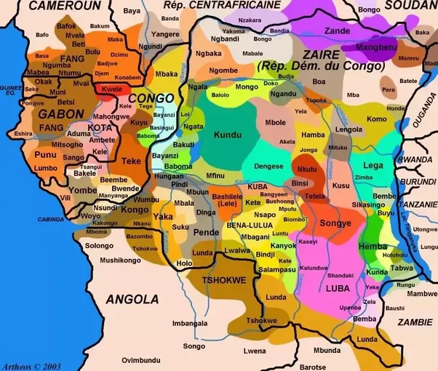
Problem 1: Bad Borders
Europe drew Africa’s borders without knowing what they were doing.
Nations are put together or split up almost at random.
This has made it very difficult for African countries to build national unity.
Hundreds of civil wars and separation movements have been created by this problem.

Slide 9
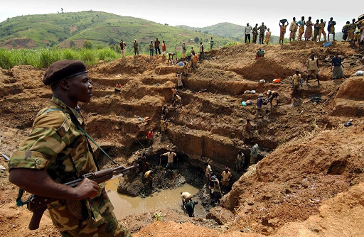
Problem 2: Foreign Ownership
Most African resources (mines, etc) are still owned by foreign companies.
Most money does not stay in Africa.
Europe, America, and China still benefit from Africa’s resources more than Africa does.
Attempts to change this are frequently suppressed by covert actions from Europe and America

Slide 10
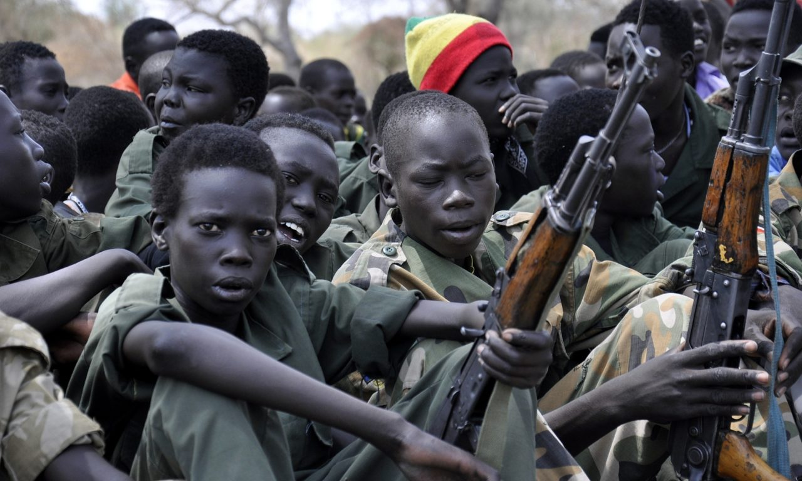
Problem 3: Political Instability
The suddenness and indifference with which Europe decolonized Africa left a power vacuum.
That power vacuum was filled by warlords, militias, religious fanatics, and rebel armies.
Many African countries have struggled to find lasting peace or political stability.

Slide 11
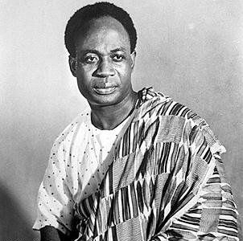
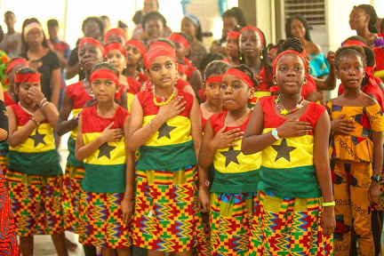
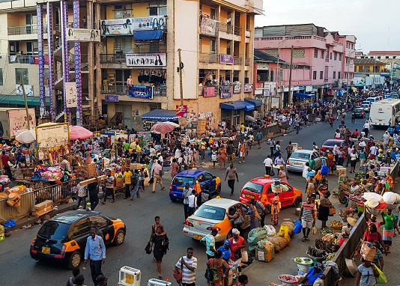
Case Study: Ghana
Ghana gained its independence in 1956
It’s leader, Kwame Nkrumah, was a hero of African Nationalism
Once free, he took bold action to break the power of the British-loyal elites
In 1966, he was overthrown by a military coup, leading to an era of civil conflict and military rule that did not end until 1979.
Despite this, Ghana has remained reasonably stable and successful.

Slide 12
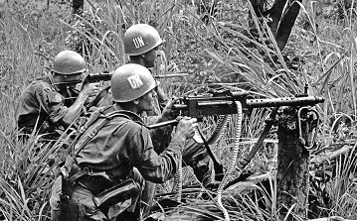
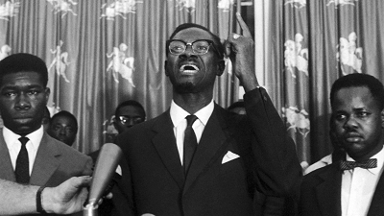
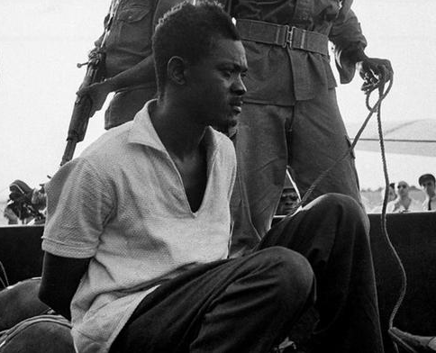
Case Study: Congo
The Congo gained its independence from Belgium in 1960.
It was a troubled country, with many problems to fix.
Its prime minister, Patrice Lubumba, asked the USA for help but was denied
He turned to the Soviet Union
America’s CIA supported a coup. Lubumba was tortured and executed

Slide 13
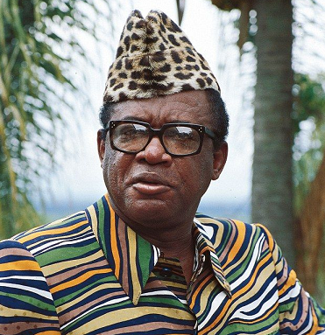
Case Study: Congo
The new ruler, Mobutu, was a brutal dictator but enjoyed US support.
He killed political rivals, took Congo’s wealth for himself, and carried on a near genocidal culture war.
When he died in ‘97, Congo collapsed into the Congo Wars, which lasted 7 years and claimed 8 million lives—more than world war 1.
Even today, Congo remains divided.

Slide 14
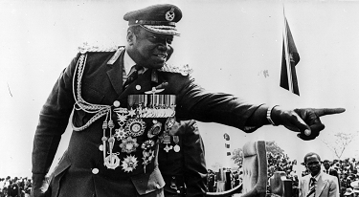
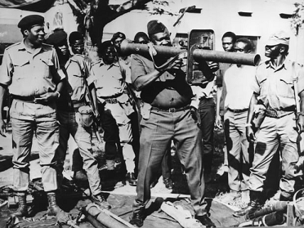
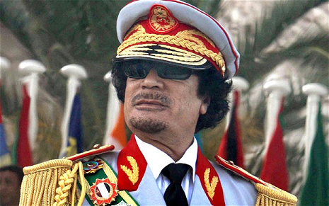
Dictators and Wars
In the wake of decolonization, without almost any support from the West, most African democracies collapsed.
Bloody civil wars of the 60s gave way to corrupt if not brutal military dictators
Almost all of these dictators had good relations with Europe and America because they kept communism away.

Slide 15
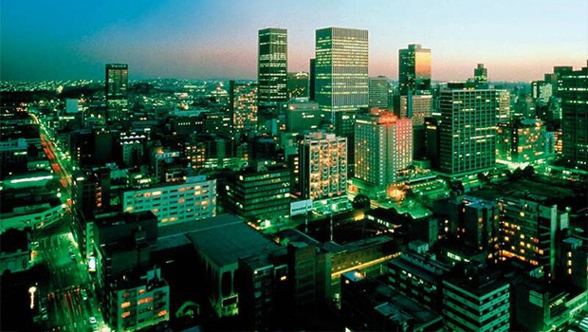
Africa’s Future
The era of the dictator has ended in much of Africa.
National unity has never been higher.
Democracy is growing throughout the continent.
Economic dependency on the West has been softened due to competition from China, India, and Korea

