Slide 1
Capitalism and Socialism
Things you are going to learn:
What is an economic system?
What is capitalism?
What is socialism?
How the two developed during the Industrial Revolution
Other kinds of related economies.

Slide 2
Notes: Economic System
An economic system describes how limited resources are produced and distributed in a society.
“Resource” in this context could be anything.
Iron, land, cell phones, medical care could all be “resources”

Slide 3
Older Economic Systems
Palace Economy: resources all given to the ruler, who then does with them whatever he/she decides.
Feudalism: a kind of palace economy
Mercantilism: government directs resources in a way to maximize accumulation of money by the state.

Slide 4
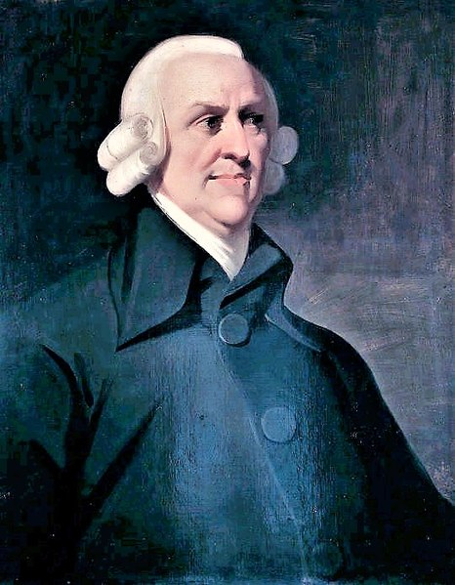
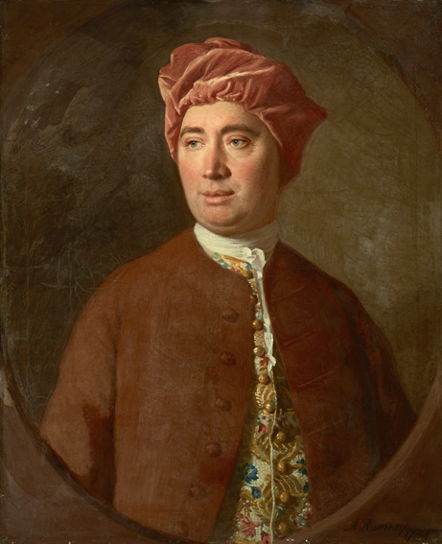
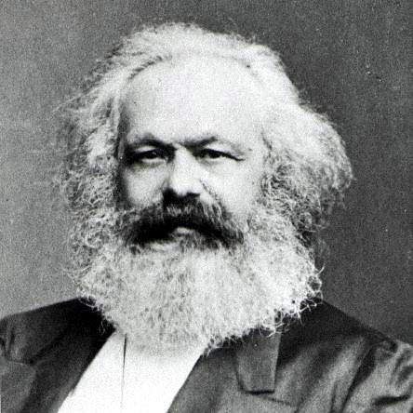
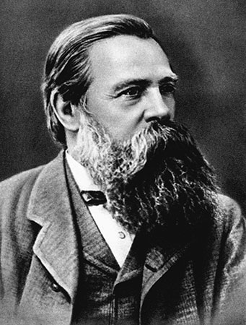
Notes: Capitalism and Socialism
Both political systems emerge during the industrial revolution.

Slide 5
Notes: Capitalism
Capitalism is an economic system based on:
People owning resources and production of the resources
Money
Resources distributed by how much people will pay for them.

Slide 6
Capitalism
Capitalism emerged in the 1750s-1770s
Advocated by David Hume and Adam Smith.
Was a reaction against the older Mercantilism, which put heavy restrictions on trade.
Capitalism based on the idea of no restrictions.
Adam Smith
David Hume

Slide 7
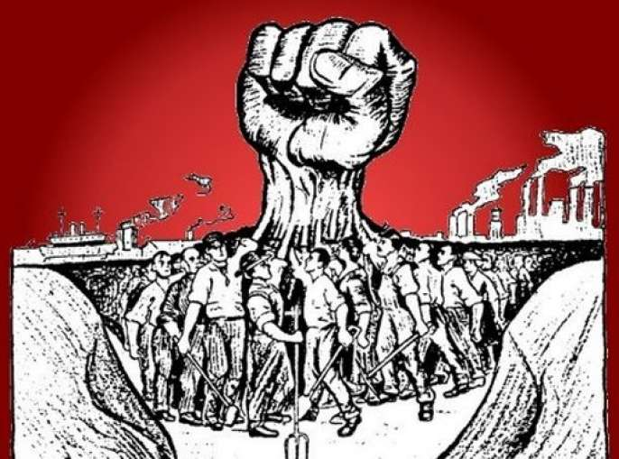
Notes: Socialism
Socialism is an economic system based on:
Common ownership of resources and their production
Resources distributed by democratic methods

Slide 8
Socialism
Socialism emerged in the 1860s-1890s
Advocated by Karl Marx and Friedrich Engels.
Was a reaction against the older capitalism.
Based on the idea of helping the poor who were suffering in the industrial revolution.
Karl Marx
Friedrich Engels

Slide 9
Notes: Mixed Economies
Almost all “socialist” economies on earth are actually mixed economies.
A mixed economy is a capitalist economy that redistributes wealth to reduce inequality and help the poor.

Slide 10
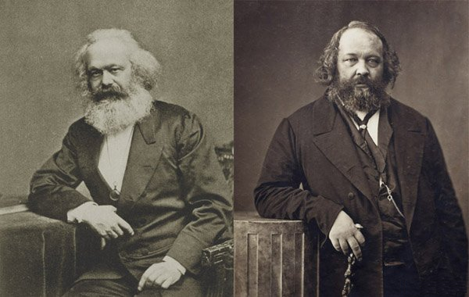
Notes: Communism
Communism is a economic system that tries to achieve a society that is both socialist and anarchist. With no:
Social Classes
Money
Government
Most people incorrectly use “communism” to refer to the economic model of the Soviet Union, which was “trying” to become communist.

