Slide 1
The End of the World War 1
The British were conquering most of the Ottoman Empire in cities like Jerusalem and Baghdad
Americans entered the War and were making a frontal assault on the Western Front
Russia left the war due to the Bolshevik Revolution
Transition from Czars to Communism
Austrians army was plagued by desertion

Slide 2
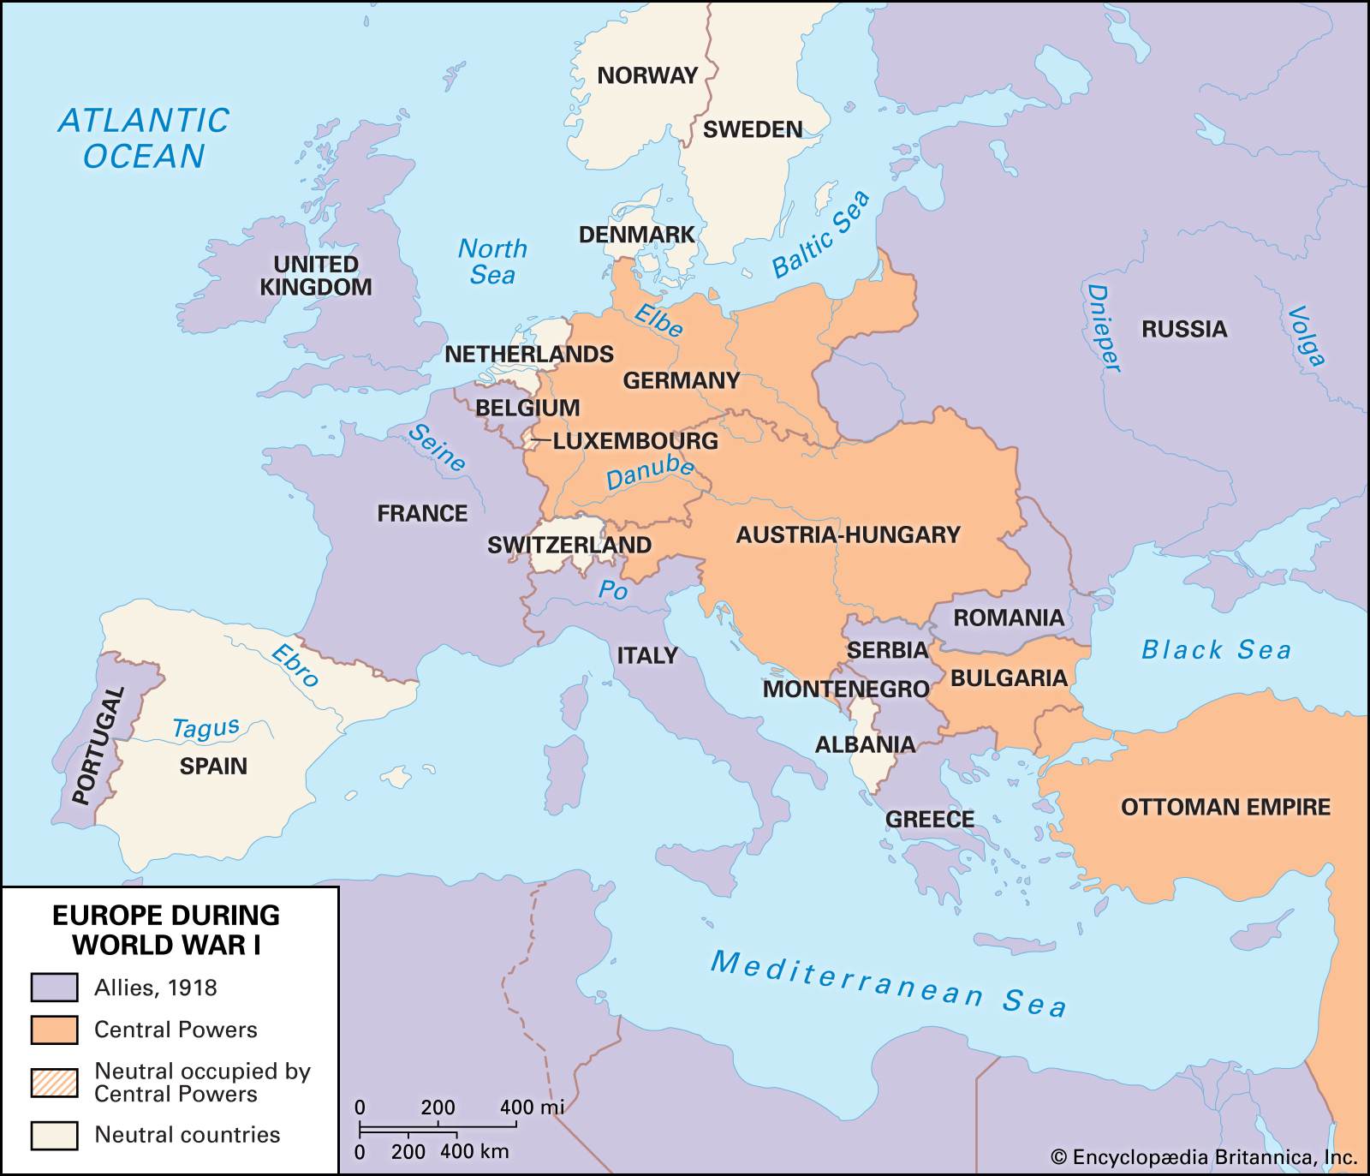
Armistices
Bulgaria on Sept 29, 1918
Ottomans on October 30
Austria Hungary on November 3
Germany on November 11th

Slide 3
Armistice Day
Revolts to abdicate Kaiser Wilhelm from the throne
Food Shortages
Prolonging the War
King commanded the army to turn against the people, but the army refused.
Armistice Day is on November 11th
Known in the U.S as Veterans Day

Slide 4
Allies objectives to the Treaty of Versailles
French wanted to protect themselves from a future German attack and large amount of reparations to be paid to limit Germanys economy
Britain wanted to rebuild Germany to establish a strong trading agreement
Italy wanted to expand its influence and land

Slide 5
Wilsons 14 points
Open Diplomacy
Freedom of the Seas
Removal of economic barriers
Reduction of armaments (weapons)
Adjustment of colonial claims
Conquered territories in Russia
Perseveration of Belgian sovereignty
Restoration of French Territory
Redrawing of Italian frontiers
Division of Austria- Hungary
Redrawing the Balkan boundaries
Limitations in Turkey
Establishment of an independent Poland
Creation of associations of nations (League of Nations)

Slide 6
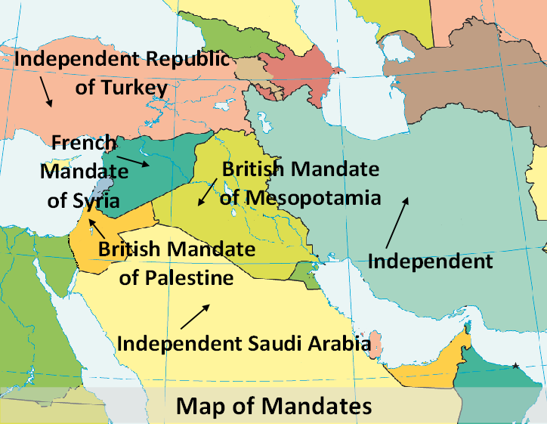
Ottoman Empire Collapse
Treaty of Serves
Military and Economic Restrictions
Lost all of their land in the Middle East to British and French mandates
Syria, Lebanon, Jordan, Israel, Palestine, Kuwait, and Iraq
Republic of Turkey were able to regain some Turkish lands after small wars of Independence versus the Greeks and Armenians
Armenia

Slide 7
Austria Hungary Collapse
Austria-Hungary monarch collapsed due to various nationalist movements
Broke up into
Austria
Hungary
Poland
Czechoslovakia
Yugoslavia

Slide 8
Baltic States
Conquered Territories of Russia had to be restored and formed the Baltic States
Estonia
Latvia
Lithuania

Slide 9
Treaty of Versailles
Germans were surprised
Thought the 14 Points were the basic of the treaty
Article 231: Germany to accept full responsibility for starting World War 1 and to pay reparations for the allies’ war losses
Give up 10% of their territory and all overseas territories.
Reduce their military, by limiting navy and army and to close down the air force
Require war crimes vs Kaiser Wilhelm

Slide 10
Repartions
The reparations that Germany had to pay was 132 Billion Reichsmarks which is equivalents to 33 Billion US.
Germany had a hyper-cash inflation after the War
Kaiser suspended the gold standard in currency to pay for the War
Borrowed money, believing that he could pay back after the winning the war with reparations and supplies

Slide 11
Treaty was a Betrayal to the German people
German people felt outraged and betrayed by the treaty
Radical right-ring political party emerged and promised to revenge the humiliation of the treaty of Versailles
The National Socialist Germans Worker Party (Nazis)
Hitler said “He saw November 1919 as a betrayal and a turning point that had to be avenged”

Slide 12
Aftermath effects from World War 1
End of Monarchies
End of Colonialism/Imperialism
Change the face of Modern Warfare
Open to new political ideologies
Communism, Fascism
Influenza (Spanish Flu)
Social Changes (Women Rights)
League of Nations

