Slide 1
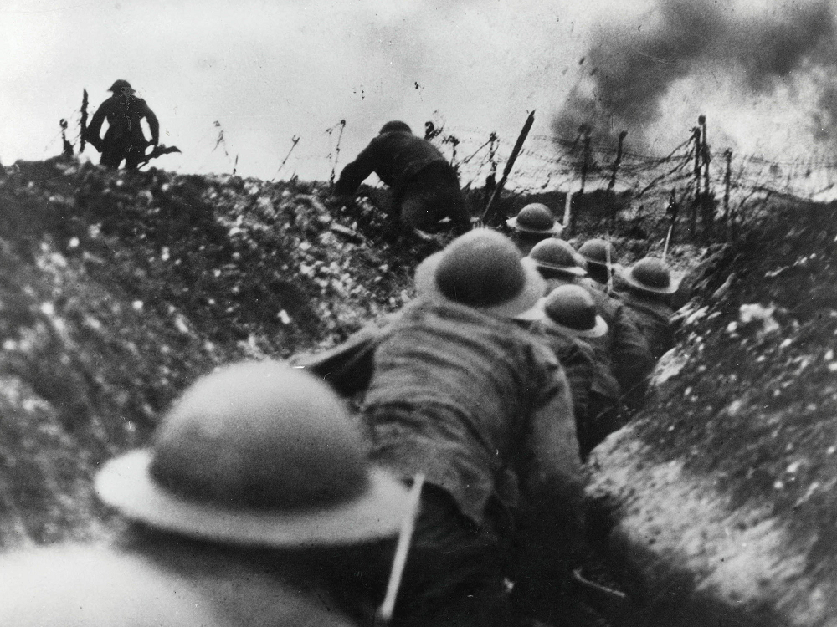
Notes: Europe on the Brink of war
There were 4 major points of tension in Europe leading up to the war:
French Revanchism
Alliances
Anglo-German Arms Race
The Balkans

Slide 2
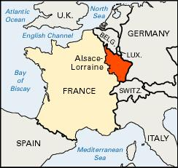
Notes: French Revanchism
Revanchism is a political policy of revenge.
In 1871, Germany had taken the provinces of Alsace and Lorraine from France.
French nationalists were obsessed with recovering them and avenging the humiliating defeat of 1870.

Slide 3
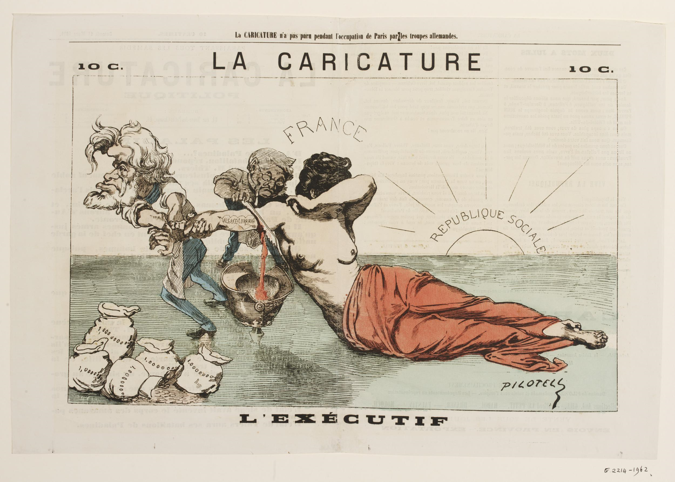
“Alsace-Lorraine”

Slide 4
Notes: French Revanchism
Germany would probably never surrender them
Many in France believed a war with Germany was inevitable.
In Germany, they also believed this war inevitable.

Slide 5
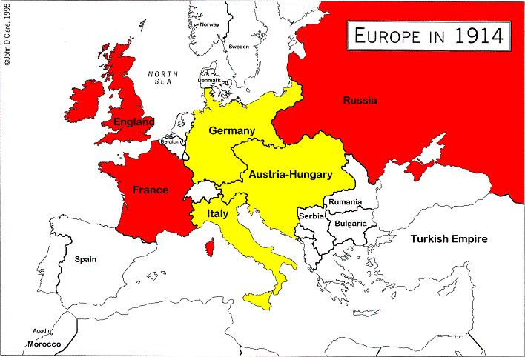
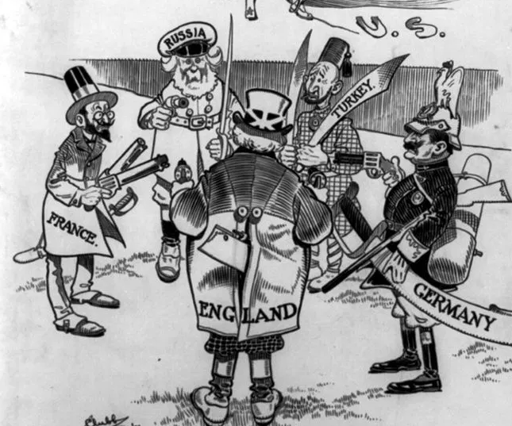
Notes: Alliances
Europe had divided itself into two general groups of alliances.
Both sides included members who were itching for a war.
Any small conflict could become a broader war.

Slide 6
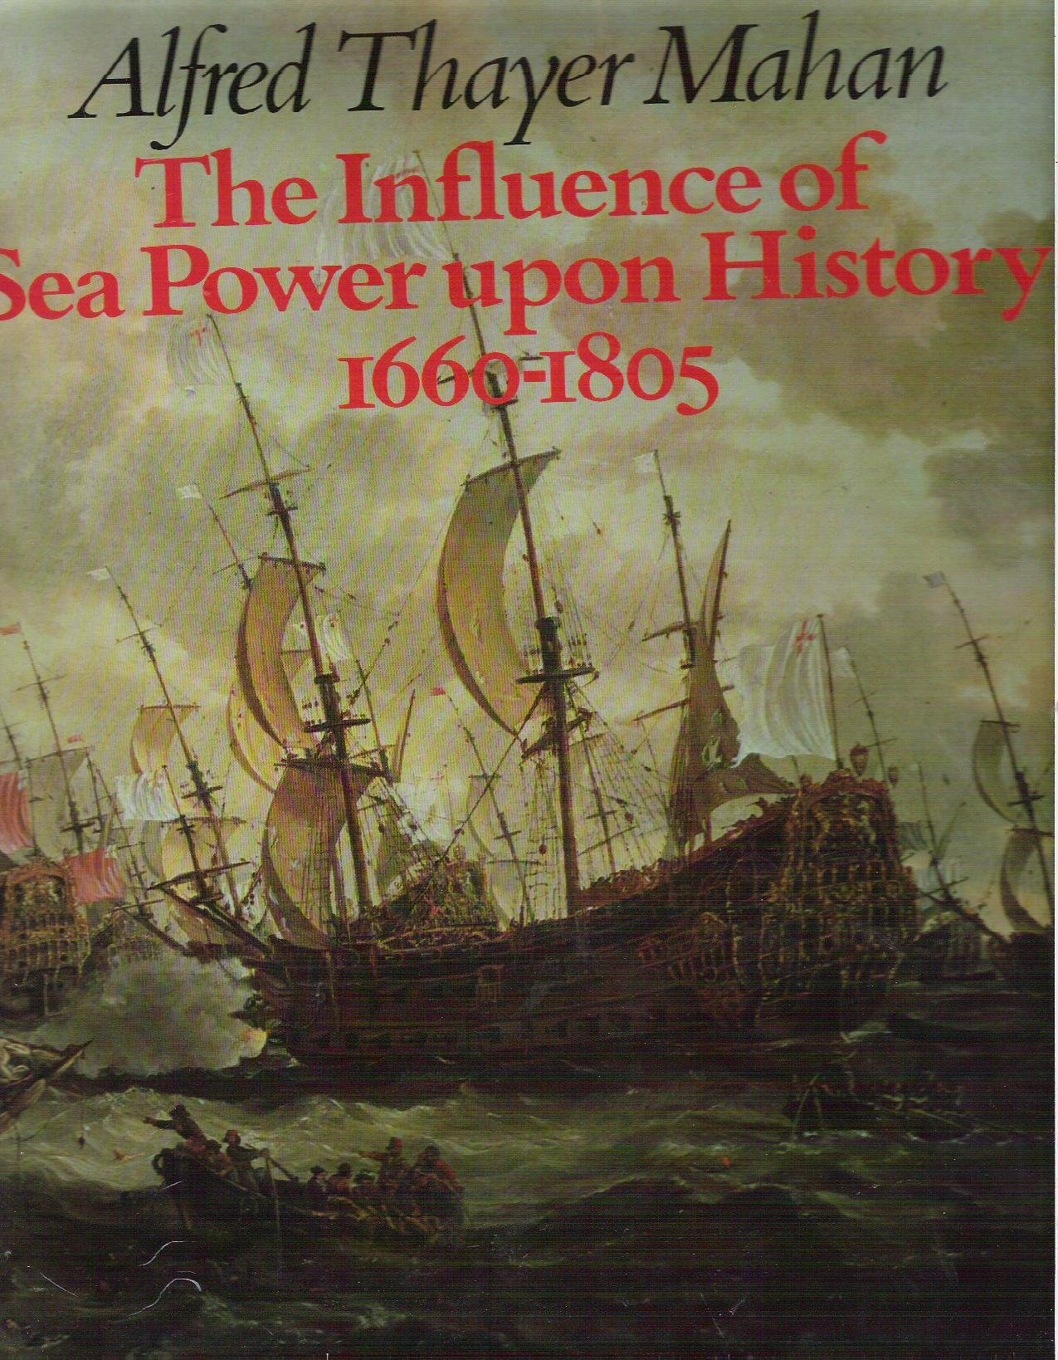
Notes: Anglo-German Arms Race
In 1890 the book “The Influence of Sea Power upon History” is published
It argued that, throughout modern history, wars have been determined by navies—not by armies.
It convinced Kaiser Wilhelm that the Germans needed a fleet.
This began an Arms Race—a competition to build the most weapons.

Slide 7
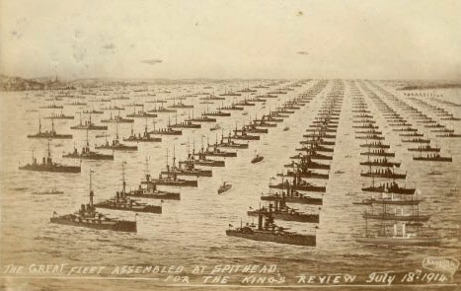
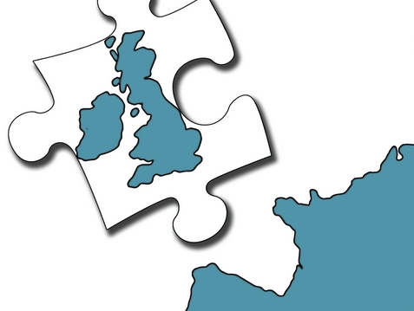
Notes: Anglo-German Arms Race
The British felt their safety was guaranteed only because they had the mightiest fleet in the world.
Now suddenly they were threatened by a potential German Fleet.
To many British the Germans had been friends. Now Germany became a specter that could threaten Britain.

Slide 8
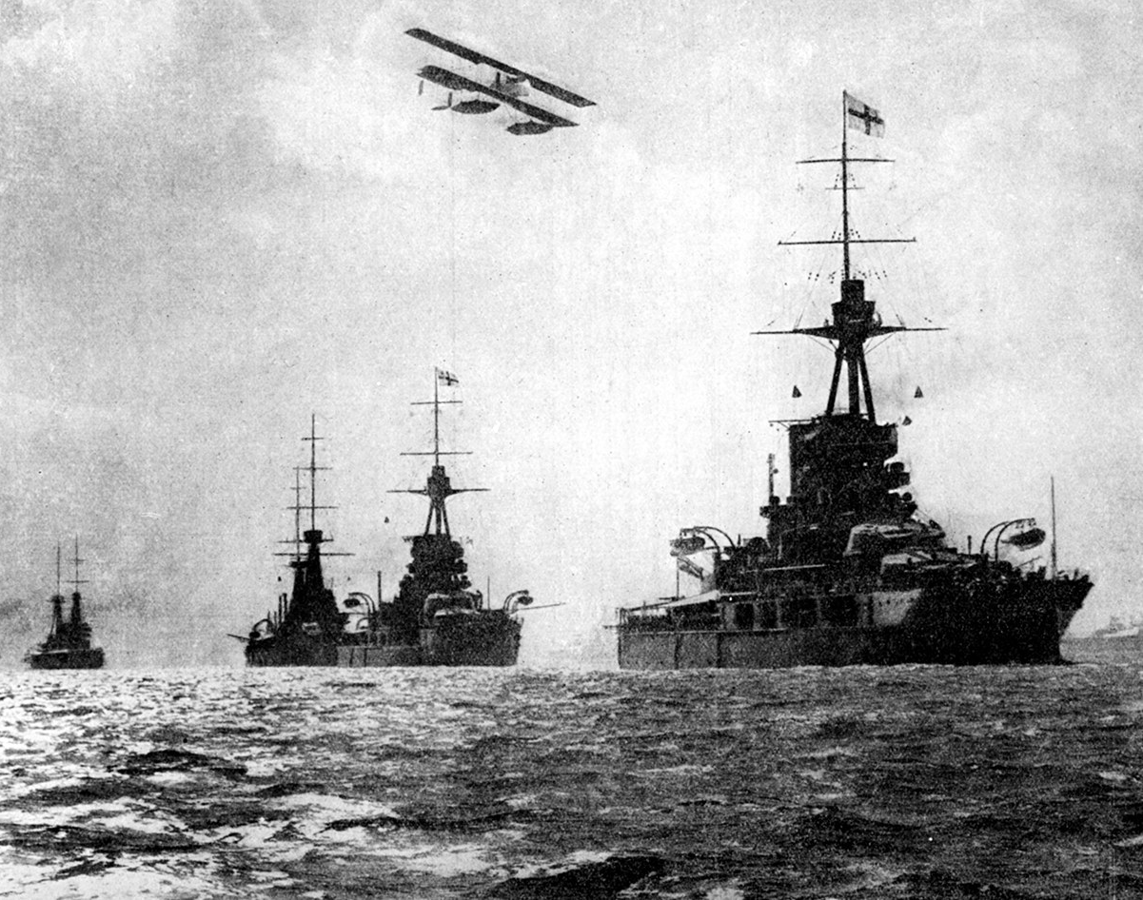
Anglo-German Arms Race
“I do not wish for a good understanding with England at the expense of the expansion of the German Fleet”
-Kaiser Wilhelm, 1909
“We do not want to send anyone into the shade—but we also demand our place in the Sun.”
-Bernhard von Bulow, German Chancelor, 1897

Slide 9
Anglo-German Arms Race
“Peace should be preserved—but at what cost? That the German is so strong by land and Sea that he can swagger down the high street of the world making his will prevail at every turn?”
-Lord Haldane,
British Secretary of State for War, 1908

Slide 10
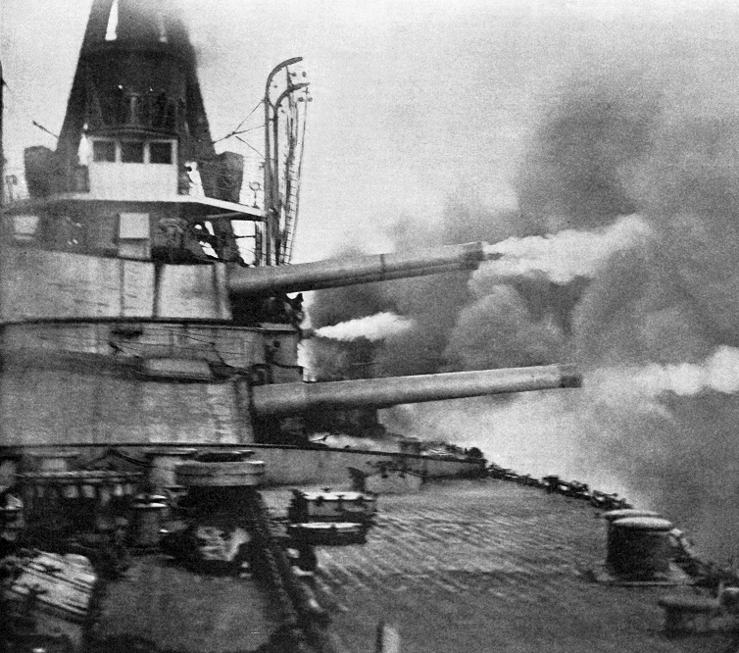
Notes: Anglo-German Arms Race
By 1914, Britain was ahead in the naval race.
However, it was exhausting a huge amount of money to do so.
In Britain, a mood prevailed that something would have to be done about Germany before Germany could catch up.

Slide 11
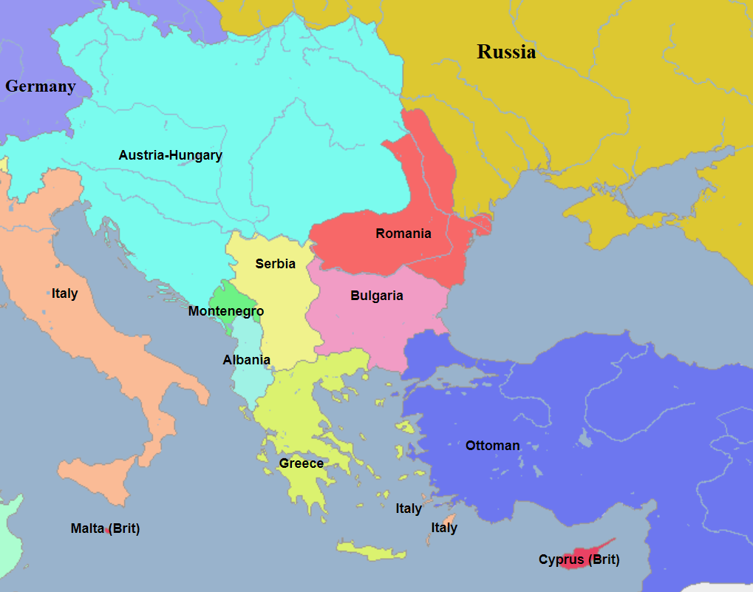
Notes: The Balkans
The Ottoman Empire had ruled the Balkans for 400 years.
As it started to collapse, both Austro-Hungary and Russia thought they should take control

Slide 12
Notes: The Balkans
Austro-Hungary thought it should be the leader of the Balkans, perhaps even taking them over.
Russia imagined an alliance of all Balkan states under Russia.
The Ottomans wanted it back.
Meanwhile the Serbs dreamt of a united states of free Balkan people

Slide 13
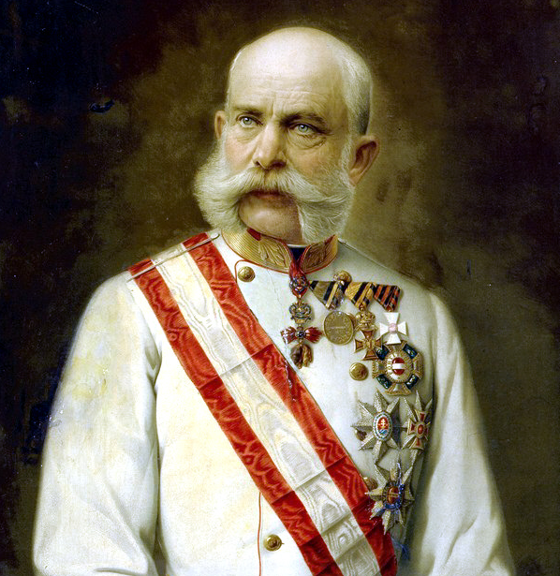
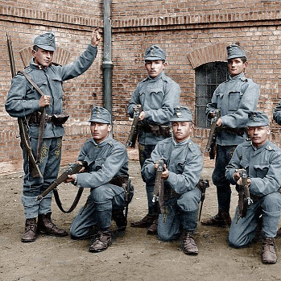
Notes: Austria’s Problem
Austro-Hungary ruled over many Balkan people still.
It was falling apart as all of these people demanded their freedom.
Serbia seemed to have a hand in this and made no secret it wanted to see Austro-Hungary destroyed.

Slide 14
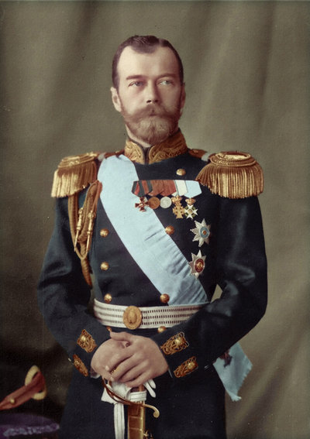
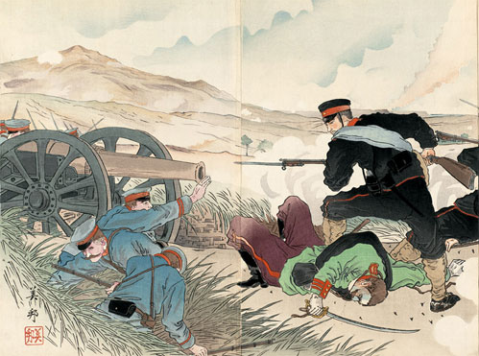
Notes: Russia’s Problem
Russia imagined itself a great power but had been humiliated recently by both Japan and Austro-Hungary.
Russia was determined to not lose face, even if it meant war.
Russia wanted all Balkan people to look to Russia for help.
They were not willing to stand down while Austria bullied a Balkan state.

Slide 15
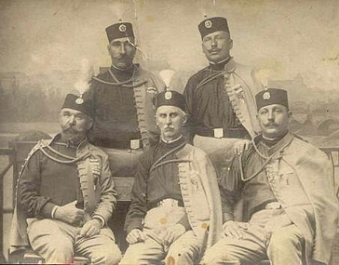
Notes: Serbia’s Problem
Serbia wanted to take down the Austro-Hungarian Empire.
Towards this end, several terrorist groups began operating within the empire.
Most were given assistance by Serbia through a shadowy organization known as the Black Hand.
It would be these problems that started the war.

