Slide 1
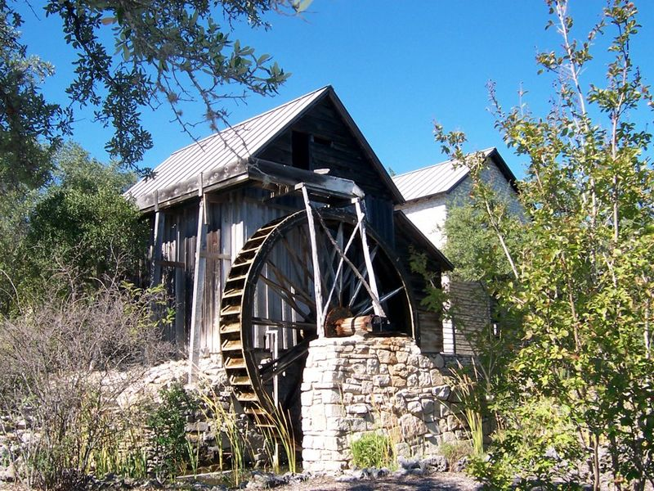
Watermills: 3rd century BC
The very first method of mechanization was the watermill. This device uses a wheel to harness the power of flowing water. This can be hooked up to any sort of device, allowing that device to be powered without human or animal power.
The watermill was generally used to grind flour in the West and hull rice in the East. However, by 1400 AD it was also powering sawmills, forges, blast furnaces, papermills, and other devices.

Slide 2
The advantage of the watermill is that it produces a fair amount of power. Unfortunately, the watermill requires you to have a consistent source of fast-running water, which is not common in many parts of the world.
This is one reason that explains why Europe tended to have more mills than other parts of the world. Europe has far more fast-running rivers because of its geography. European crops (wheat, barley, rye) also require grinding to flour, another reason that mills may have been more popular than in China, where Rice doesn’t really need grinding.

Slide 3
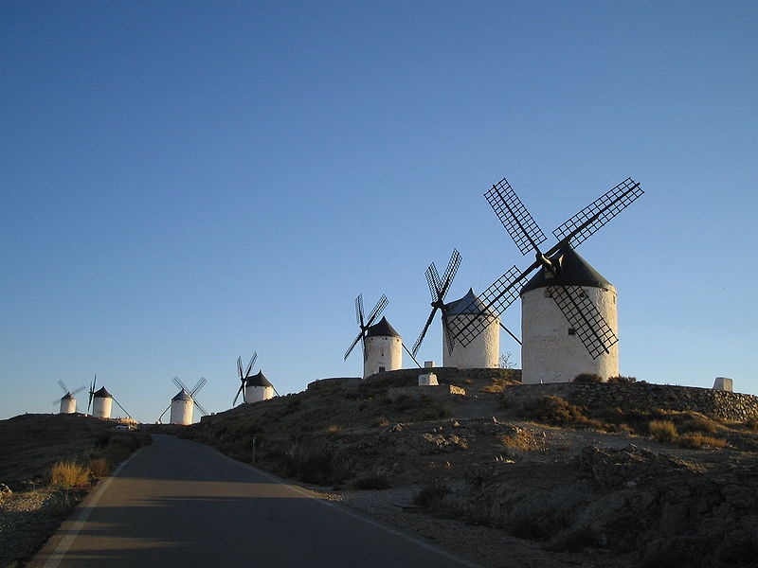
Windmill: 1st century AD
The windmill is a considerable step forward for mechanization compared to the watermill. It allows mechanization away from fast-flowing rivers, which aren’t common.
However, the disadvantage for the windmill is that they don’t produce that much power compared to the waterwheel. This meant that they were rarely used much in lands that had the rivers to run watermills such as England or France.

Slide 4
The windmill was very important to low-lying countries, however. Many of these places did not have the fast flowing rivers to power watermills so windmills were the next best thing.
Windmills aren’t powerful enough to run sawmills or blast furnaces but they are powerful enough to run flour and papermills. Because of this lack of power, the windmill was never really a cornerstone of industry.

Slide 5
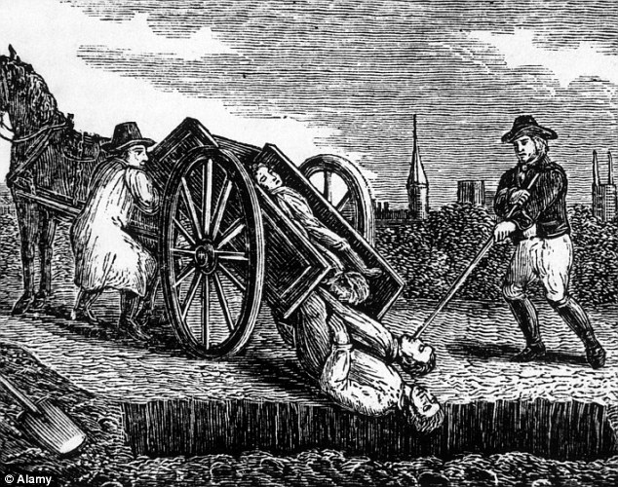
The Black Death: 1347-1353
The Black Death killed between 30-50% of Europe’s population in just 7 years. After that it stuck around for three centuries, occasionally striking again in smaller regions.
The Black Death had a huge impact on Europe. Firstly, it greatly improved the value of labor (since so many laborers had died). It also lowered the value of land (since so many landlords died). This meant that many peasants became the owners of their land and in general became wealthier.

Slide 6
The Black Death: 1347-1353
This had 2 impacts:
Some peasants became fairly well-off and began to enter into the realm of middle class, where they could afford things non-essential to their living.
Second, landlords had to innovate. Labor cost so much money now that it became practical to think of ways to save labor. This lead to developments in new farming techniques and tools that would later lead to the British agricultural revolution

Slide 7
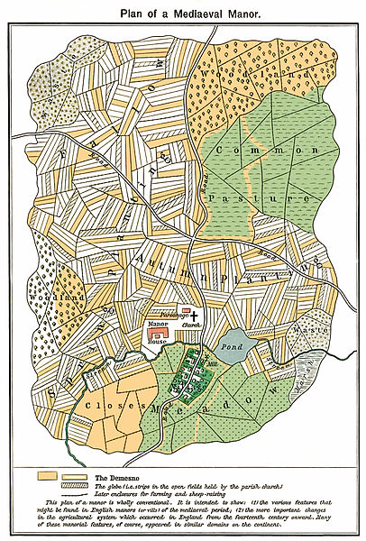
British Agricultural Revolution: 1650-1750
From about 1650-1750, Britain experienced a boom in its ability to produce food. This was driven by a number of things. Crop rotation made the land more consistently fertile, new tools like the seed drill and Dutch plow made labor easier, and a series of laws known as the Enclosure Acts allowed wealthy farms to take over common areas.
This all lead to a massive increase in the food supply, which fueled a population boom.

Slide 8
However, one of the most important effects was that British Peasants found it harder to compete in the food market compared to all of the massive manor farms.
This led to many peasants pursuing other careers. One of the most common was spinning wool. While their husbands and sons worked in the fields, women spun cloth in the home to sell. This became known as the Cottage Textile industry. It represented Britain shifting the base of its economy away from farming and towards manufacturing.

Slide 9
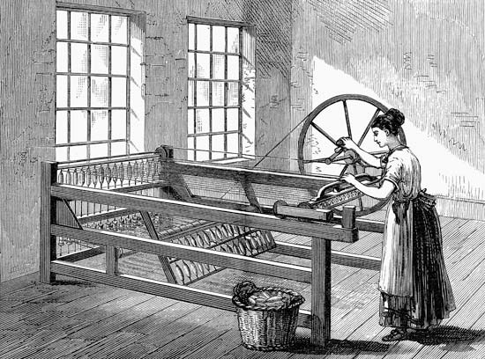
The Spinning Jenny: 1764
The Spinning Jenny was a device for spinning cloth. It was sold to the peasants who worked in the cottage textile industry. It allowed a single spinner to spin dozens of thread at once—rather than only one.
This was a massive time-saving technique and allowed the British cloth industry to become even more productive.

Slide 10
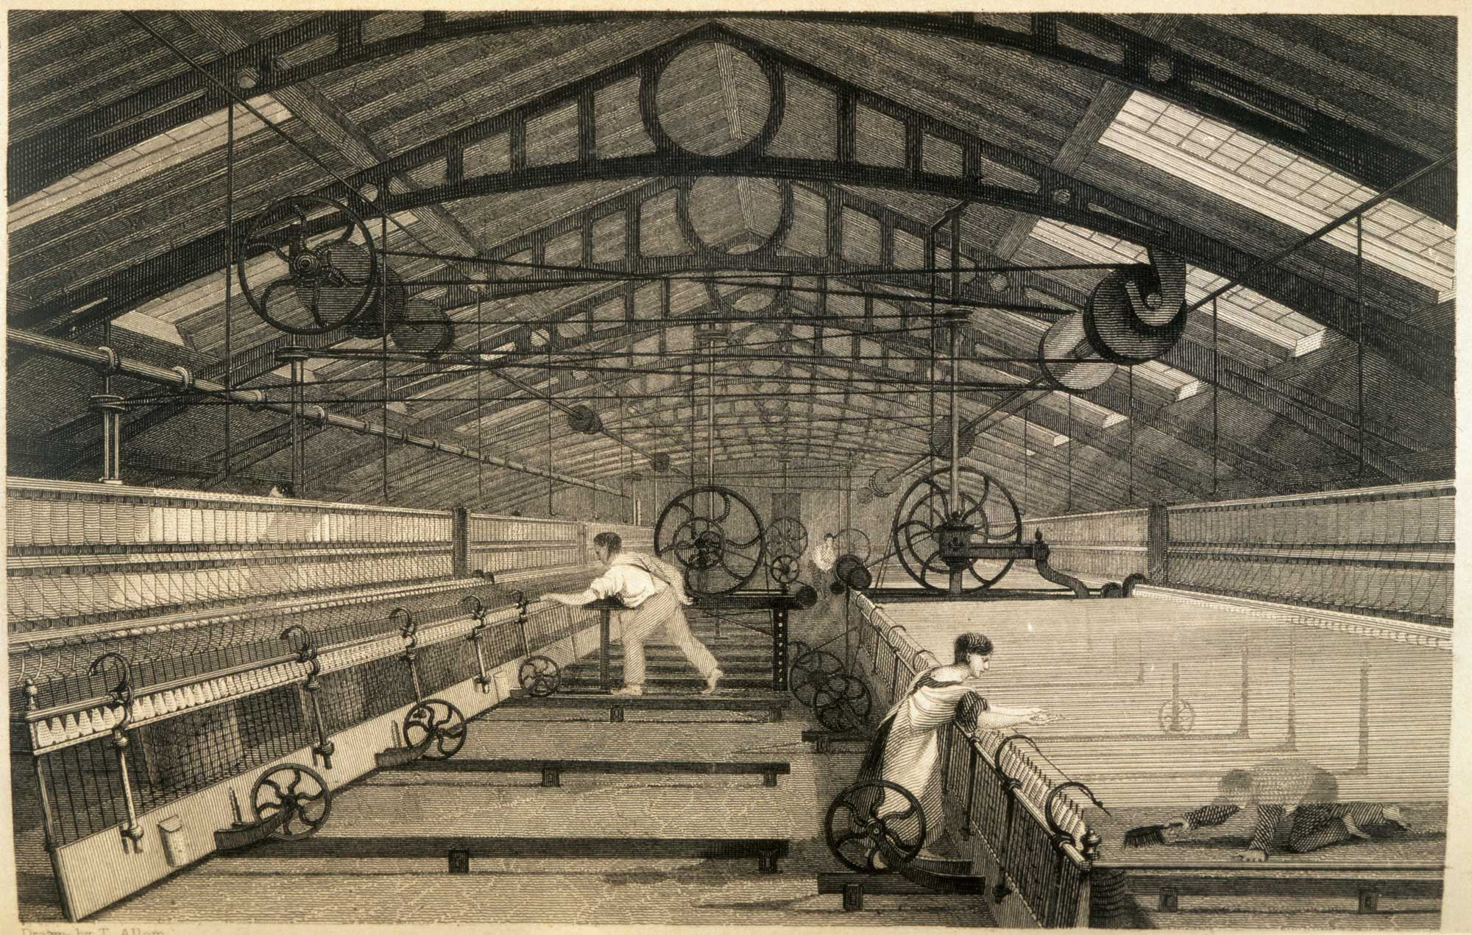
However, the moment of genius came when someone realized you could hook spinning jennies up to watermills. Now humans weren’t required to turn the crank to power the jennies.
After this, a handful of people working together could spin thousands of threads at once. Here the first true factories were born and the Industrial Revolution began.

Slide 11
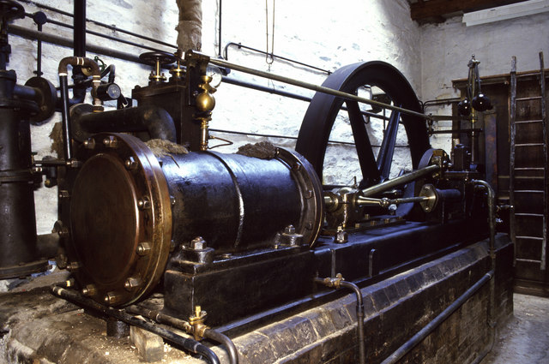
The Steam Engine: 1781
The steam engine had existed since 1712. However, in 1781 a Scotsman named Thomas Newcomen modified it to make it considerably more powerful, efficient, and durable.
This device was powered by coal, which boiled water, which turned a wheel. This was a massive step in mechanization—the first new form of power since the windmill 1700 years prior.

Slide 12
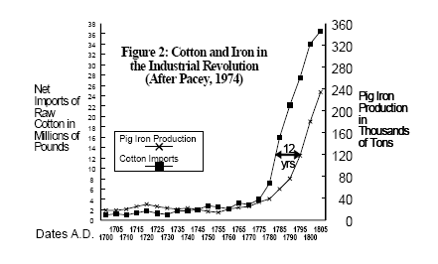
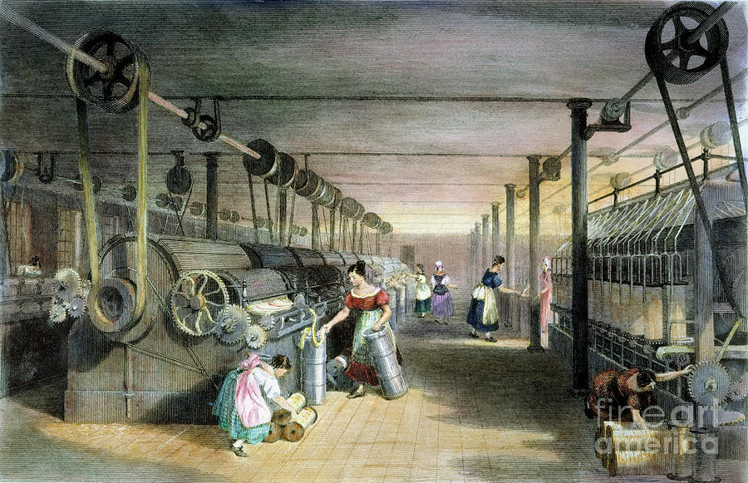
Factories began to convert from water to coal for 2 reasons: 1) steam engines are more powerful. 2) you can build a coal-fired plant anywhere, you don’t need running water.
Now textile plants and iron foundries would both become considerably more prevalent and productive in Britain. All the inventions of the First Wave Industrial Revolution were powered by the Steam Engine

Slide 13
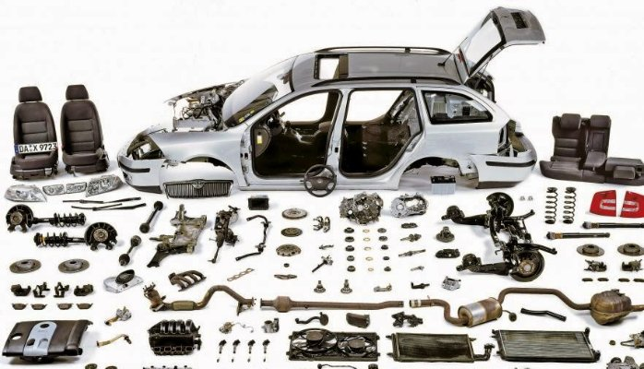
Interchangeable Parts: 1860-1900
The second Industrial Revolution was driven by interchangeable parts. This means that machines would be built in pieces and then assembled. This had two huge advantages.
The first is that it made production much more efficient. The first car produced with interchangeable parts, the Model T, was about 25% the price of cars that came before it.

Slide 14
The second is that it made operating machinery much cheaper. If one part broke you could just replace that one part rather than the whole machine.
This led to a huge number of new industries in every imaginable kind of product from cars to toys to clothes to cereal.

Slide 15
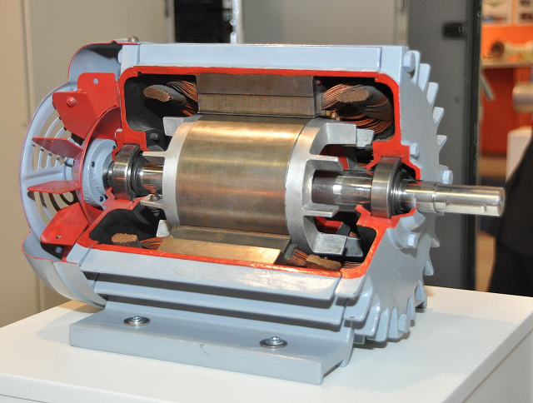
The Electric Motor: 1890s
Electricity and the electric motor changed everything. This was a revolution not in power but in transmission.
With electric motors, you can produce the power in one place, convert it to electricity, transport it thousands of miles, and convert it back to kinetic energy at any location in any device.

Slide 16
The electric motor fueled the appliance revolution. Dishwashers, ovens, fans, heaters, refrigerators, and countless other appliances all make use of the electric motor.
This also made industry far cleaner as the huge smoke stacks could be moved out of the city while the actual factories could remain—powered now on electric motors.

