Slide 1
History of Mechanization
Follow along with the posted video

Slide 2
Mechanization
The use of power that does not come from humans or animals.
Three parts of mechanization:
Power: how the power is created.
Transmission: how the power is transported.
Utilization: what is done with the power

Slide 3
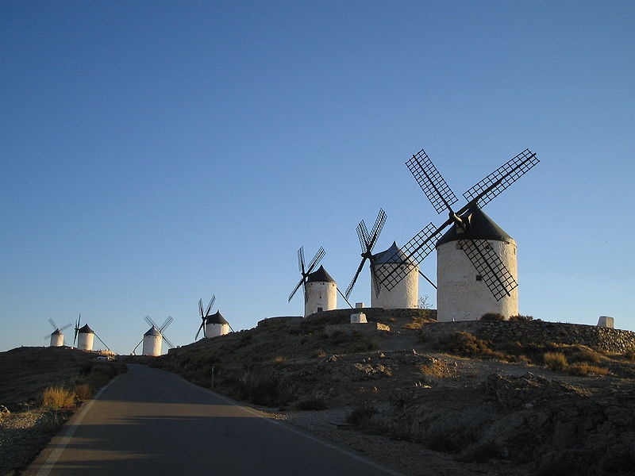
Early Mechanization
Watermills had existed since 400BC
Windmills since about 1000AD
Both represent early mechanized power but their invention did not launch an industrial revolution.
China was the most innovative in the use of mills
Europe had a much greater number because of the need to grind wheat—which you don’t need to do to rice

Slide 4
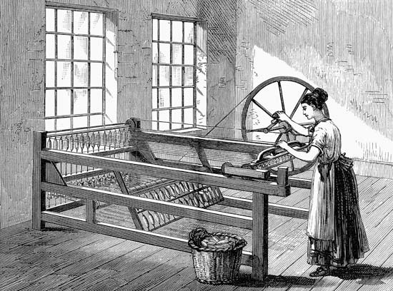
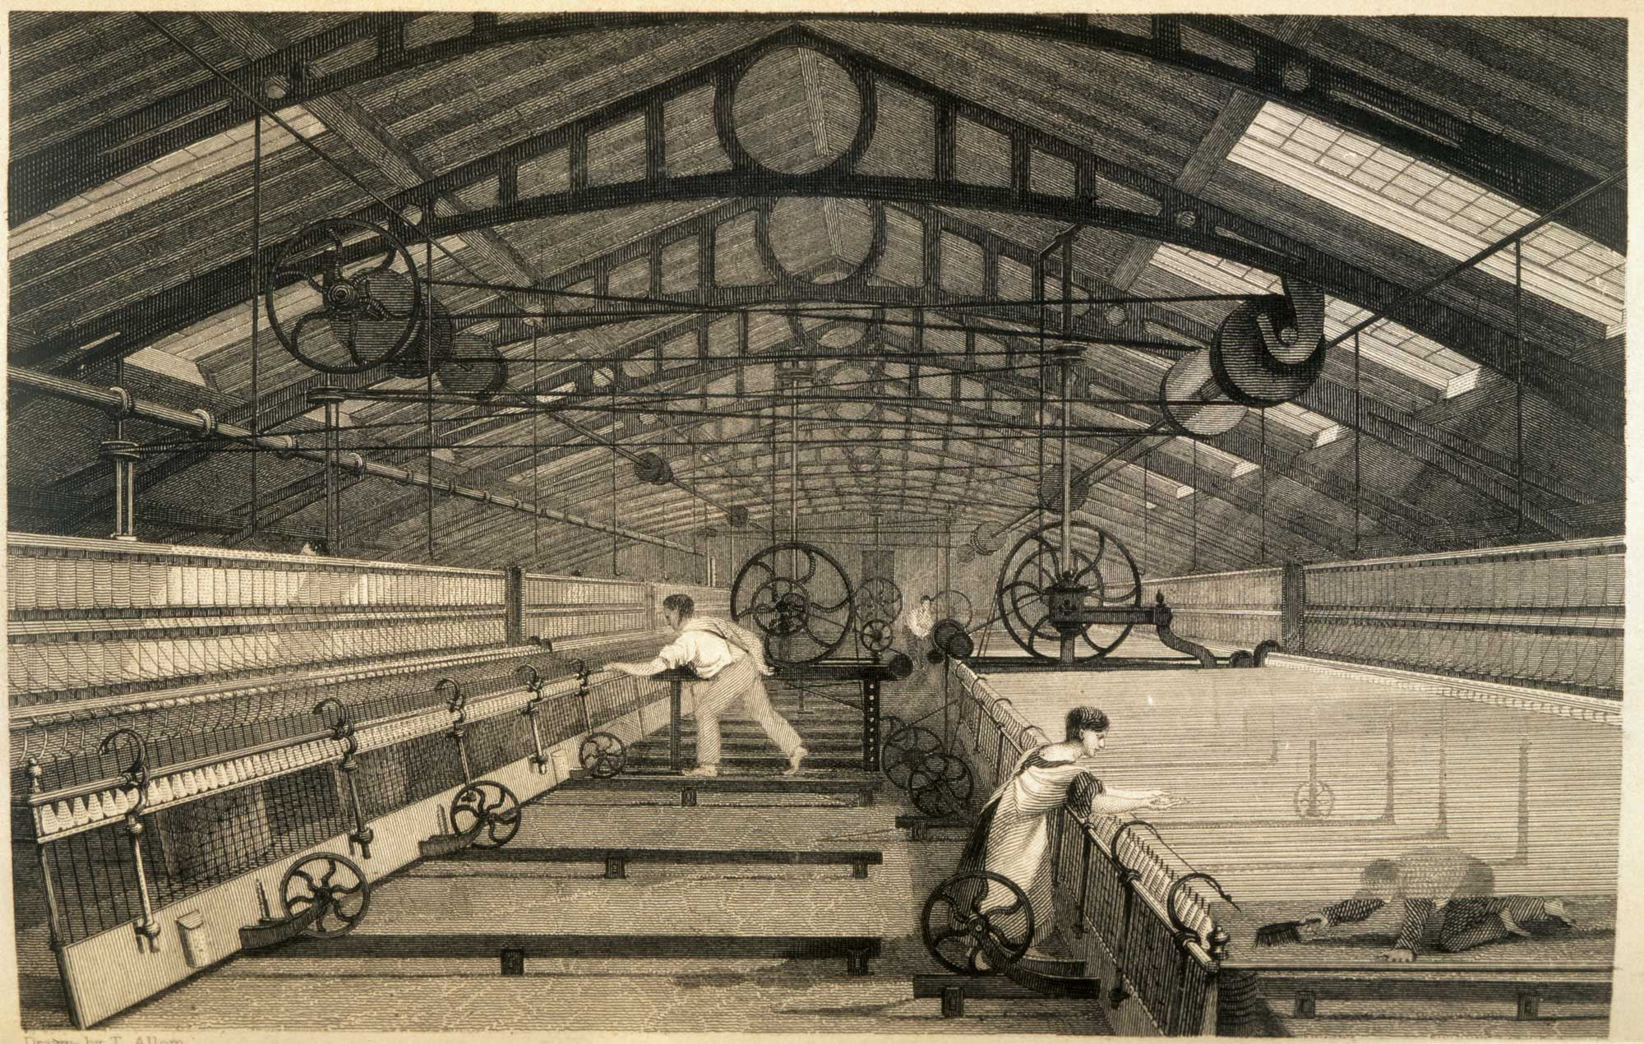
Industrial Revolution – Textile Inventions
A combination of new utilization methods drove the first industrial revolution:
Spinning Jenny: spun loose fiber into thread
Waterframe: spun loose fiber into thread but much better and more efficiently
Power loom: wove thread into sheets of textile
Cotton gin: separated cotton fiber from cotton seeds

Slide 5
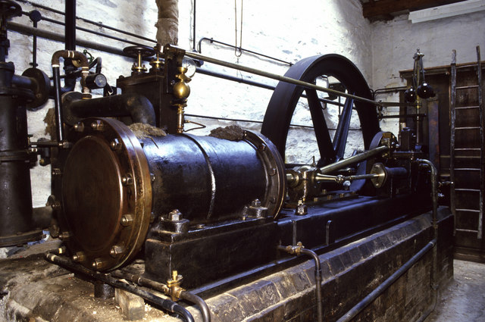
Industrial Revolution – Power
Eventually the new steam engine begins to replace watermills
Driven by coal which heats water, which spins a turbine.
Far more powerful, versatile, and reliable than the watermill.
Powers a huge increase in productivity in almost all factories.

Slide 6
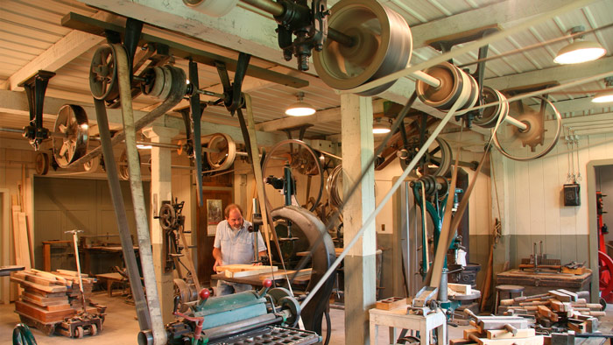
Industrial Revolution – Transmission
During this time the only form of distance transmission was the line shaft.
Steam engine or mill would be hooked up to a spinning metal rod on the ceiling by means of pulleys and belts.
The spinning metal rod could then be used to power other machines
Could only transmit power 100-200 feet from where it was harnessed

Slide 7
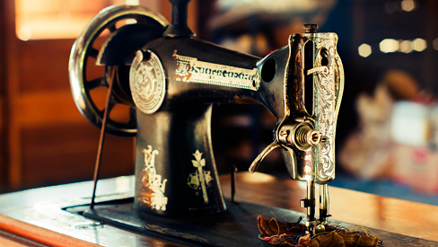
Second Rev – Utilization
Countless new inventions are created to utilize the power of the steam engine during the second revolution.
For textiles, the big invention is the sewing machine, which allows the final product to be mechanized.

Slide 8
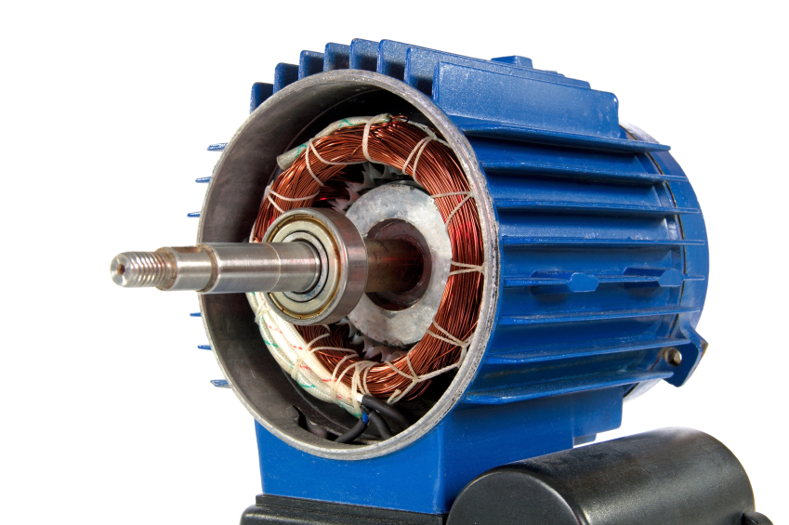
Second Rev – Transmission
The biggest gain of the second revolution was in transmission.
The electric generator allowed kinetic energy to be converted to electricity and the electric motor allowed electricity to be converted to kinetic energy.
This allowed power to now be transmitted hundreds or thousands of miles.
Almost all household inventions of the industrial revolution owe their creation to the electric motor.

