Slide 1
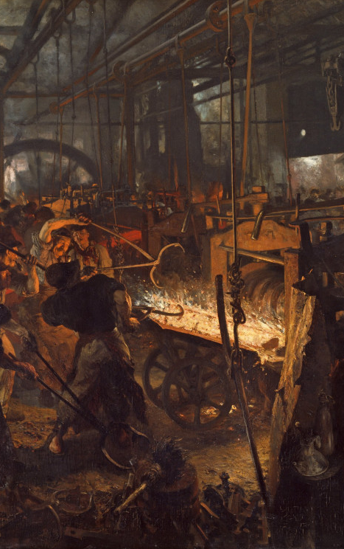
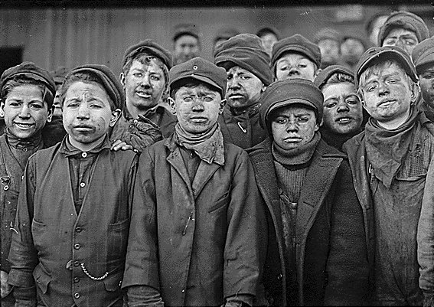
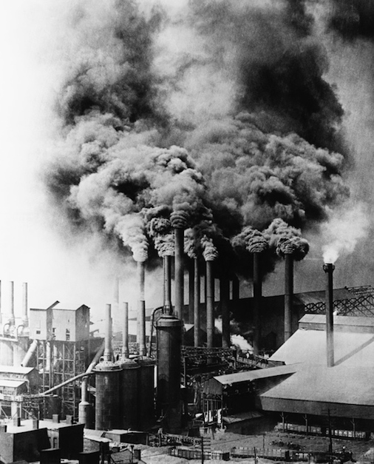
Unit 7: The Industrial Revolution

Slide 2
NOTES: The Industrial Revolution
The second great social revolution in human history.
Industrial Revolution: the shift from farming-based economies to manufacturing-based economies.

Slide 3
Notes: Industrialization
Industrialization is the process of a society changing into a mechanized society.
Mechanization is the use of machines to create things or do work—rather than human/animal power.

Slide 4
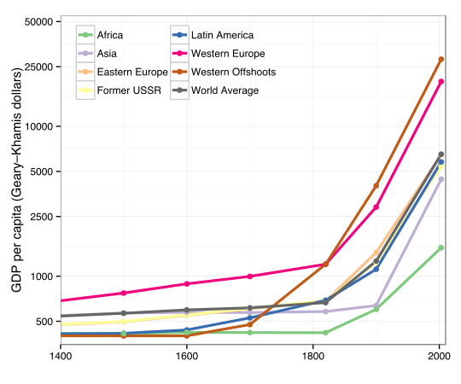
Notes: Changes in Production
Society could now make significantly more stuff per person.
This greatly increased the wealth of industrial countries

Slide 5
Notes: Short-Term Life Changes
For the first 150-ish years, industrialization worsened the lives of most people.
Wages decreased dramatically.
Working conditions were horrible
Cities became polluted and dangerous
Children increasingly became the dominant workforce

Slide 6
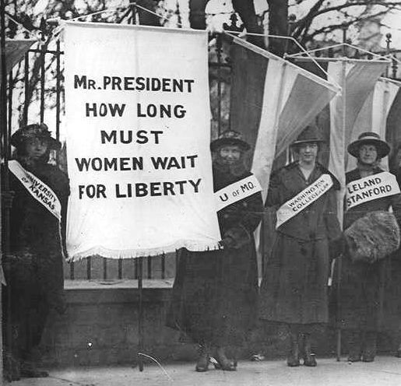
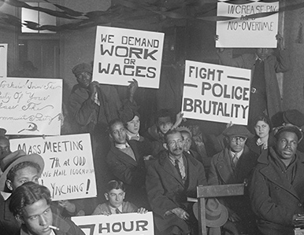
Notes: Short-Term Life Changes
The terrible conditions of life were rolled back broadly from 1880-1920
This was because of the work of unions, progressives, and journalists willing to expose the terrible conditions of the time.
It corresponded with the Second Industrial Revolution, which also significantly improved the lives of everyday folk.

Slide 7
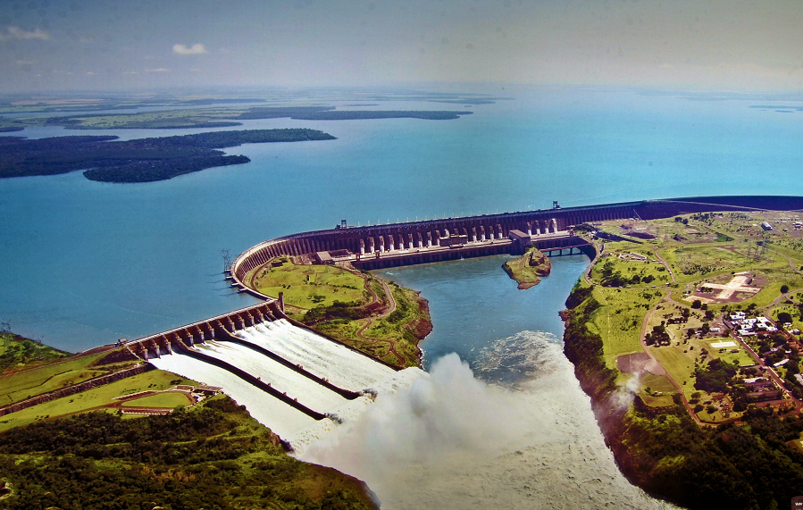
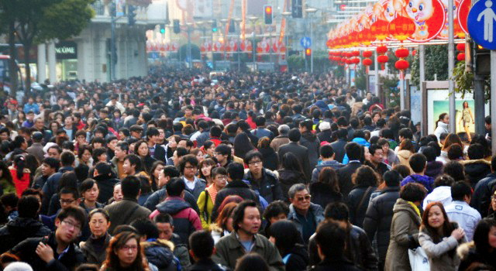
Notes: Long-Term Life Changes
Industrialization fundamentally changed how we live our lives:
Most people are specialists very skilled in one or two things but lacking many broad skills
Most people live in cities (84% in USA)
People are extraordinarily wealthy by past standards
Travel and communication is vastly easier.
Humans have the power to cause and fix problems at truly massive scales

