Slide 1
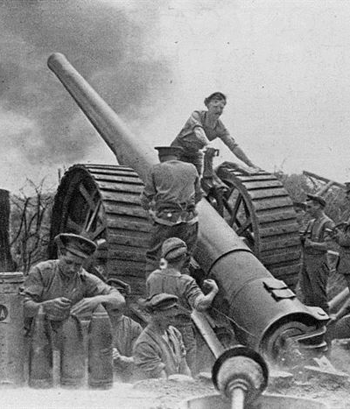
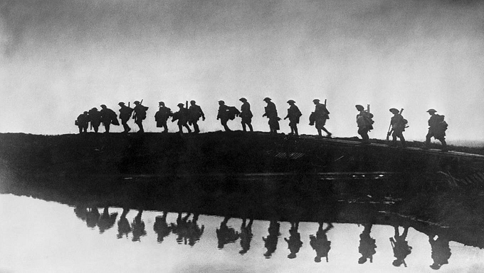
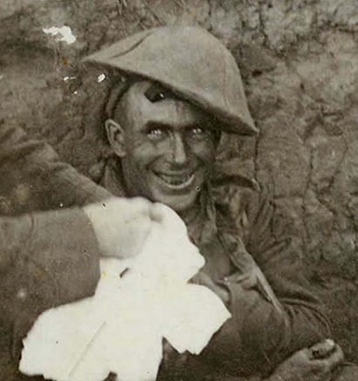
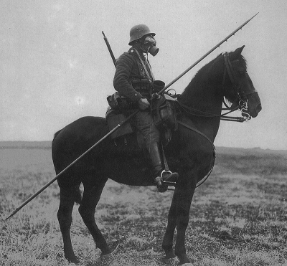
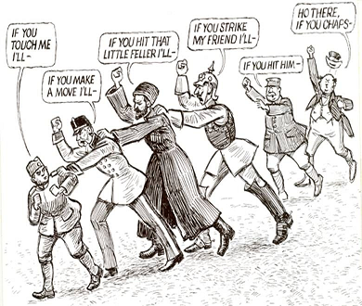
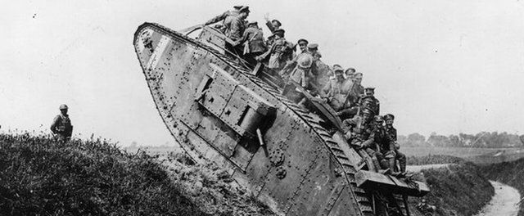
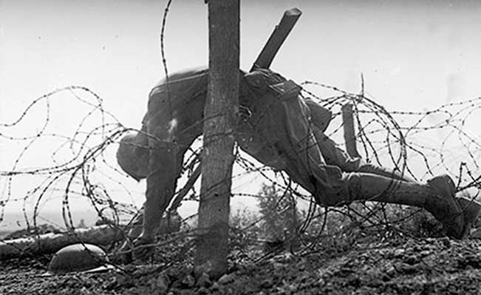
Unit 9: World War One

Slide 2
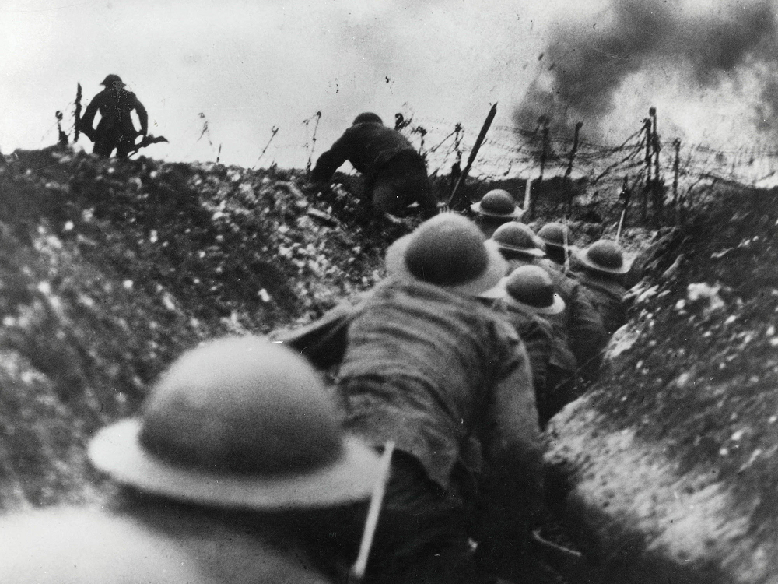
Notes: World War One
WWI lasted from 1914-1918
Involved all the major powers of the world
Central Powers | Entente (or Allies)
Germany | France
Austro-Hungary | Russia
Ottoman Empire | Britain
 | Serbia
 | Italy (in 1915)
 | America (in 1917)
 | Japan and China
 | Others

Slide 3
Notes: World War One
The Entente wins (spoilers)
But no one really gained anything
Millions died for nothing
Cynicism became one of the dominant ways to view the world
And World War 2 comes just 20 years later

Slide 4
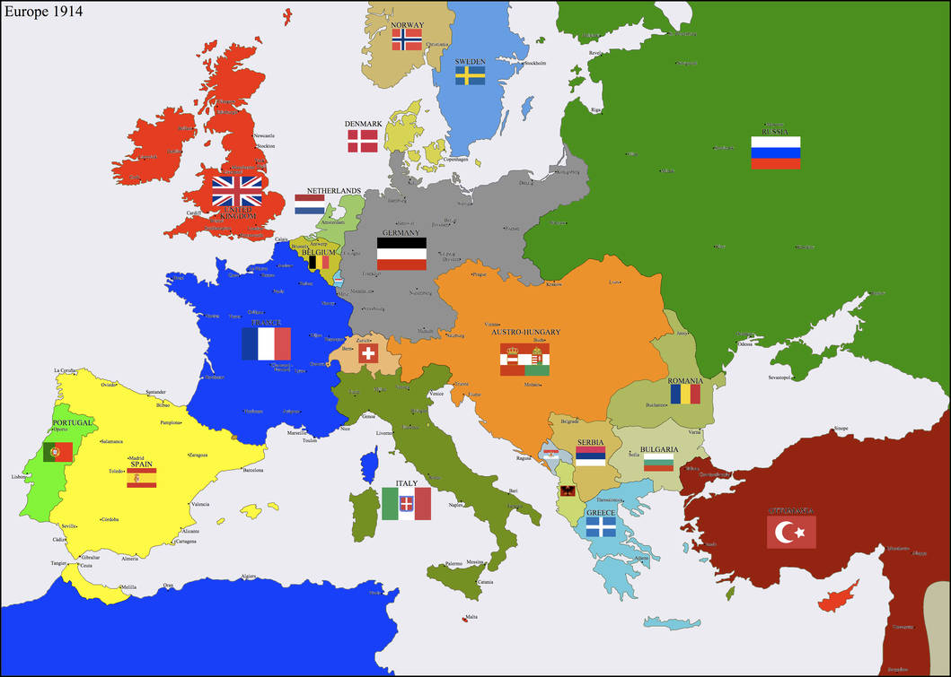
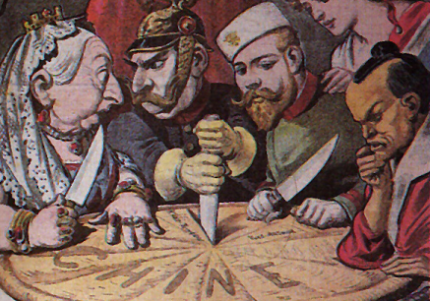
Background: Modern Europe
By 1914, most of Europe had industrialized, though the east lagged behind.
Europe had not had a major war since 1871, even while their empires carved up the rest of the world.
Nationalism had been building since 1815 and now the people of each nation deeply hated and feared their rival nations.

Slide 5
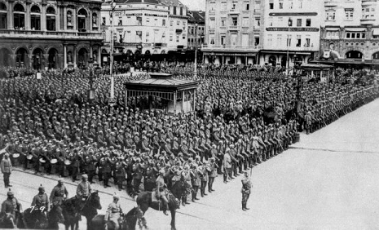
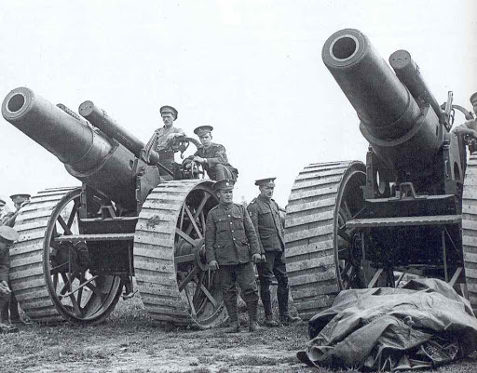
Growing Armies
While wars were infrequent, militaries were growing.
New weapons like machine guns, heavy artillery, battle ships, cars, barbed wire had all been invented since the last war.
Armies now numbered millions of soldiers. Most had grown10x in the last century

Slide 6
Alliances
Europe’s peace was built on a delicate balance of power.
That balance had been broken by the unification of Germany in 1871
Fear of Germany drove France, Russia, and Britain to join together in an alliance against it.
Germany had allied to Austro-Hungary in response.

Slide 7
Notes: Meet the Gang

Slide 8
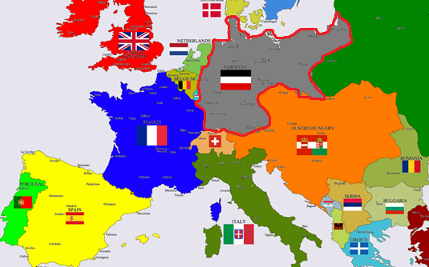
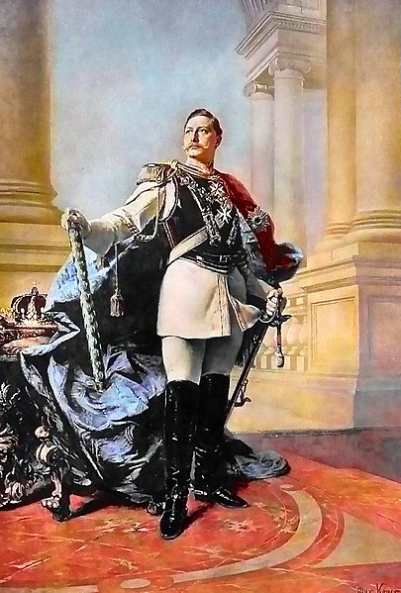
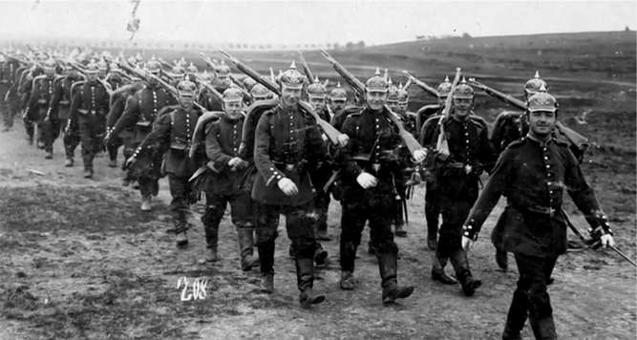
Meet the Gang: Germany
Germany was 39 different states before 1871.
Now it was the most powerful state in Europe.
Germany was ruled by the Kaiser Wilhelm II, who was loud and militaristic.
Germany felt that it should be recognized as the great state of Europe.

Slide 9
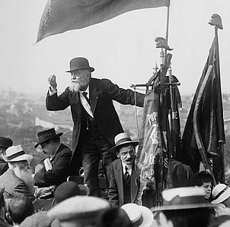
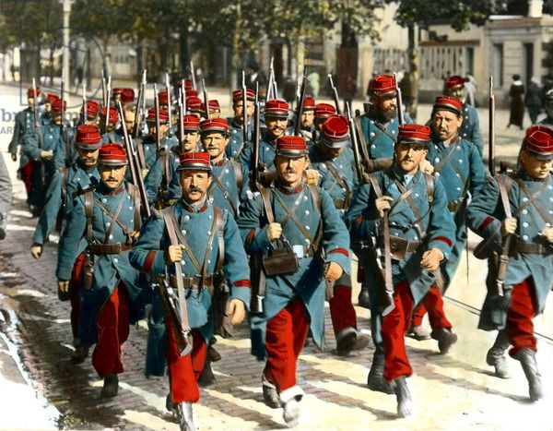
Meet the Gang: France
France had been defeated by Germany in 1870 and two of its provinces, Alsace-Lorraine, were taken by Germany.
France was obsessed with gaining them back.
So even while France was a democracy, there was an enormous amount of French militarism.

Slide 10
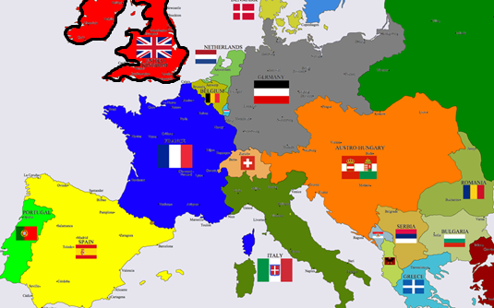
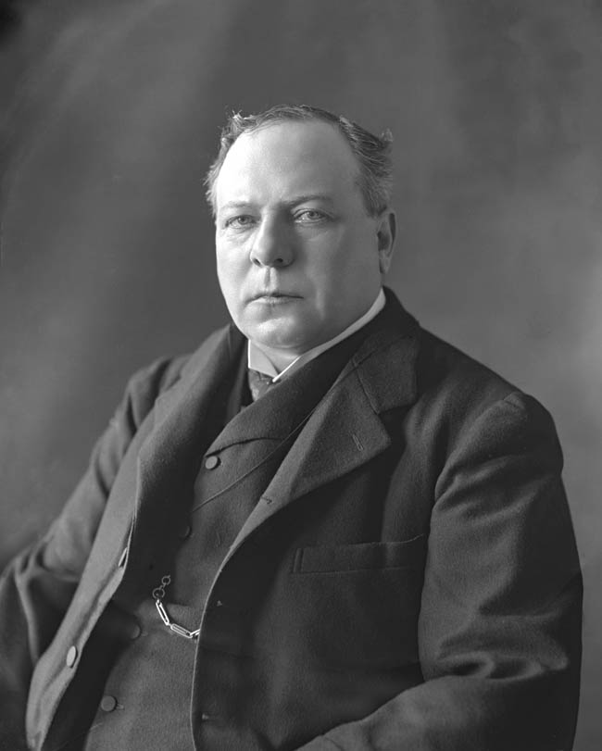
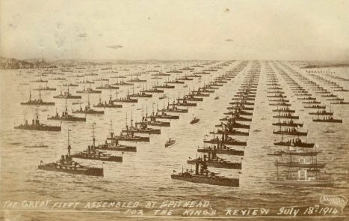
Meet the Gang: Britain
Britain ruled the largest empire to EVER exist.
Britain is an island and liked to pretend it wasn’t part of Europe.
It could do this because it had the largest fleet in the world.
Germany’s stated goal to build the greatest fleet on Earth deeply troubled Britain

Slide 11
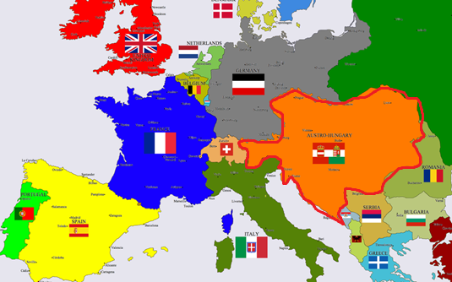
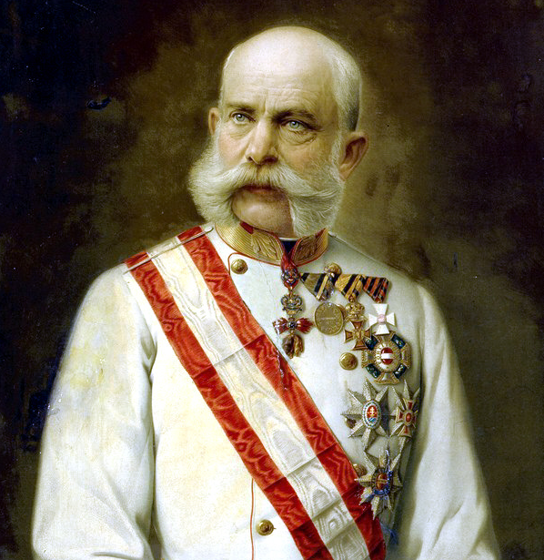
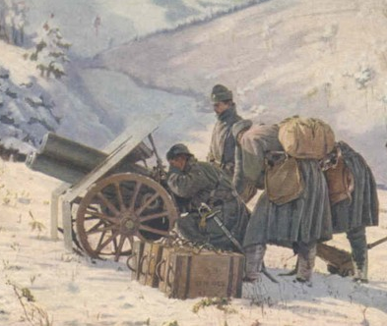
Meet the Gang: Austro-Hungary
Austro-Hungary was an old empire. It was not nationalistic and in fact contained over a dozen nations, all ruled by the German Austrians.
Austro-Hungary was being ripped apart by nationalism amongst its Slavic population.
Only the brutal repression of its imperial government kept it from falling apart.

Slide 12
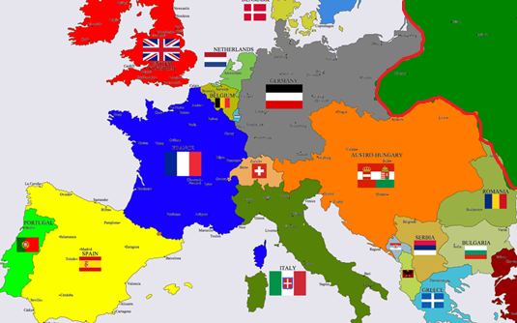
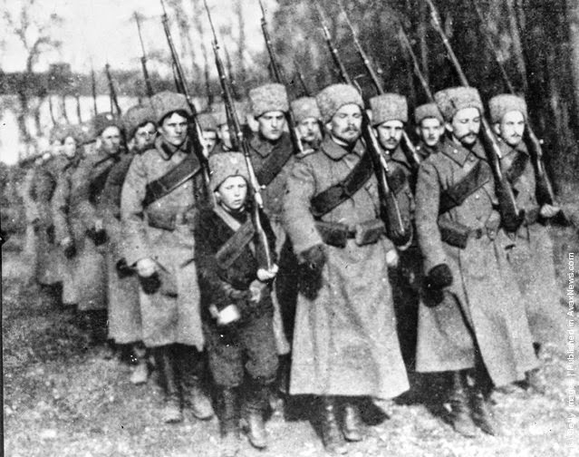
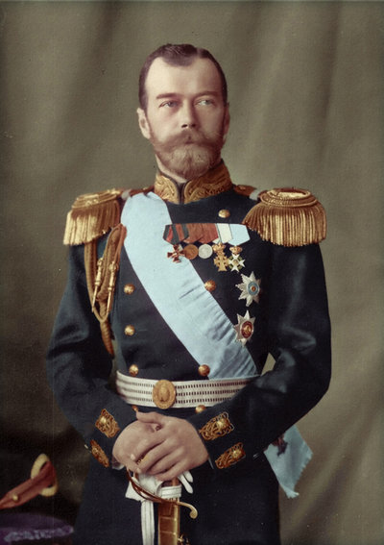
Meet the Gang: Russia
Russia was a gigantic country.
Barely industrial, mostly agricultural.
Ruled by a brutal, autocratic government.
Had an enormous population. Not even its own government knew how many but over 100 million.
Wanted to gain more European territory.

Slide 13
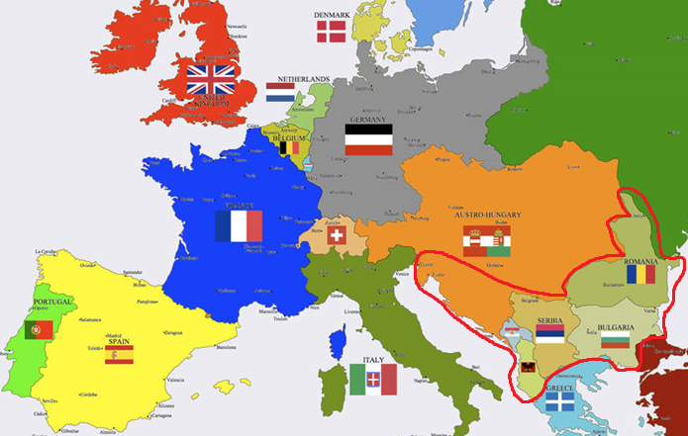
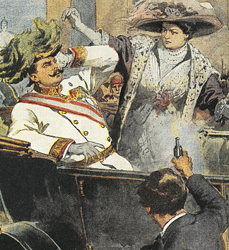
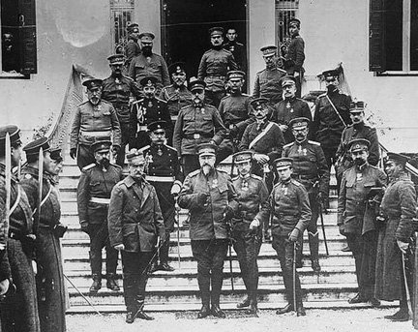
Meet the Gang: Balkans
The Balkans were new countries.
They had been freed from the Ottoman Empire by war.
Unlike the rest of Europe, the Balkans were dominated by wars, terrorism, and other political violence.
Austro-Hungary and Russia both thought they should be in charge of the Balkans.
Many Balkan people envisioned a world where they were free of the Empires for good.

