Slide 1
Resistance to Imperialism in Asia

Slide 2
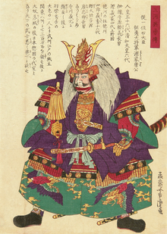
Success: Japan’s Background
Tokugawa Shogun
Feudal Society
Enforced by Samurais
National Military was weak as each shogun had their own armies
Economy was agriculture based with little technology.
Western powers had forced Japan to sign the unequal treaties.

Slide 3
The Unequal Treaties
Treaty of Kanagawa
Ended Japan isolation
Japan open their ports for US ships to gather supplies
Harris Treaty
Exempted U.S. citizens living in the ports from the jurisdiction of Japanese law

Slide 4
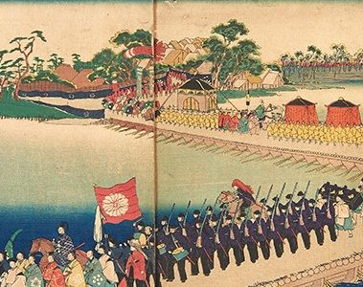
Shogun Demise
After signing treaties with the United States. Shoguns loyalty and his role as subdueder of barbarians came to be in question
Went to the Daimyo for help but were unaware these men were nationalists and wanted the foreigners gone
Change was coming and it is became the Meiji Restoration

Slide 5
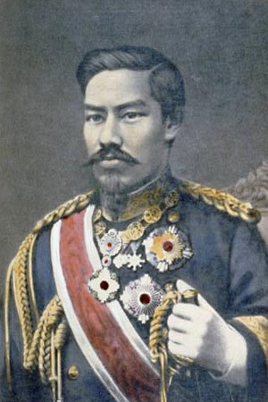
Meiji Restoration
Sent diplomats to the Western world to study their culture
Japan had regained complete control of its foreign trade and legal system
Created an Tax system
Modernize military
Weapons
National Army- Conscription
Manufactured weapons and technology that lead to an Industrial Revolution

Slide 6
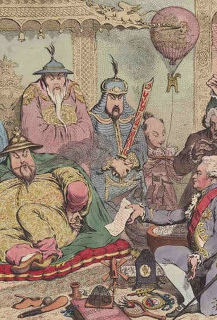
Failure: China Imperialism in China
Opium War
China increased their cotton production, so the British needed something new to sell in exchange for tea
That something new=smuggling Opium
China tried to stop Britain of selling drugs, but Britain went to war to legalize the drug

Slide 7
Unequal Treaties
Open ports for trade
Chinese courts were forbidden to put foreigners on trial
Repay British in silver for the loss of money in opium and military expenses
Surrender Hong Kong and other areas

Slide 8
Boxer Rebellion
The Boxers was a Chinese secret society who used violence to drive all foreigners from China
A rebellion erupted in northern China that sought to restore the power of the Empress against Western powers
Western powers and Japan quickly defeated the Boxers and the Chinese

