Slide 1
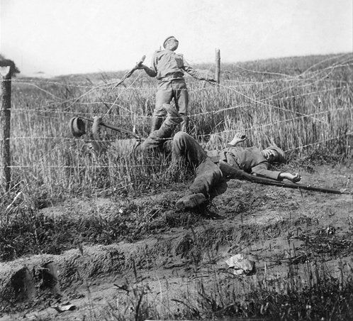
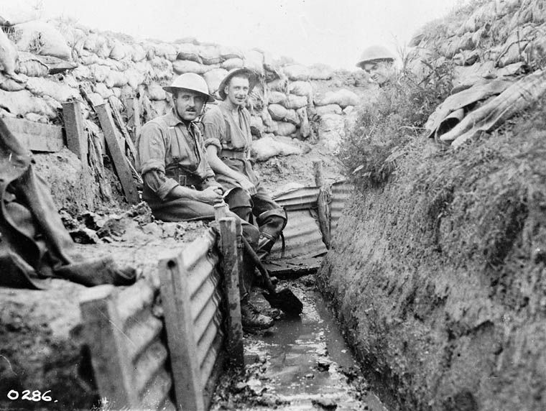
The Bad War
WW1 was an extremely ugly war
Millions of lives were thrown away in pointless attacks that were doomed to fail.
The conditions for soldiers was horrific
The death rates among combat units was extremely high
Today we will look at why

Slide 2
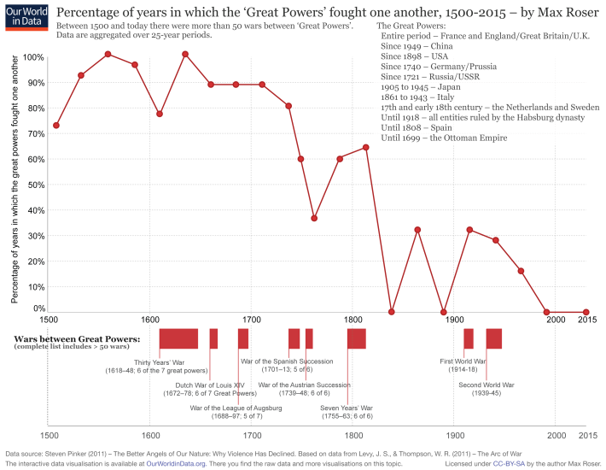
The Bad War
You always prepare for the last war you fought.
There were very few wars from 1815-1914 for Europe to study.
This meant that countries came to World War 1 with VERY outdated views on war.

Slide 3
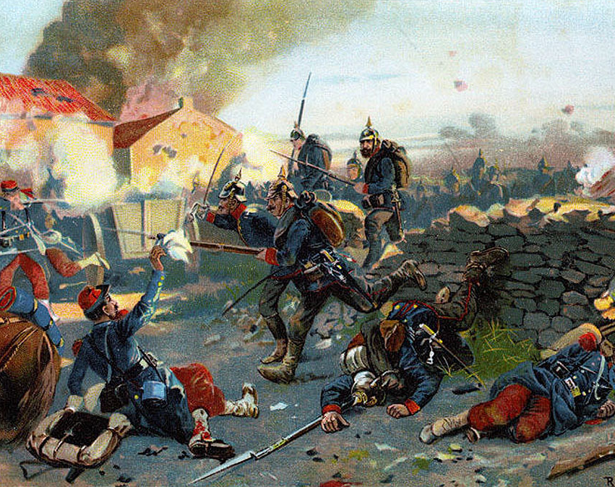
Legacy of the Franco-Prussian War
The last major war was in 1870, the Franco-Prussian War.
Prussia destroyed the French army with mobility.
Superior use of trains meant the Prussian army moved 2x as fast and outflanked France in every battle.

Slide 4
Legacy of the Franco-Prussian War
The lessons of the war taught Europe a few things:
Trains and speed were the key.
Only by aggressively attacking could you win.
The war would be short.
The first to mobilize would have a huge advantage.

Slide 5
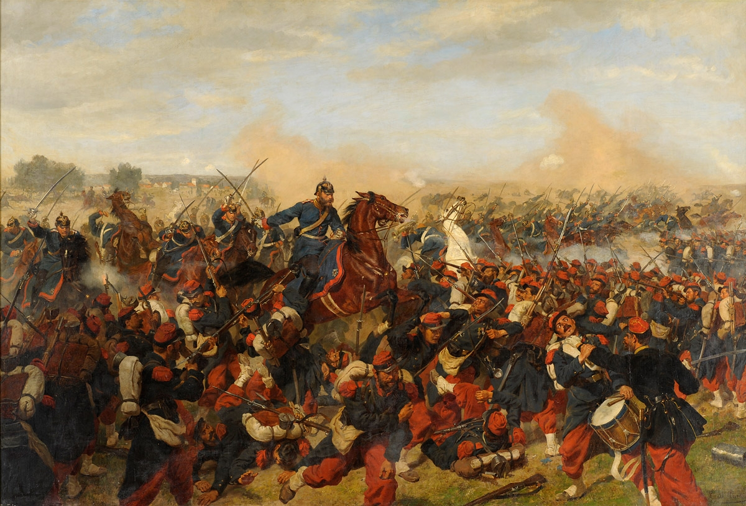

Slide 6
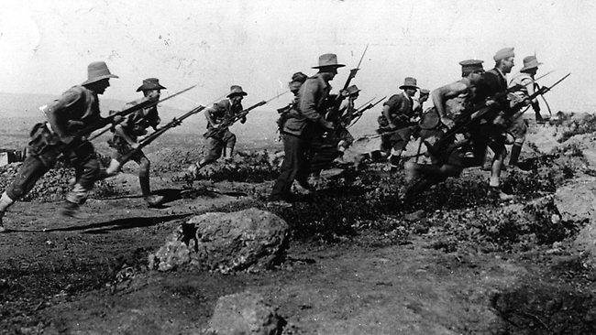
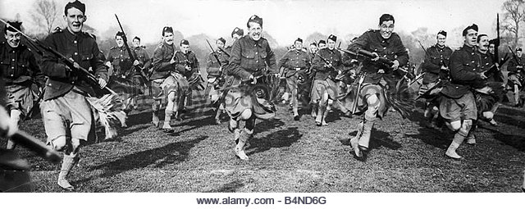
The standard method for attacking a position was still the infantry charge.
But three critical technologies were invented that made that rather hard.

Slide 7
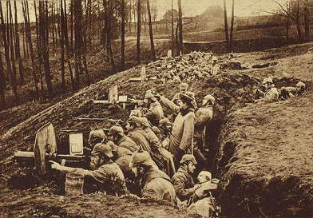
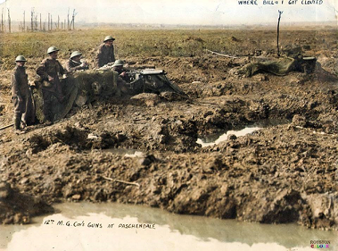
Machine Guns
The Machine gun made it very hard to advance across open terrain.
Could gun down dozens of charging soldiers at once.
Really doesn’t help much on attack as people in a trench are protected from direct fire.

Slide 8
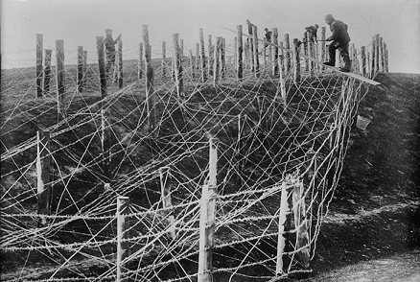
Barbed Wire
Enormous tangles of barbed wire made it very hard for soldiers to advance.
Unlike other barriers, you can still shoot through barbed wire.
Can be constructed easily and quickly (often built in a single night)

Slide 9
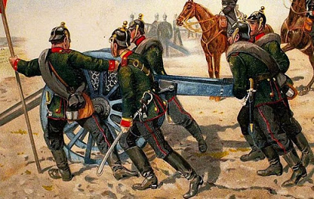
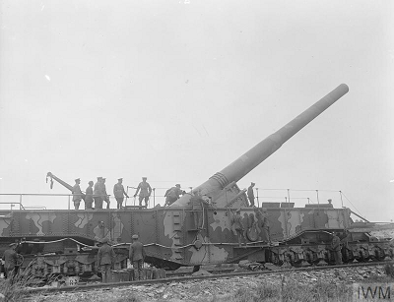
Artillery
Artillery had changed massively since the Franco-Prussian War
Huge cannons could fire from miles away
Could be put behind hills where it was very difficult to return fire
Exploding shells made them far deadlier against infantry

Slide 10
Artillery
Pre-war artillery
https://www.youtube.com/watch?v=MjUjYR-hbY0
(0:55)
Ww1 artillery
https://www.youtube.com/watch?v=IUQpSiG0yuw

Slide 11
Trenches
After the failure of the war plans, both fronts turned into a series of “trenches”
A trench is just a hole in the ground.
Over 30 million men would live in these holes and 4 million would die in them over the next 4 years.

Slide 12
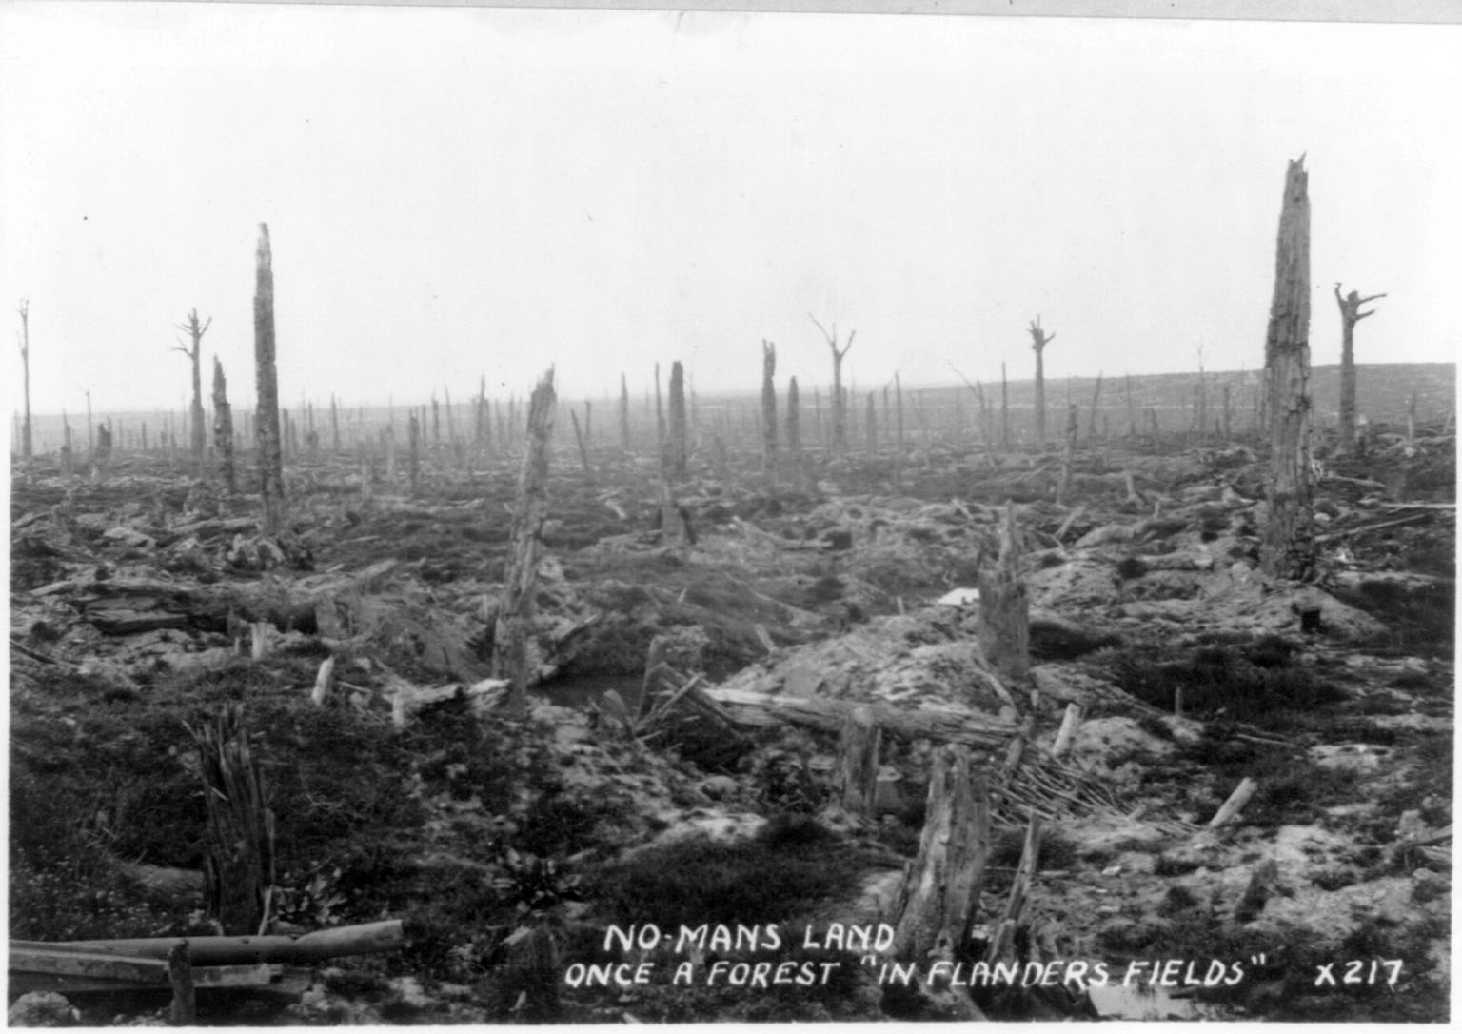

Slide 13
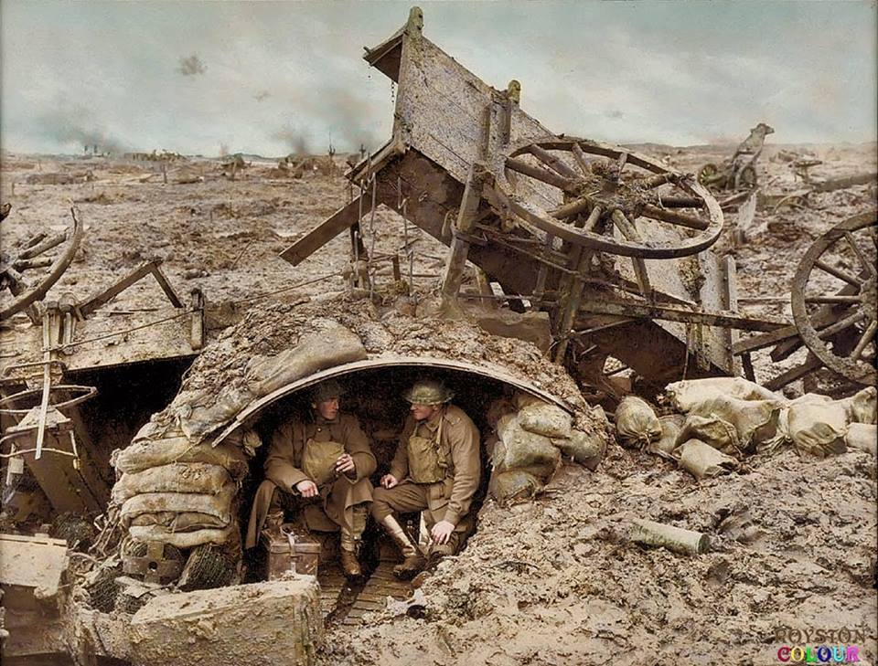

Slide 14
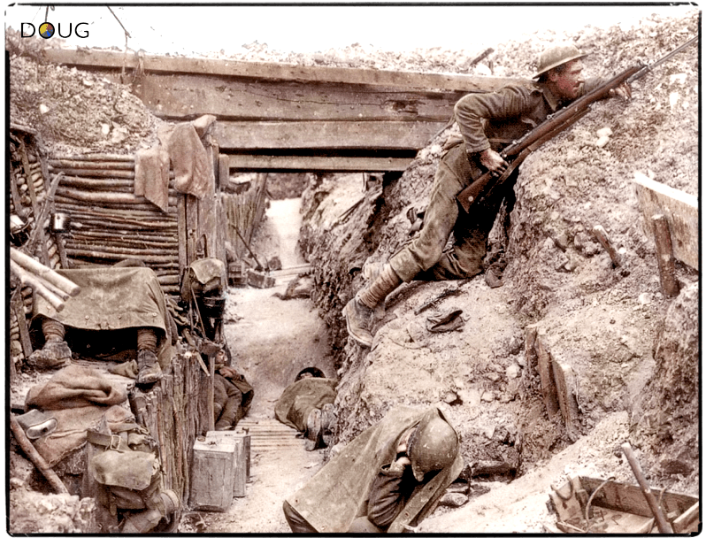

Slide 15
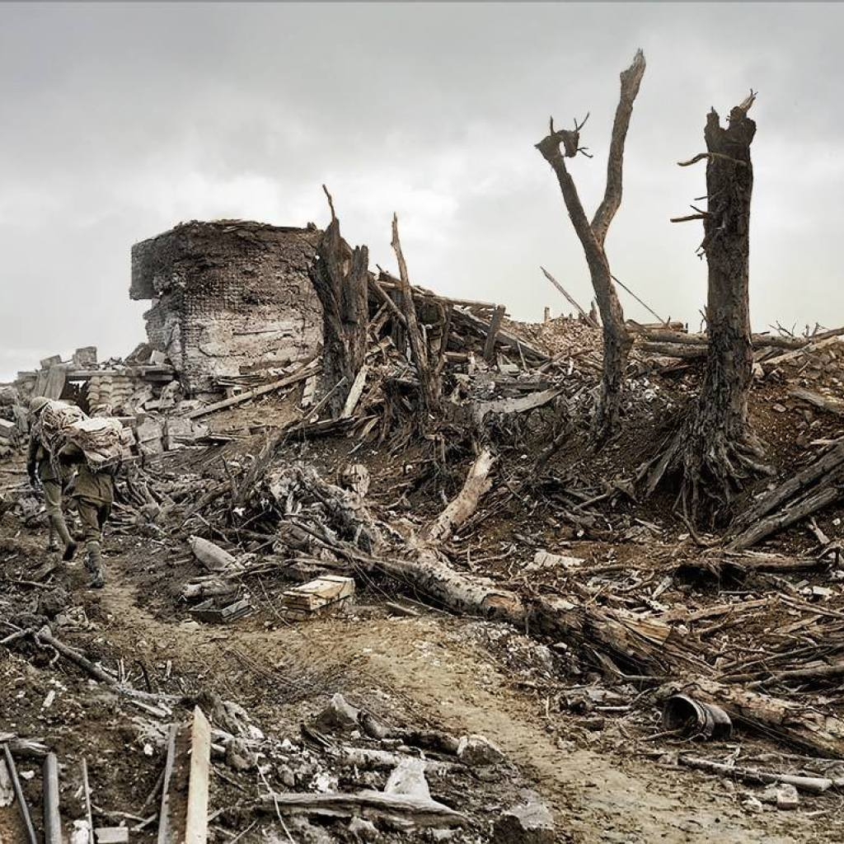

Slide 16
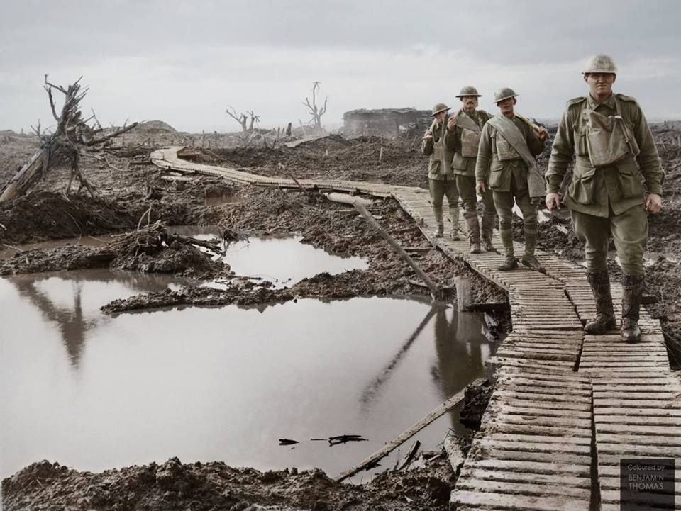

Slide 17
Horror Stories of the Trenches
Couldn’t leave for days/weeks
Couldn’t fight back
Trench Foot would rot people’s feet
Rats
Mud and sewage mixed

Slide 18
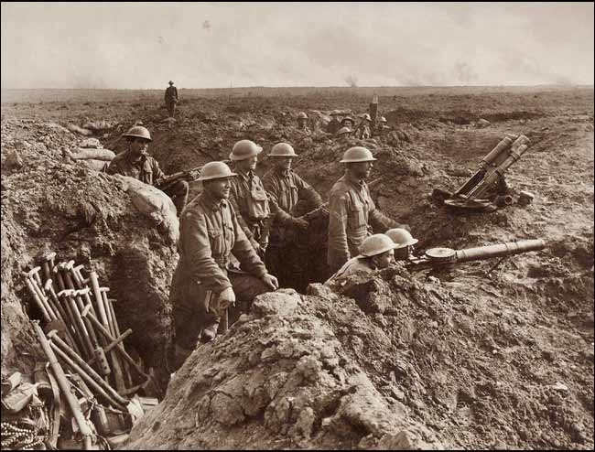
Trenches
While horrible to live in, trenches were very hard to take.
Defensive weapon technology had grown dramatically.
Offensive tech or tactics hadn’t yet caught up.

Slide 19
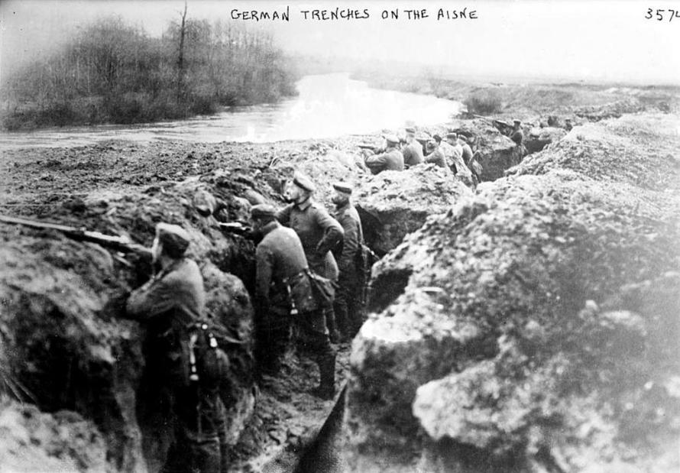
How do you take a trench?

Slide 20
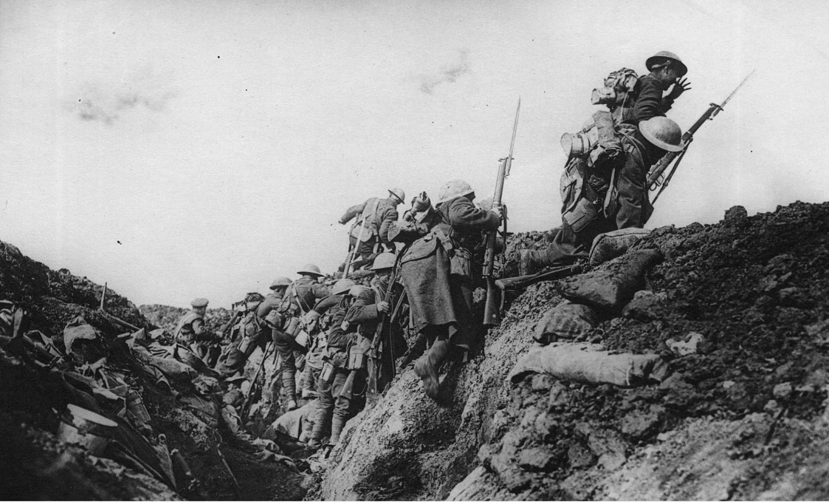

Slide 21
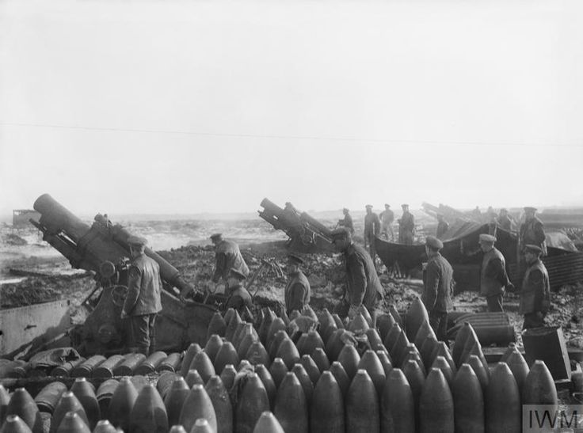

Slide 22
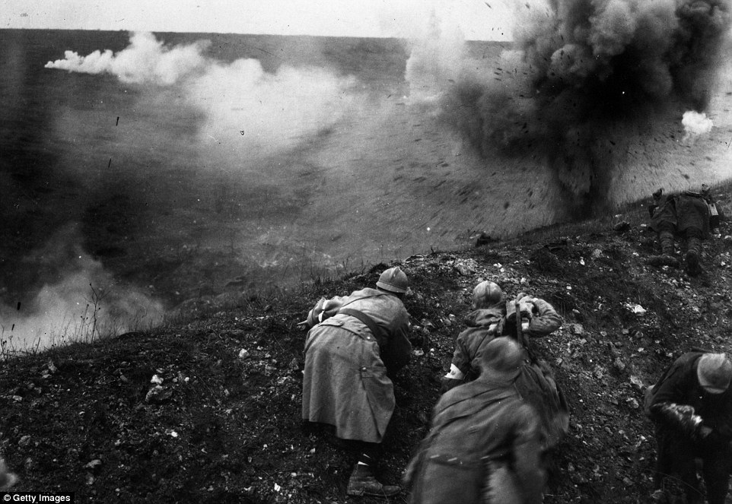

Slide 23
Trench Warfare
https://www.youtube.com/watch?v=XOwsvDQiVJI
(1:50-4:45)

Slide 24
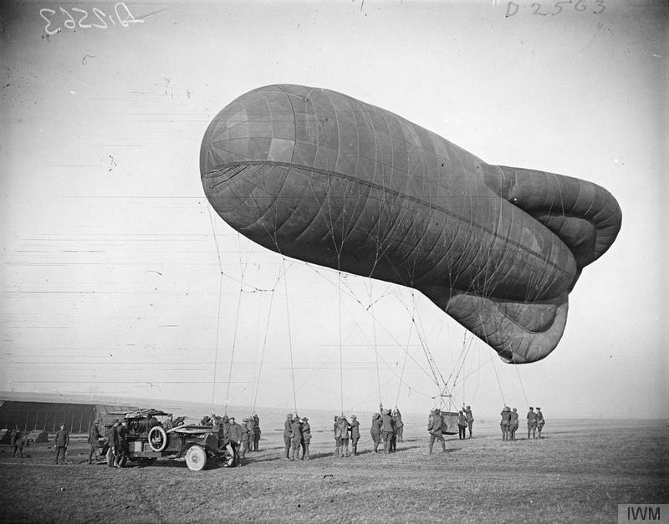
Air Warfare
The first war where planes were used heavily.
Air warfare was almost completely invented by this war.
Extraordinarily high fatality rates for pilots.
1 in every 3 pilots to serve on the Western Front died.

Slide 25
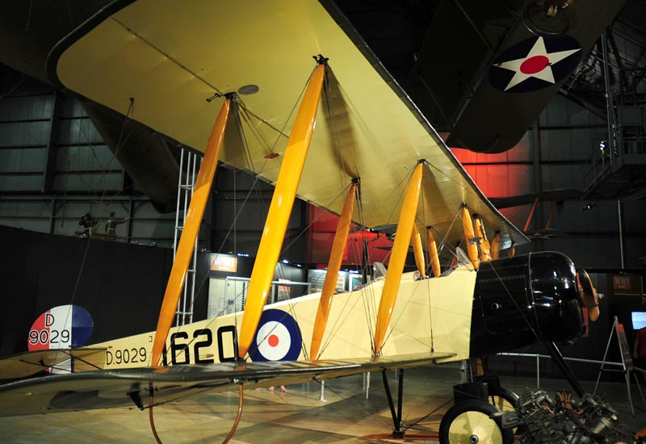

Slide 26
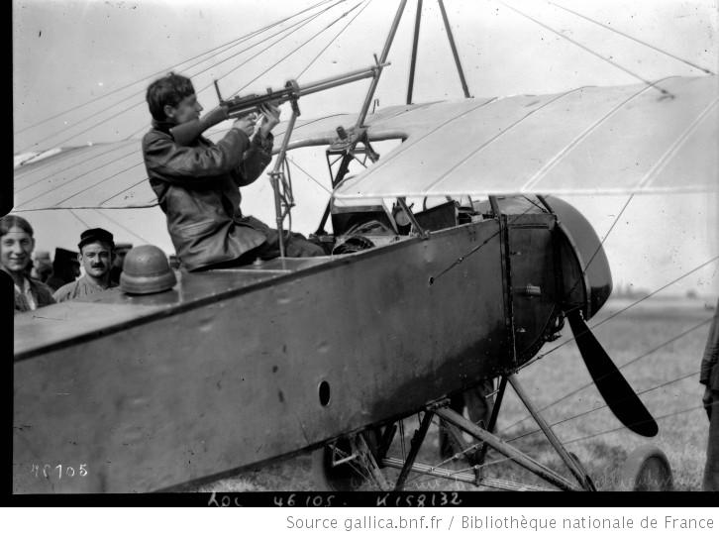

Slide 27
https://www.youtube.com/watch?v=VX3fDlR-SDw
Fun video if you want to watch

Slide 28
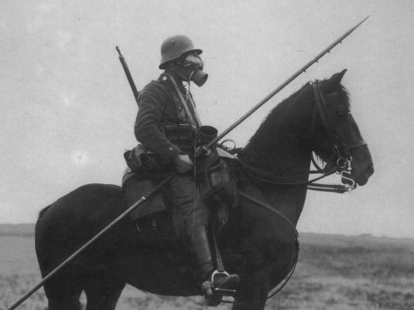
FUN FACT
How long did it take for people to start putting parachutes in planes?
The parachute would not be given to German pilots until 1918, the last year of the war. The allies wouldn’t get them until after the war

Slide 29
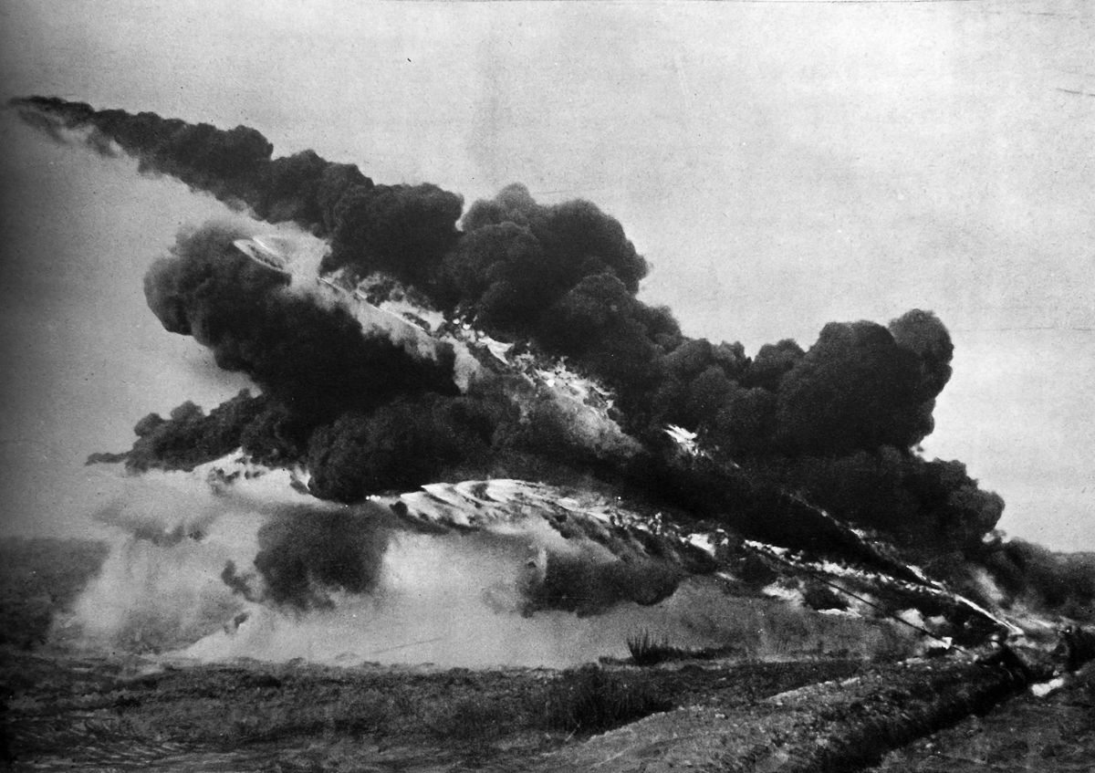

Slide 30
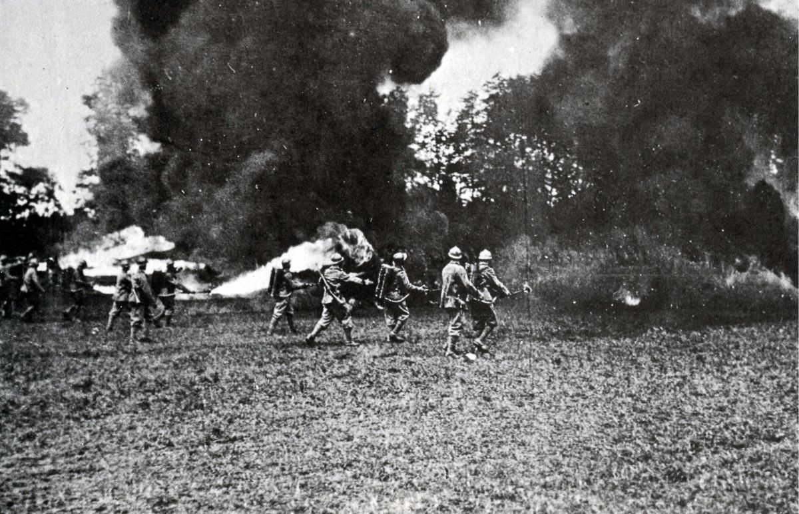

Slide 31
Flamethrowers
Used to clear trenches. First used by the Germans in 1916.
Could shoot fire around 20 yards.
Kills by burning people alive

Slide 32
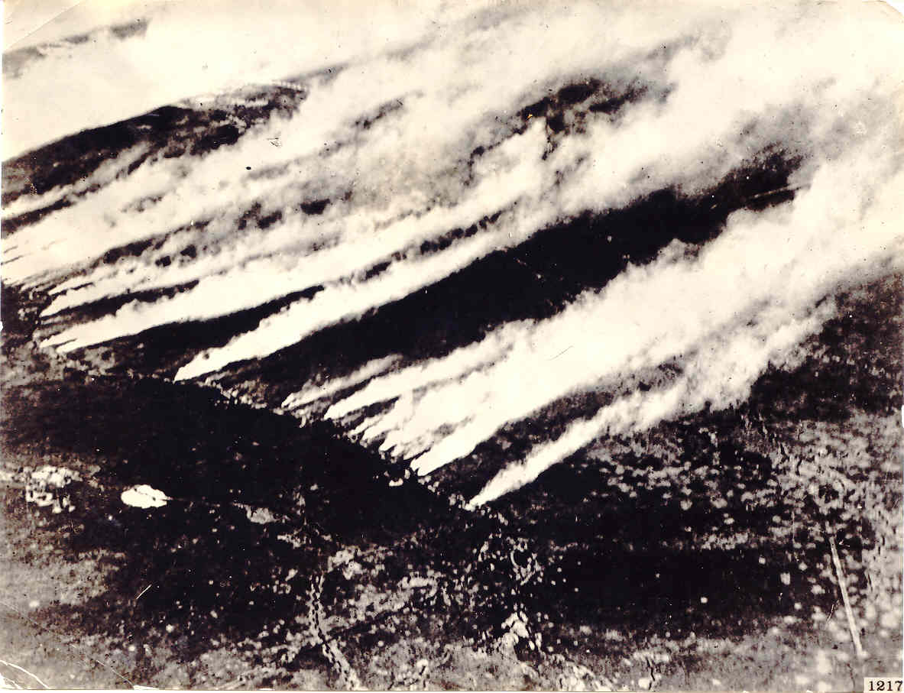
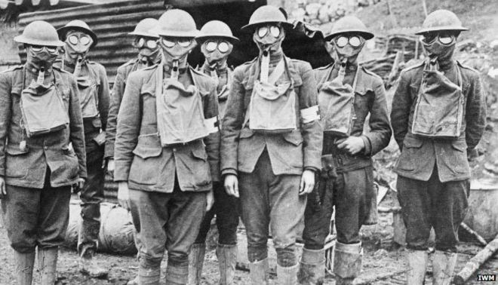
Poison Gas
Poison gas was heavily used after its invention in 1915
Was, for soldiers, the worst weapon of the war.
Condemned by the Entente as a crime against humanity
But the Entente quickly started using it as well

Slide 35
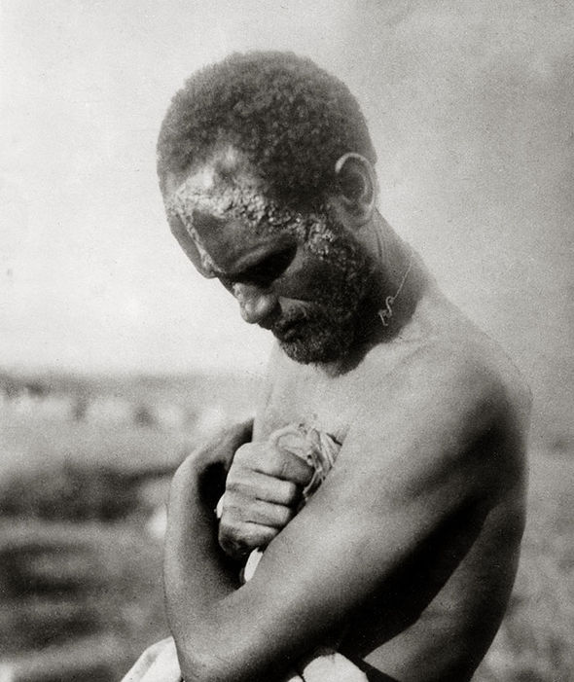

Slide 36
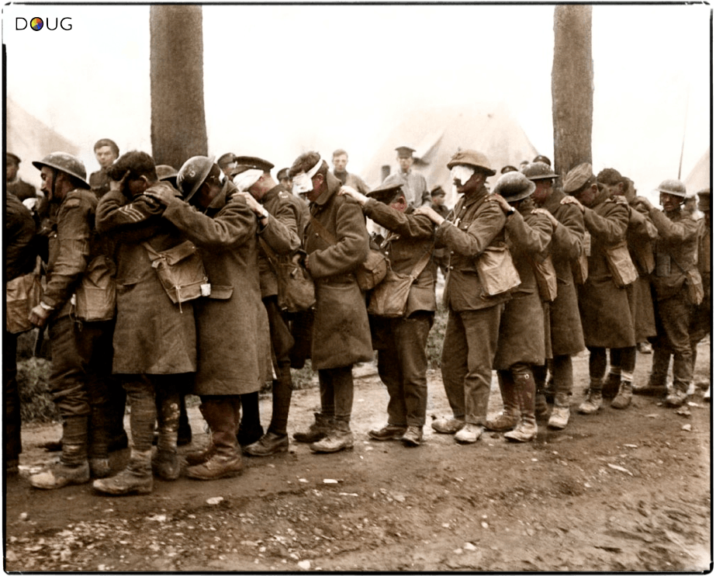

Slide 37
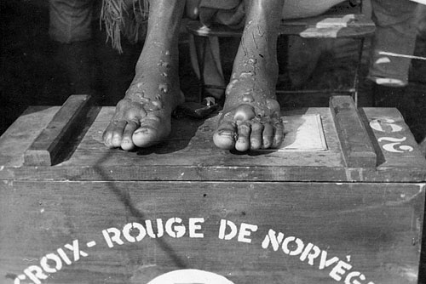
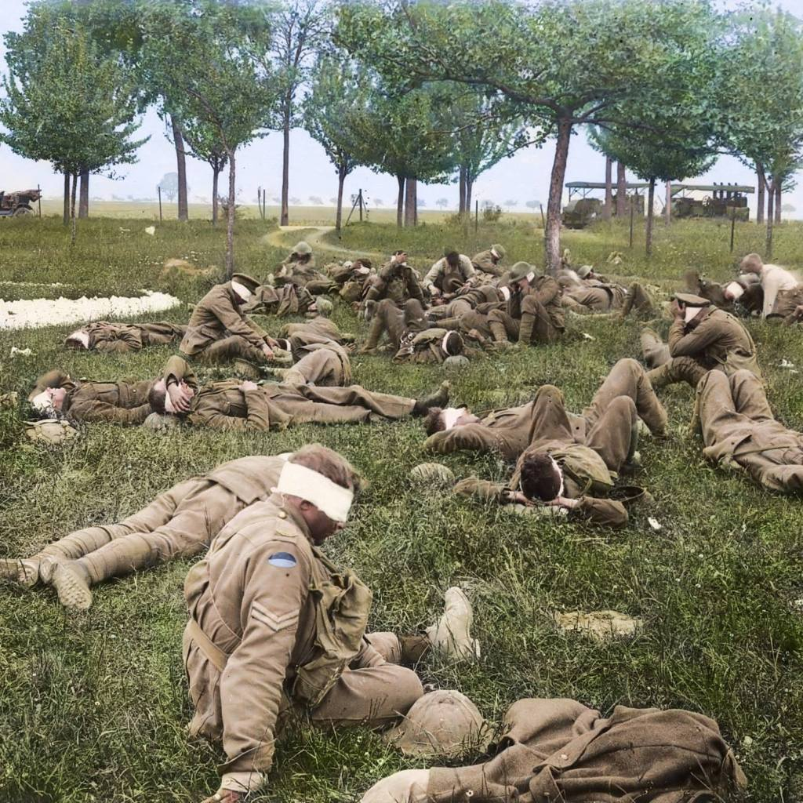
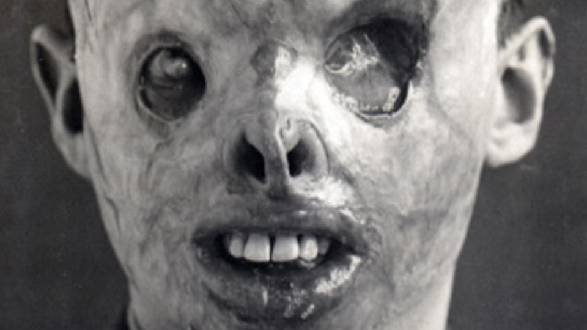

Slide 38
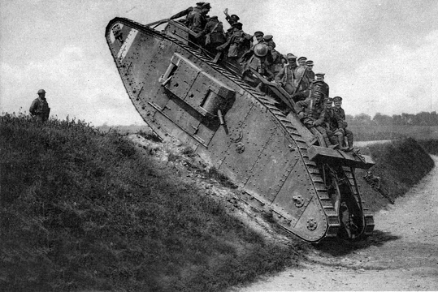
Tanks
The most decisive weapon of the war was the tank.
For the first time, a weapon was created that could solve trenches.
Invented late in the war.
Between ww1 and ww2, the tank quietly ended the era of defensive dominance.
The next war would be all about offense.

Slide 39
FUN FACT
By the end of the war, the English and French had built around 6500 tanks between them. How many did the Germans build?
20

Slide 40
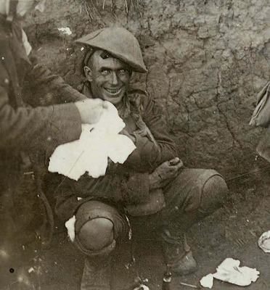
Shell Shock
Many soldiers suffered an anxiety disorder known as shell shock.
Similar to PTSD or Combat Fatigue.
For many, it was completely debilitating.

Slide 41
Shell Shock
https://www.youtube.com/watch?v=yQD7ffTIhTM
https://www.youtube.com/watch?v=IWHbF5jGJY0

