Slide 1
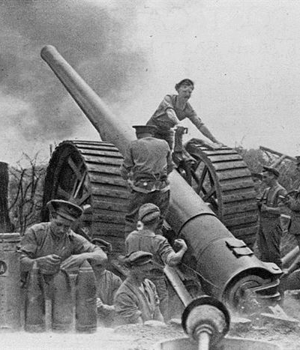
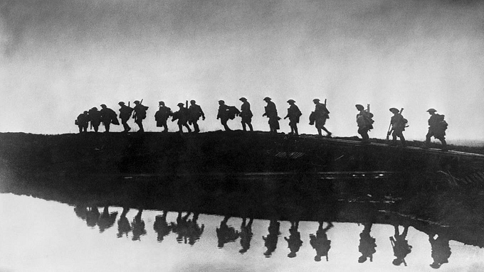
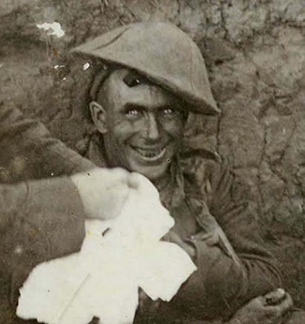
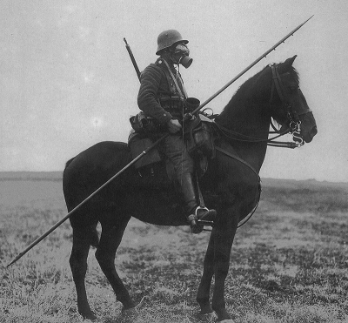
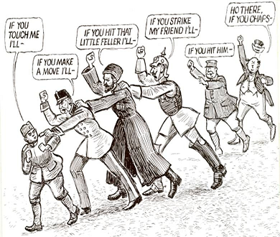
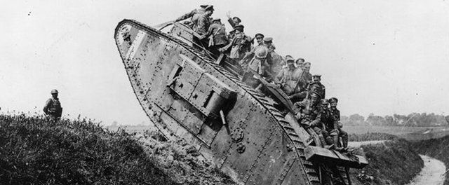
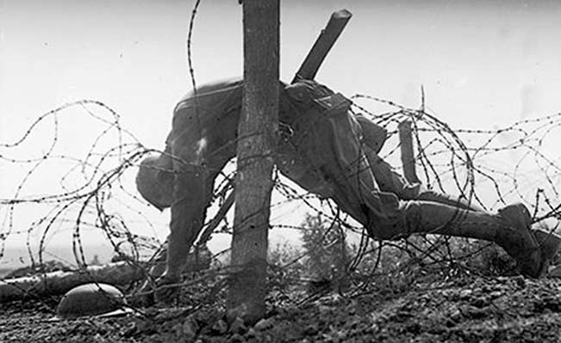
World War One Begins

Slide 2
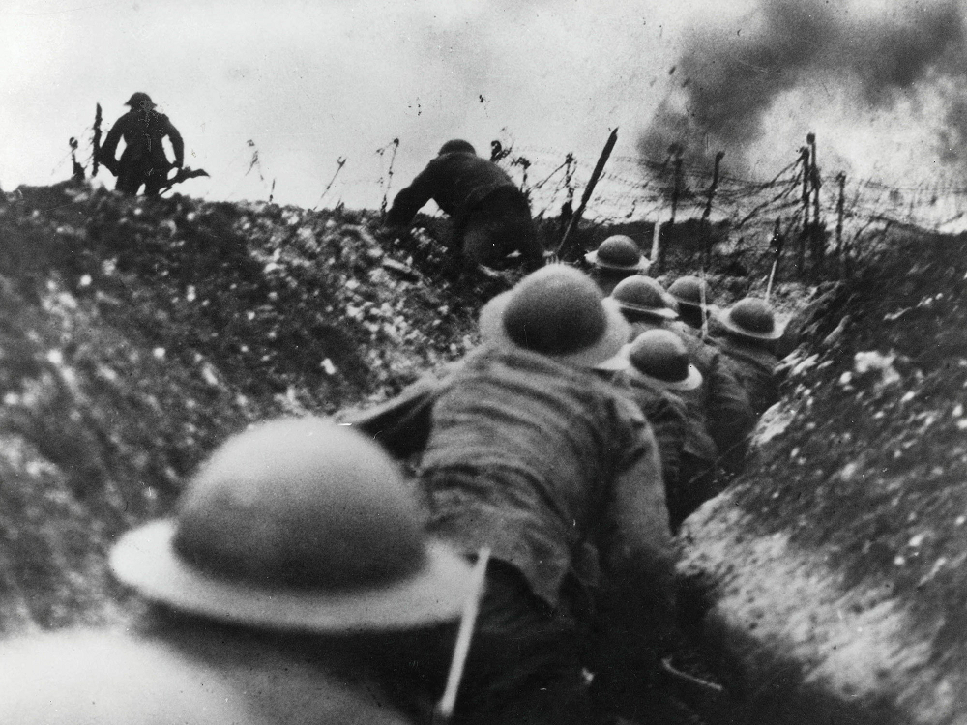
Military Strategy of the Age
Focused on speed
Focused on offensive action
Believed that mobilizing first was a huge advantage
Had learned all of these lessons in old wars whose lessons no longer applied to modern conflicts.

Slide 3
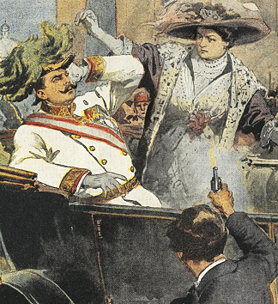
Europe Goes to War
Europe’s path to war was not exceptionally clear. It went through 5 steps:
The Assassination
The Blank Check
The Ultimatum
Mobilization
War

Slide 4
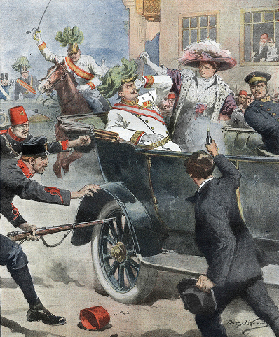
Pt 1: The Assassination
Franz Ferdinand was killed in Sarejevo on June 28th, 1914.
He was both an Archduke and the next in line to the Austrian throne
He was killed by Gavrilo Princip, who was the member of a terrorist group called the Young Bosnians
Austro-Hungary believed the Young Bosnians were supported by the Serbian Black Hand

Slide 5
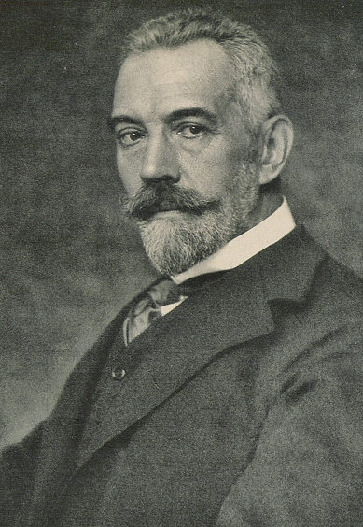
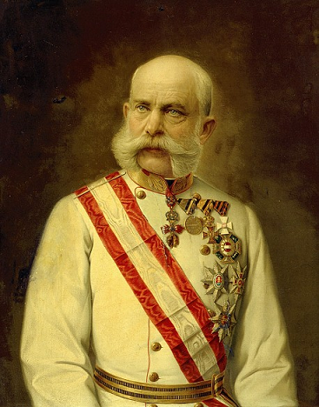
Pt 2: The Blank Check
Austro-Hungary decided to take final action before Serbia becomes any more of a problem.
It asked Germany if it would support this action.
Germany said it would support Austria no matter what on July 5th,
This is known as the Blank Check

Slide 6
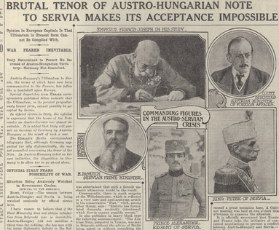
Pt 3: The Ultimatum
Austro-Hungary issues an ultimatum to Serbia on July 23. Demands incredible concessions or war.
Serbia caves to most demands on July 26th
On July 28, Austro-Hungary declares war on Serbia.
But the rest of Europe is not yet involved

Slide 7
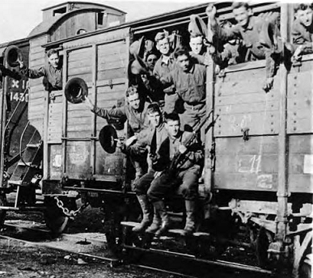
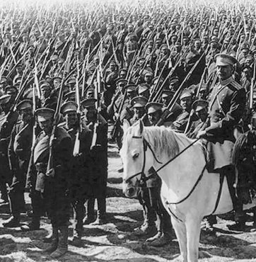
Pt 4: Mobilization
On July 28, Russia begins mobilizing while pretending not to.
On July 29, the German Kaiser and Russian Tsar (who are cousins) try to bring an end to the coming war.
They are unable to come to an agreement.

Slide 8
Pt 5: War
Germany mobilizes and declares war on July 30. France and Russia declare war same day.
Britain stays out for the moment—joins on August 4 when Germany refuses to respect neutral countries (especially Belgium.

Slide 9
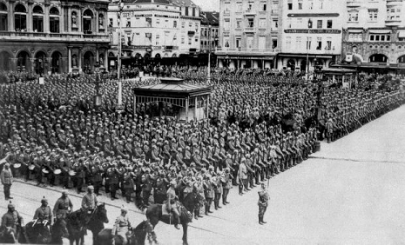
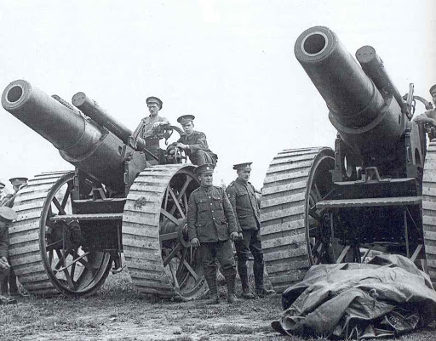
Growing Armies
While wars were infrequent, militaries were growing.
New weapons like machine guns, heavy artillery, battle ships, cars, barbed wire had all been invented since the last war.
Armies now numbered millions of soldiers. Most had grown10x in the last century

Slide 10
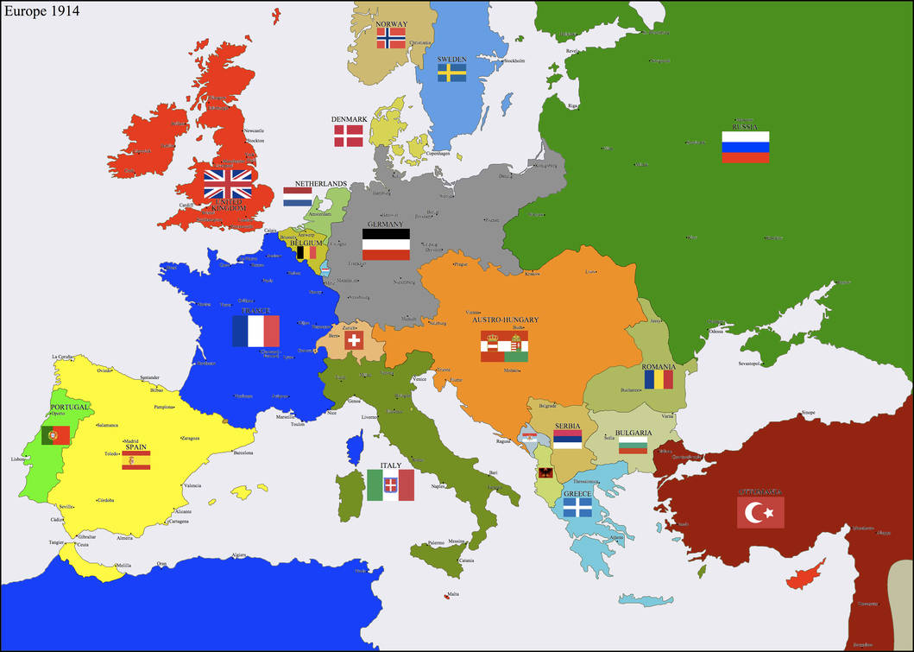
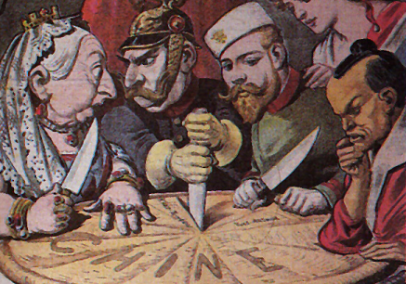
Alliances
Europe’s peace was built on a delicate balance of power.
That balance had been broken by the unification of Germany in 1871
Fear of Germany drove France, Russia, and Britain to join together in an alliance against it.
Germany had allied to Austro-Hungary in response.

Slide 11
Notes: Meet the Gang

Slide 12
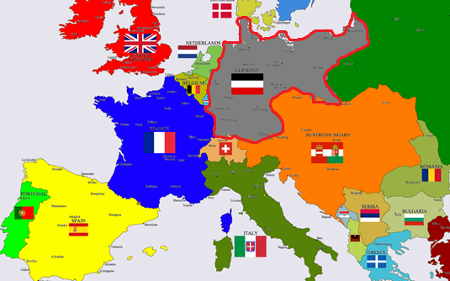
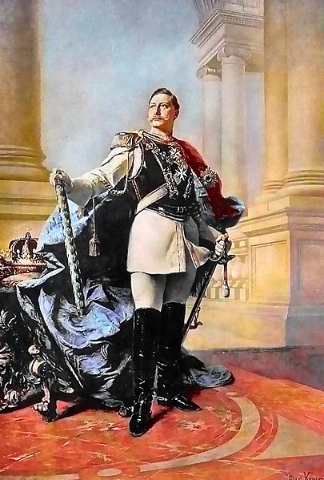
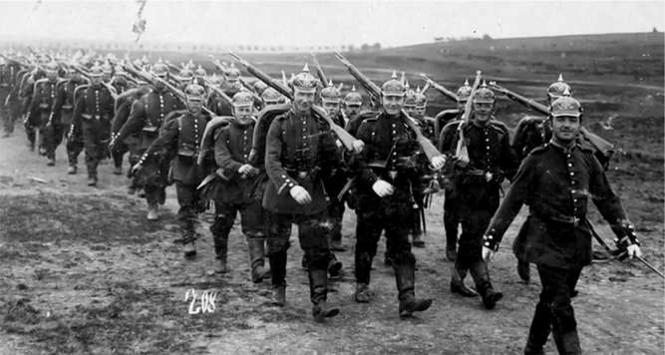
Meet the Gang: Germany
Germany was 39 different states before 1871.
Now it was the most powerful state in Europe.
Germany was ruled by the Kaiser Wilhelm II, who was loud and militaristic.
Germany felt that it should be recognized as the great state of Europe.

Slide 13
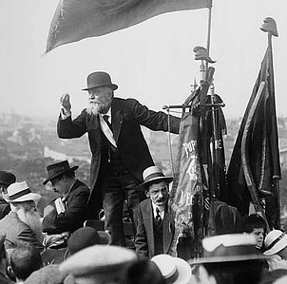
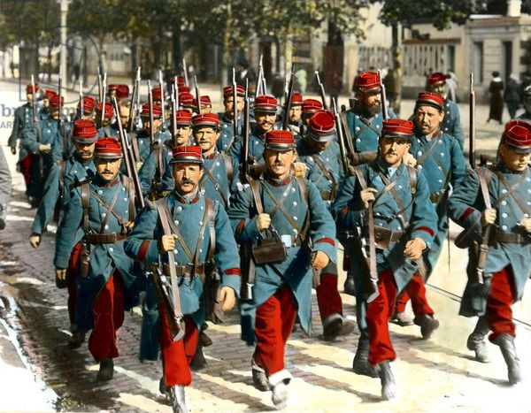
Meet the Gang: France
France had been defeated by Germany in 1870 and two of its provinces, Alsace-Lorraine, were taken by Germany.
France was obsessed with gaining them back.
So even while France was a democracy, there was an enormous amount of French militarism.

Slide 14
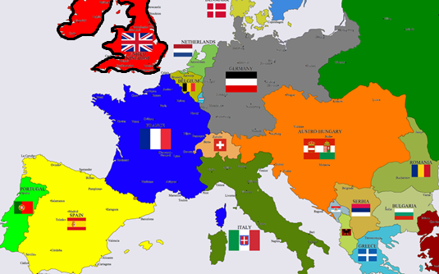
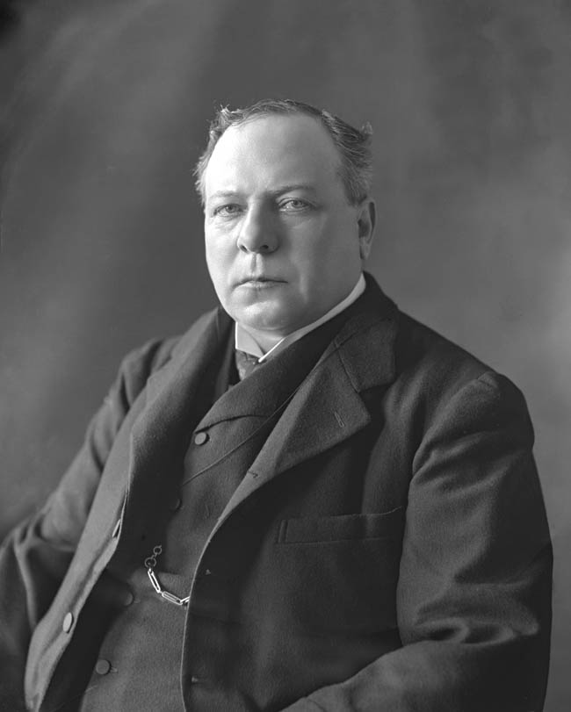
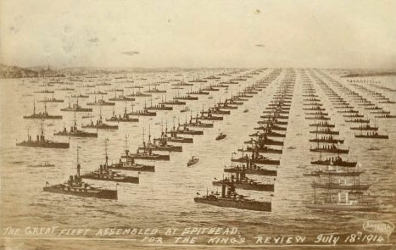
Meet the Gang: Britain
Britain ruled the largest empire to EVER exist.
Britain is an island and liked to pretend it wasn’t part of Europe.
It could do this because it had the largest fleet in the world.
Germany’s stated goal to build the greatest fleet on Earth deeply troubled Britain

Slide 15
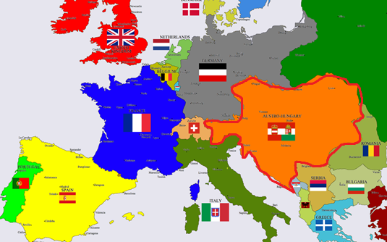
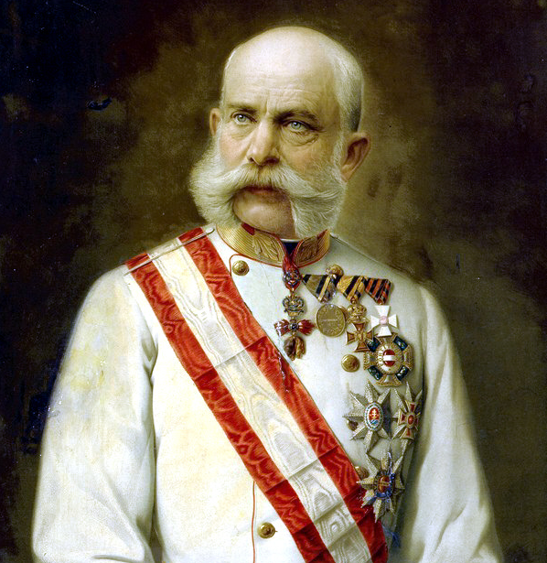
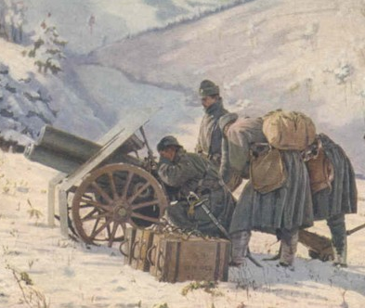
Meet the Gang: Austro-Hungary
Austro-Hungary was an old empire. It was not nationalistic and in fact contained over a dozen nations, all ruled by the German Austrians.
Austro-Hungary was being ripped apart by nationalism amongst its Slavic population.
Only the brutal repression of its imperial government kept it from falling apart.

Slide 16
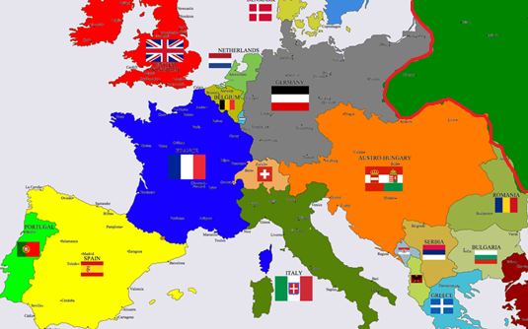
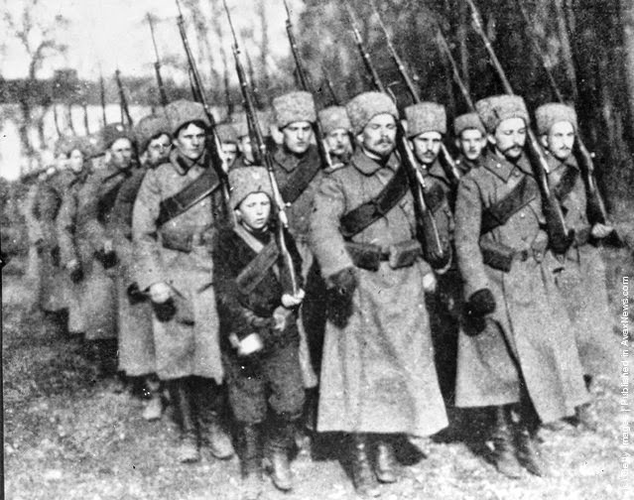
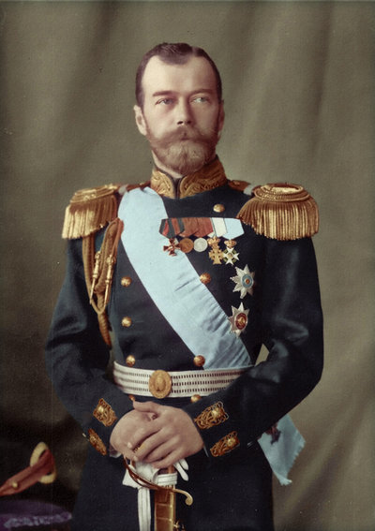
Meet the Gang: Russia
Russia was a gigantic country.
Barely industrial, mostly agricultural.
Ruled by a brutal, autocratic government.
Had an enormous population. Not even its own government knew how many but over 100 million.
Wanted to gain more European territory.

Slide 17
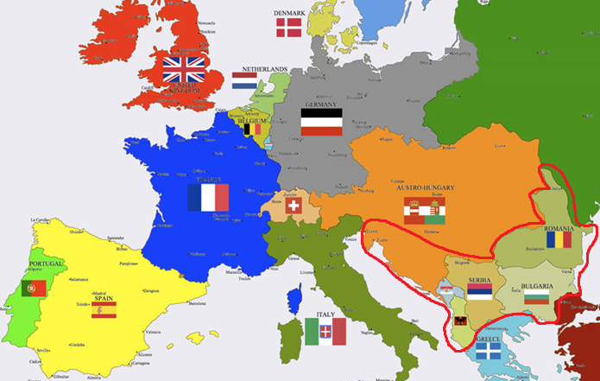
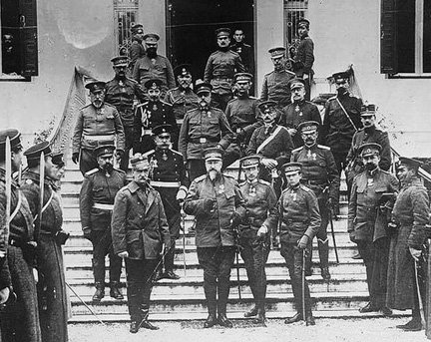
Meet the Gang: Balkans
The Balkans were new countries.
They had been freed from the Ottoman Empire by war.
Unlike the rest of Europe, the Balkans were dominated by wars, terrorism, and other political violence.
Austro-Hungary and Russia both thought they should be in charge of the Balkans.
Many Balkan people envisioned a world where they were free of the Empires for good.

